Slide 1








How Remote Patient Monitoring Can Help Your RHC and Your Patients
Dr. Xiaoxu Kang, CEO kang@kangaroohealth.com
kangaroohealth.com
hello@kangaroohealth.com

Slide 2
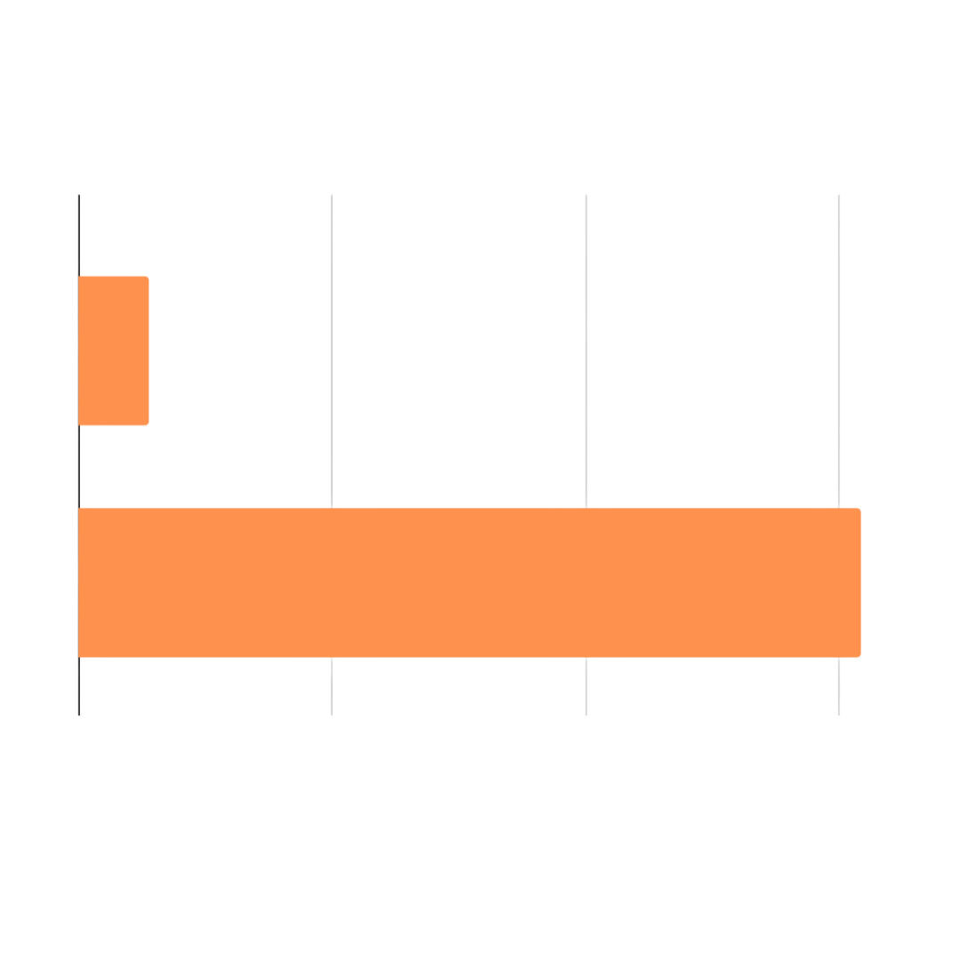


Major 2024 CMS Changes Benefit RHCs
Medicare RPM Reimbursement for RHCs and FQHCs
2023
$55 per patient/month
2024
$616 per patient/month
kangaroohealth.com
hello@kangaroohealth.com

Slide 3

Today, We’ll Share Everything You Need to Know
Agenda
What exactly is RPM?
RPM benefits
CMS reimbursement changes
A sample ROI
Key factors to ensure success
Red flags to avoid
Notes:
What exactly is RPM?
RPM benefits
Key factors to ensure a RPM program is successful
compliance
patient consent
insurance verification
offer monitoring nurses
device coverages (need to cover multiple internet networks, not a single provider)
things to avoid from a partner
CMS reimbursement changes + codes
pro forma + your organization’s economics when partnering with a vendor

Slide 4

Chronic Care is Broken Everywhere, But Rural Healthcare Providers Face Even More Obstacles
All this contributes to a higher rate of deaths from chronic conditions
Facilities face staff shortages and razor-thin margins
Distance to care can be challenging and lead to no-shows
kangaroohealth.com
hello@kangaroohealth.com

Slide 5
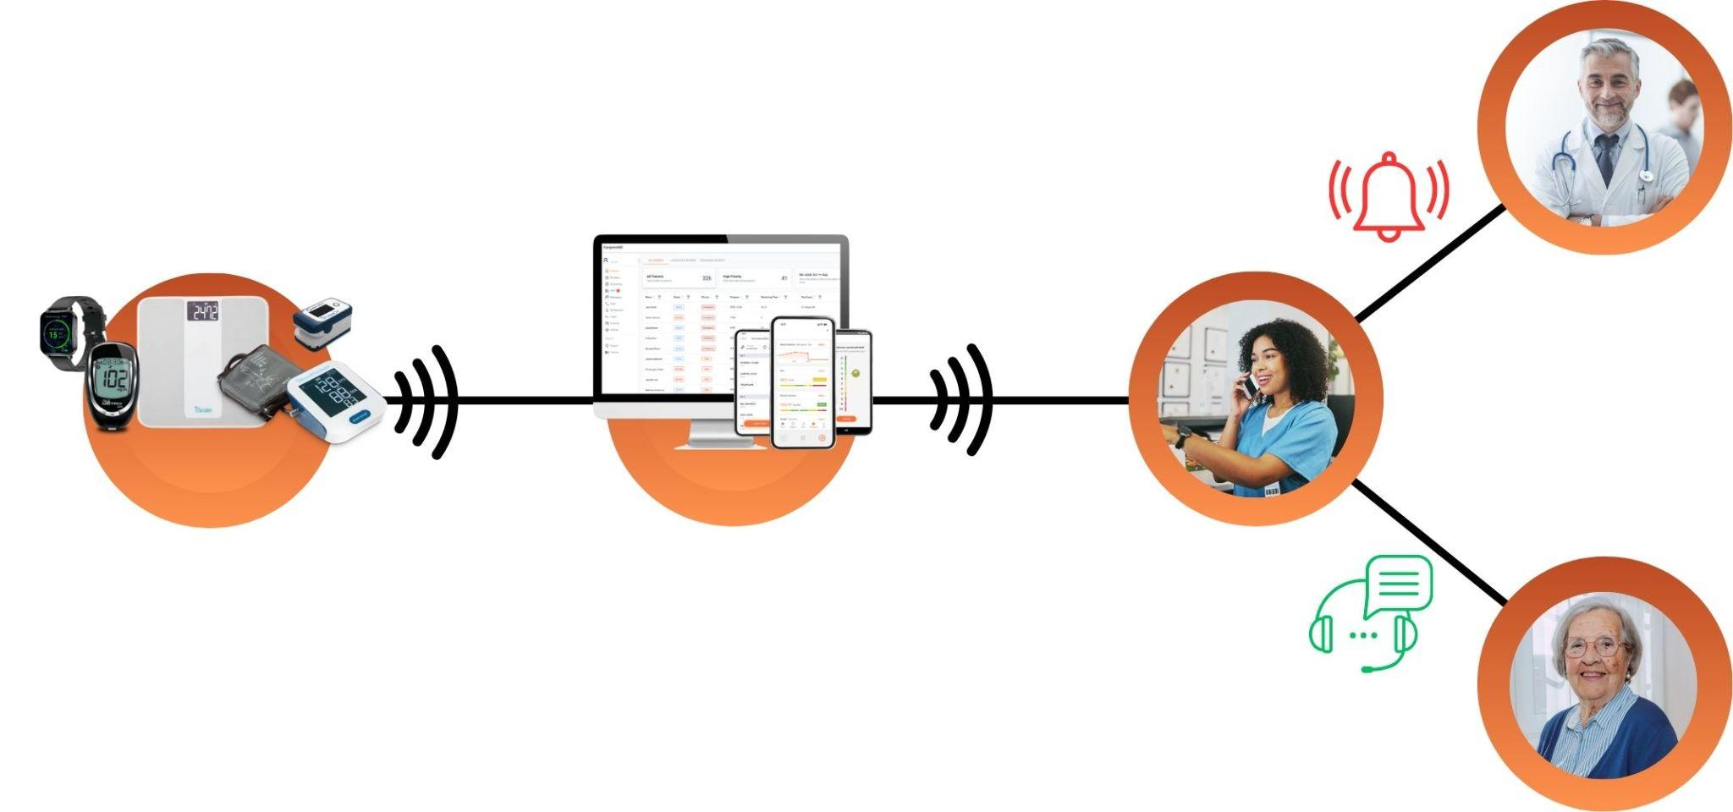
What is Remote Patient Monitoring and How Does it Work?
Smart Medical Devices
RPM Data Platform
(HIPAA, SOC2 certified)
(100+ connected devices)
Provider
(PCP, Specialists, MTDM, Case Management)
Monitoring Team
(CMA, LPN, RN)
Patient
kangaroohealth.com
hello@kangaroohealth.com
Notes:
RPM is proactive care to keep track of patient vitals between visits
Patients use a connected medical device at home to check vitals
Data is automatically uploaded if the device is cellular (like what KH uses)
The data is monitored by clinical staff for progress or health alerts
It is different from telehealth and not encounter based

Slide 6

Sounds Great…But We Don’t Have the Staff for That
RPM enables RHCs to boost care outcomes and top-line revenue, without burdening your staff
Monitoring can be done by an external nurse team that escalates cases to your staff only when needed
kangaroohealth.com
hello@kangaroohealth.com

Slide 7

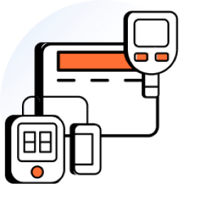


Benefits of Remote Patient Monitoring for RHC Providers and Patients
Visibility into patients’ health trends and data at home
Identifying early warning signs to alert staff and allow timely intervention as needed
Providers can proactively adjust meds, follow up, or provide support
kangaroohealth.com
hello@kangaroohealth.com

Slide 8
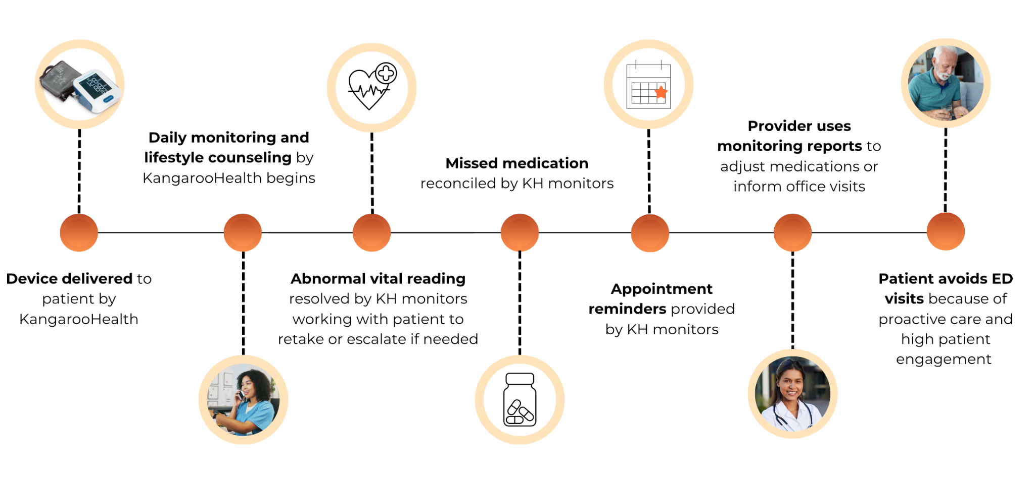
What a Typical Hypertension Patient’s Experience Can Look Like
kangaroohealth.com
hello@kangaroohealth.com

Slide 9
Recent CMS Changes Boosted RPM Reimbursements by 11X fold
Medicare: all cover RPM.
Commercial Plans: many cover RPM, and their reimbursements rates are typically 50% higher than Medicare.
Provider Billable CPT | Average Medicare Rates | Notes
G0511 (99453) | $77 | One-time (Enrollment)
G0511 (99454) | $77 | Monthly Recurring Data Collection
G0511 (99457) | $77 | Monthly Recurring PPPM First 20 min. of monitoring
G0511 (99458) | $77 | Monthly Recurring PPPM Additional 20 min. of monitoring (up to 2 units)
*KangarooHealth does not bill patients or payors
kangaroohealth.com
hello@kangaroohealth.com

Slide 10

Now, RHCs Can Unlock Significant RPM Reimbursements
These numbers will change based on if an RHC does their own monitoring or uses an external company. The below shows bottom lines for providers using KangarooHealth’s turn key RPM program, as an example.
$4,000,000+
per 1,000 participating patients,
per year
$40,000+
per every 10 participating patients,
per year
kangaroohealth.com
hello@kangaroohealth.com

Slide 11






Combine RPM With CCM or PCM to Maximize Revenue Benefits
Remote Patient Monitoring
Principal Care
Management
$4,000+
Chronic Care
Management
(for 1 chronic condition)
PER PATIENT PER YEAR
(for 2+ chronic conditions)
PCM
RPM
CCM
This can add hundreds of dollars per patient to a provider’s bottom line.
(The $ will depend on the set up of the RPM program, the above is using KH monitoring as an example)
kangaroohealth.com
hello@kangaroohealth.com

Slide 12

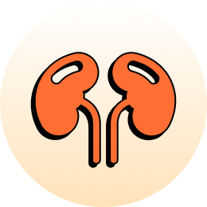










Common Chronic Conditions That Can be Monitored with RPM
Cardiovascular Diseases
Renal Diseases
Oncology Side-Effects
(i.e., Congestive Heart Failure)
(i.e., End-stage Renal Disease)
Hypertension
Liver Diseases
Neurological Diseases
(i.e., NASH / NAFLD / Liver Failure)
(i.e., Stroke, Traumatic Brain Injury)
Diabetes & Pre-Diabetes
Respiratory Diseases
Mental Health Conditions
(i.e., COPD, Respiratory Failure)
Obesity
Musculoskeletal Diseases
Post-Acute Care Episodes
(i.e., Osteoporosis, Arthritis)
(i.e., Post-Surgery Monitoring)
kangaroohealth.com
hello@kangaroohealth.com

Slide 13
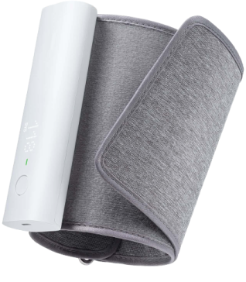

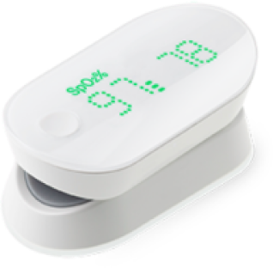
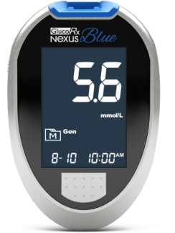
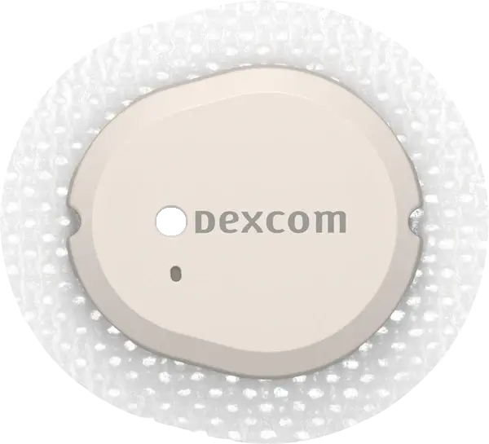
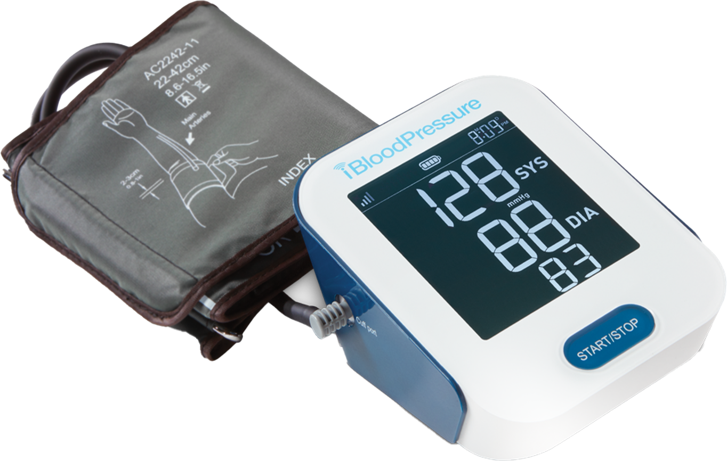
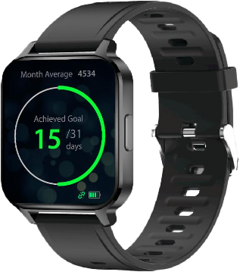


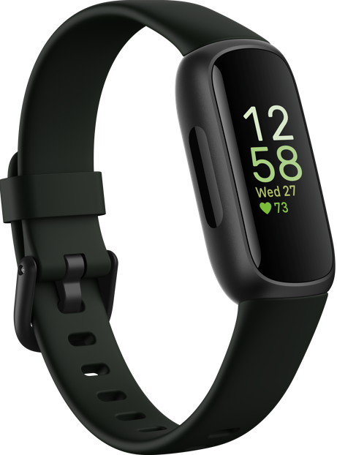
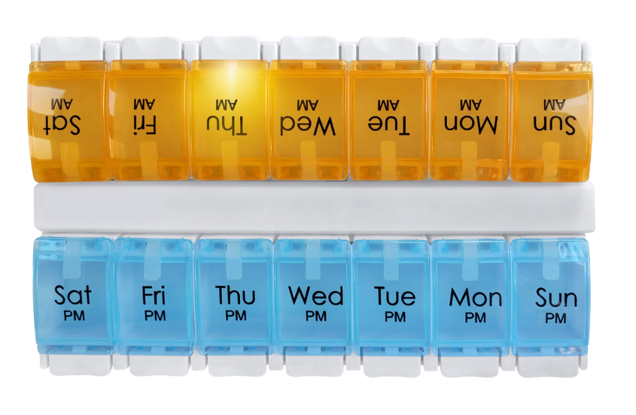
A Sample of the Devices That are Covered for Patients Through RPM
Blood Pressure Monitor
Supported brand examples:
Tenovi, SmartMeter, Withings, Omron, iHealth
Dexcom
(Continuous Glucose Monitoring)
Blood Pressure Monitor
Weight Scale
Pulse Oximeter
Glucometer
Blood Pressure Monitor
Supported brand examples:
Tenovi, SmartMeter, Withings, Omron, iHealth
Pill Box
Smart Watch
Peak Flow Meter
Thermometer
Fitness Tracker
kangaroohealth.com
hello@kangaroohealth.com

Slide 14




More Reasons You and Your Patients Will Love RPM
Improves patient engagement in care, boosting retention for RHCs
Reduces the risk of patients going to urgent care or the ER
Saves patients money on unplanned expenses, while boosting RHC revenue
kangaroohealth.com
hello@kangaroohealth.com

Slide 15
Key Components of a Successful RPM Program
Flexible partner that can protect your staff’s time
Communication and tech options for patients
High patient compliance
Flexible partner that can protect your staff’s time
Devices that are senior friendly
Device coverage with multiple cellular networks to cover all areas
Dedicated monitor
Provides insurance verification
Offers monitoring nurses
Offer billing services
Patient consent
Phone, SMS or app options
Meet patients at own tech level
Easy set up
kangaroohealth.com
hello@kangaroohealth.com

Slide 16
Common Mistakes to Avoid
Using medical devices that depend on Wi-fi to function
Choosing an RPM partner that requires costly device investment upfront
Programs that require the patient must use an app or log into a website
kangaroohealth.com
hello@kangaroohealth.com

Slide 17
Upcoming CMS Changes Proposed for 2025
RHCs and FQHCs may begin reporting individual codes for care coordination services, rather than under the single G0511 code
CMS proposes to permit billing of the add-on codes associated with these services. This will improve payment accuracy.
RHCs and FQHCs may provide APC services, paid the non-facility MPFS rate when the individual code is on an RHC or FQHC claim.
kangaroohealth.com
hello@kangaroohealth.com

Slide 18
Top Takeaways from Today’s Session
New CMS changes are a tremendous revenue opportunity
RPM gives RHC patients a partner in managing their condition at home
RHCs do not need to add staff or burden current staff to implement an RPM program
Set yourself up for success by choosing the right RPM partner for your needs
kangaroohealth.com
hello@kangaroohealth.com

Slide 19

Questions?
CONTACT US:
kangaroohealth.com
hello@kangaroohealth.com

