Slide 1
Keeping your Clinic’s
IT Secure
Notes:
Good Morning – I want to Thank the Mississippi Rural Health Association for this opportunity. As was mentioned, our company – The Solutions Team is focused on Healthcare. We have clients in 38 states and have been doing healthcare since 2010. Our goal is to impact Patients Lives – If we can provide Solid IT Systems that are secure and work – then our clients can better provide patient care – BUT Today we are talking about Keeping your Practice IT Secure

Slide 2
OVERVIEW
Specific threats that exist today – 4 Major Threats – but many others
2018 examples of PHI and other private data violations
The cost of lack of protection for your networked and database assets
What an attack / hack looks like and what you should do
Best practices for protecting your valuable data and networked devices
Specific preventive products and services
Notes:
There are 4 Major Threats that I want to key in on, but a lot more threats than just 4 exist. We will discuss some examples of PHI Violations. Some potential fines if a violation happens. What an attack might look like. Ways to protect and prevent these attacks from happening

Slide 3
TAKEAWAYS
The objective of the session is for you to walk away with the following:
Better understand the threats you face
Best methods to avoid PHI / privacy breaches
How to recognize an attack / hack
What to do if you get attacked / hacked
Notes:
I want to provide you with some value for your time. At the end, I have some gifts to those of you who can answer some key questions – I will give you the answers during this presentation, so listen and make notes.
We will discuss the threats you face – Ways to avoid PHI Breaches – How to Recognize an attack and what to do if you are attacked or hacked

Slide 4
Overall Security – A Quick Note…
If a hacker truly wants into your systems, he / she will find a way. The objective is to make is so difficult for the hacker, that they give up before reaching your data / systems.
It’s like the two guys and the bear…
Notes:
There is no 100% way to guarantee you never get hacked. Anyone that tells you that they can Guarantee is not being truthful. If someone wants in, they will get it.
Its like the story of the bear and the guys in the woods

Slide 5

Notes:
Your goal is to not out run the bear, but to outrun the other guys. Think of it this way, if you have an ADT sign in your yard, burglar bars on your doors and window – the odds are the thief will go on to the next house. That’s what we want for our Cyber Security in Healthcare

Slide 6
Biggest Risk Factors
#1 - Knowledge
OR the Lack of Knowledge
Notes:
In healthcare, we all work with providers and Doctors are some very smart people for what they went to school to do. But sometimes, we over simplify others career paths because they are not doctors. We see this all the time. Like I played golf last year with a doctor and he said “yea, I don’t use IT folks because I don’t trust them and besides, I have “Google”. I responded and said, oh yea. Well I don’t go to doctors because I have WebMD. JOKE

Slide 7

Notes:
! Point is that too many times we see where Practices simply don’t know what they don’t know – this is very dangerous
Hopefully this is not your providers or administrators. You need to educate your entire team and don’t believe that just because its on the Internet – Its True! Just because you ignore a problem doesn’t mean the problem isn’t real

Slide 8
Email
tgooden@Gmail.com
br549@yahoo.com
drfeelgood@Hotmail.com
todd321@Comcast.com
practiceadmin@att.com
Notes:
Anyone in the Room have an email that looks similar in format to the ones here? Anyone use these types of emails to do Practice Business? See it all the time.
Story of LowCountry / Brain & Spine

Slide 9
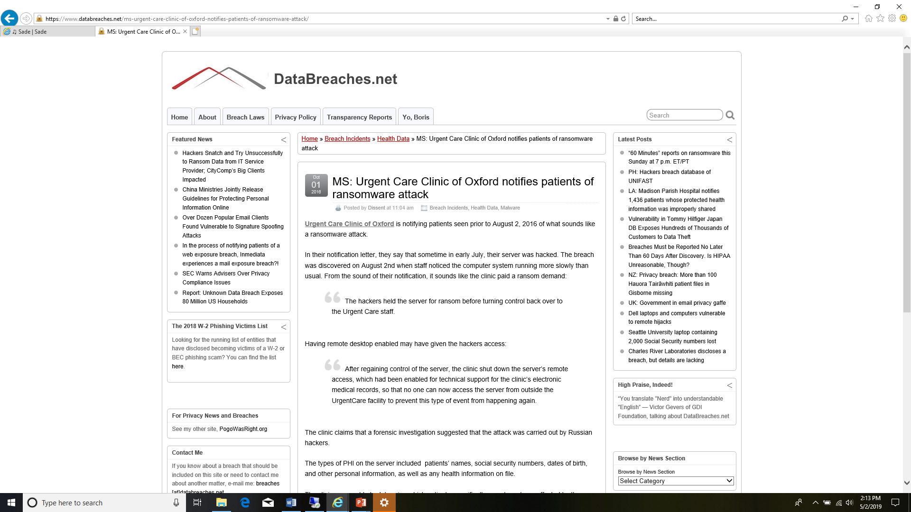
We are a Small Rural Healthcare organization – who would want to hack us?
Notes:
Hear it everyday… We are a small practice – who would want to hack us? This happened years ago and people still talk about it.
Reputation isn’t something that’s easily fixed

Slide 10
Biggest Risk Factors
#2 - Phishing
Email
Web Sites
Notes:
Phishing is becoming more and more sophisticated – its become a huge threat to all organizations – especially healthcare
Until 2010 – I thought all doctors made a lot of money – average person does – great target to try and get money from

Slide 11
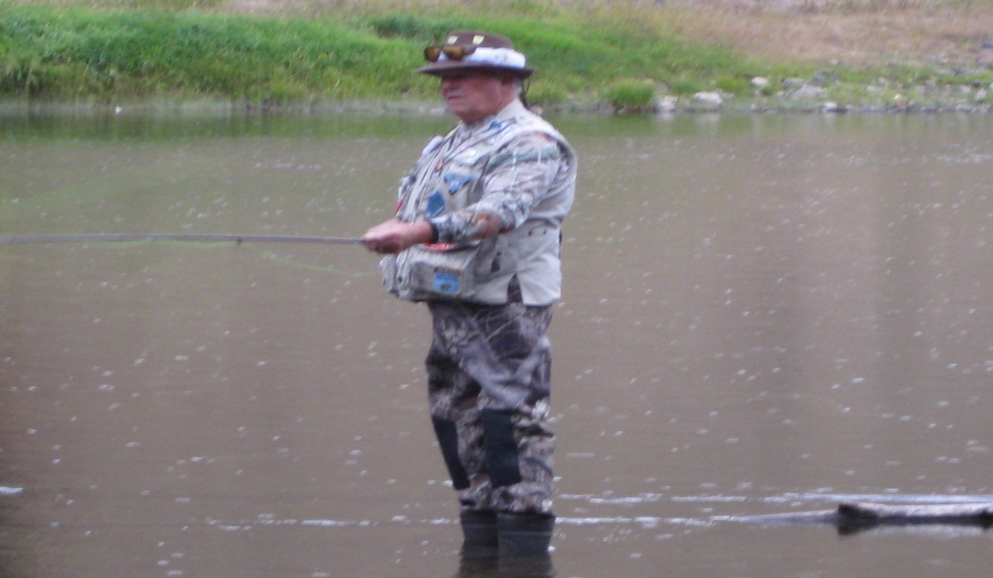
Not this kind…
Notes:
This isn’t the kind of fishing I am talking about

Slide 12
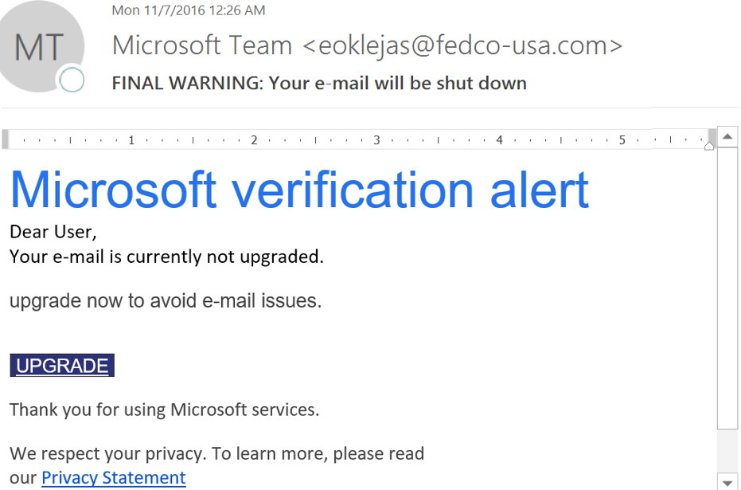
Phishing
Notes:
Phishing attacks are getting very sophisticated – Notice the Display name – Now notice the actual Email address
Group in LA Story

Slide 13
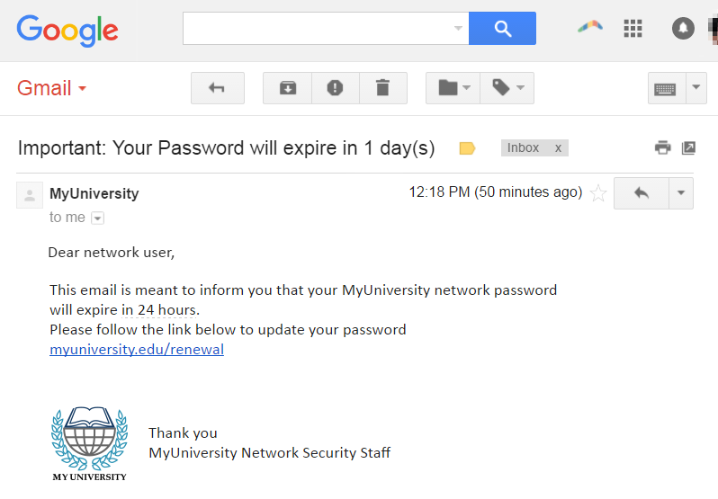
Phishing
Notes:
Hackers have plenty of time to get creative with their graphics, etc to make it look real

Slide 14
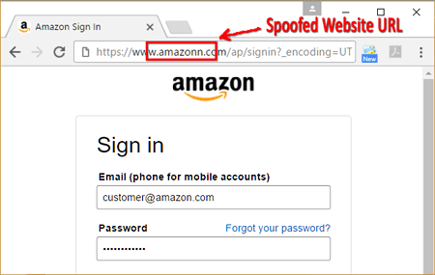
Phishing
Notes:
This site looks real – but notice the URL – at first glance you will think this is legit.
Whats a SSN Worth? Whats a Patient Record worth?

Slide 15
Biggest Risk Factors
#3 - RansomWare
Notes:
The 3rd biggest threat is Ransomware – Greenway Health’s Hosted EMR Intergy got a ransomware in 2017 – Affected 400+ Practices
Tell Story about how it happened

Slide 16
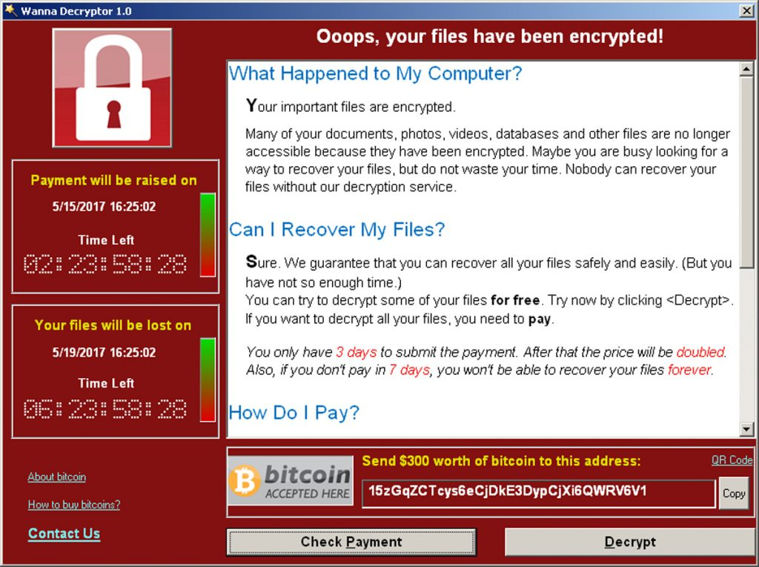
Ransomware
Notes:
Anyone know what BitCoin is? Do you know how to buy it? 3 Key ways to prevent ever having to find out
1. Maintenance of your systems – Patch Updates – Not Just turning on Auto Update – 2. Good AV - Behavioral Based 3. Disconnected Backup

Slide 17
Biggest Risk Factors
#4 – The Doctors Nephew
Notes:
4th biggest threat – Nephew, son, buddy – an IT company that doesn’t focus on Healthcare IT.
Healthcare is the only industry with Fed oversite that can levy fines – Hire someone that does Healthcare IT

Slide 18
The HIPAA Police
HHS Office for Civil Rights enforces the HIPAA Privacy, Security, and Breach Notification Rules.
What do they seek?
Violations!
Notes:
I remember back in 2002 when I would be asked – Who is the HIPAA Police? Well for years there wasn’t a Hippa Police – Now there is.
Recent healthcare conference in Colorado where one of the OCR enforcement Officers Bragged about the amount of fines

Slide 19
What Constitutes a HIPAA Violation?
A HIPAA violation is when a HIPAA covered entity – or a business associate – fails to comply with one or more of the provisions of the HIPAA Privacy, Security or Breach Notification Rules.
● The Privacy Rule sets national standards for when protected health information (PHI) may be used and disclosed
● The Security Rule specifies safeguards that covered entities and their business associates must implement to protect the confidentiality, integrity, and availability of electronic protected health information (ePHI)
● The Breach Notification Rule requires covered entities to notify affected individuals; U.S. Department of Health & Human Services (HHS); and, in some cases, the media of a breach of unsecured PHI
Notes:
Is it a Violation? IF a tree falls and no one is around to hear it – does it make a noise?
Drive 50 mph in a 30 mph zone – is a violation if you don’t get caught?

Slide 20
OCR Wall of Shame
U.S. Department of Health and Human Services – Office for Civil Rights
Breach Portal (Or, the Wall of Shame)
https://ocrportal.hhs.gov/ocr/breach/breach_report.jsf
Notes:
Please don’t make this list – but this a good link to go and check out from time to time

Slide 21
Reported PHI Breaches in 2018
Wall of Shame
01/01/18 Through 01/01/19
Greater than 500 Individual’s PHI Affected
Location of Breached Data | Incidence Count | Individuals Affected
Email | 93 | 3,305,392
Server | 52 | 5,228,331
Paper | 52 | 1,071,278
PC | 19 | 433,207
Laptop | 14 | 67,205
All (Several Devices) | 6 | 27,324
Portable | 14 | 40,833
Other (Undefined) | 33 | 1,902,213
TOTALS | 283 | 12,075,783
Notes:
As you can see – from Jan 2018 – Jan 2019 – There were 283 identified cases with over 12 million records exposed
Identity Theft – Brandi’s story – Average fine is $403 per Patient Record

Slide 22
PROFESSIONAL “HACKERS” / THEIVES
Ransomware
Malware
Phishing
Direct Hack
Hacked Email Access (Pro / Amateur)
OTHER COOKS IN THE KITCHEN
Medical Device Manufacturer Error
Third Party Vendor Error – Phone System
CONFIGURATION EXPLOITS
Misconfigured Database
Misconfigured Servers
Misconfigured WiFi
Misconfigured Firewall
HUMANS
Lost Laptop / Theft
Notes:
Here are some examples of Hacks – 3rd Party Vendor – Phone System – Old – Not Supported – But potential area to get hacked
Casino Aquarium Story

Slide 23

Are There Penalties for HIPAA Violations?
Notes:
Athens Ortho Story

Slide 24
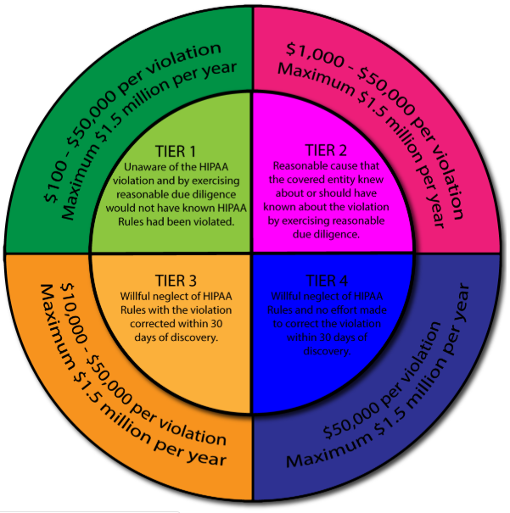
WHAT ARE THE PENALTIES?
TIER 4
Willful neglect of HIPAA rules and no effort made to correct the violation within 30 days of discovery
Notes:
4 Tiers of types of violations – From “I had no clue” to “I knew but the doctors didn’t want to spend the money”
Cyber Insurance doesn’t likely cover the fine – WHO HAS CYBER INSURANCE? Did you actually read the policy? Did you have an attorney read the Policy?

Slide 25
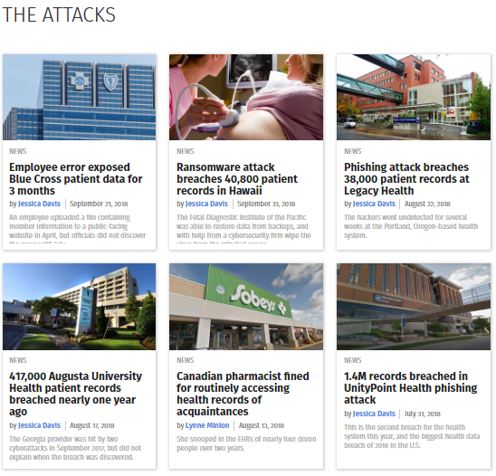
HIPAA Journal
Notes:
Read Brief about each story

Slide 26
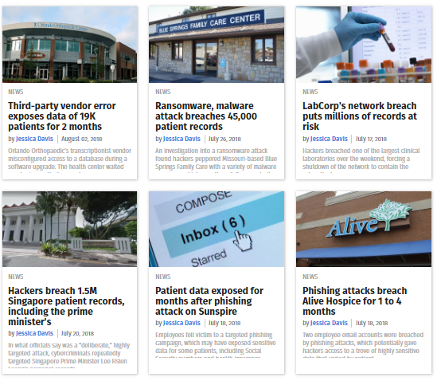
Notes:
Read Notes

Slide 27
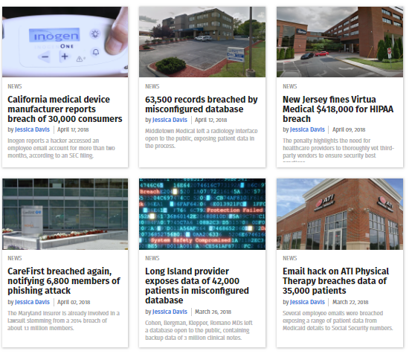
Notes:
Read Notes

Slide 28
UMMC – Laptop Stolen
$2.7+ Million Fine
No proof that Laptop even had PHI
But no proof that it didn’t either
Notes:
Read NOtes

Slide 29
2017 HIPAA Fines
Date | Organization | Fine Total
January 9, 2017 | Presence Health | $475,000
January 18, 2017 | MAPFRE | $2,200,000
February 1, 2017 | Children’s Medical Center of Dallas | $3,200,000
February 16, 2017 | Memorial Healthcare Systems | $5,500,000
April 12, 2017 | Metro Community Provider Network (MCPN) | $400,000
April 20, 2017 | The Center for Children’s Digestive Health (CCDH) | $31,000
April 24, 2017 | CardioNet | $2,500,000
May 10, 2017 | Memorial Hermann Health System (MHHS) | $2,400,000
May 23, 2017 | St. Luke’s Roosevelt Hospital System Inc. | $387,200
June 7, 2017 | Rite Aid | $1,000,000
December 18, 2017 | 21st Century Oncology | $2,300,000
2017 TOTAL: |  | $20,393,200
2018 HIPAA Fines
Date | Organization | Fine Total
February 1, 2018 | Fresenius Medical Care North America (FMCNA) | $3,500,000
February 13, 2018 | Filefax, Inc. | $100,000
June 18, 2018 | The University of Texas MD Anderson Cancer Center | $4,348,000
September 20, 2018 | Boston Medical Center (BMC), Brigham and Women’s Hospital (BWH), and Massachusetts General Hospital (MGH) | $999,000
October 16, 2018 | Anthem | $16,000,000
November 26, 2018 | Allergy Associates of Hartford, P.C. | $125,000
December 4, 2018 | Advanced Care Hospitalists PL (ACH) | $500,000
December 11, 2018 | Pagosa Springs Medical Center (PSMC) | $111,000
2018 TOTAL: |  | $25,683,000
Notes:
In the last 2 years – Over $45 Million in Fines – with Reduced Reimbursements facing all healthcare – this isn’t something you want to pay

Slide 30
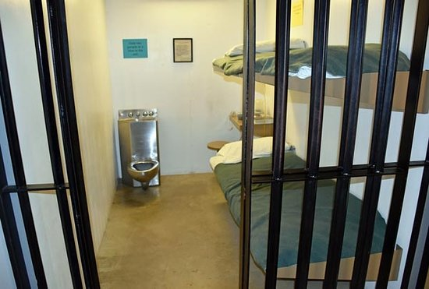
PENALTIES FOR HIPAA VIOLATIONS?
Notes:
Never been to Jail, but this jail looks pretty nice – but still not as nice as my Bed

Slide 31
Criminal Penalties for HIPAA Violations?
In addition to civil financial penalties for HIPAA violations, criminal charges can be filed against the individual(s) responsible for a breach of PHI.
The tiers of criminal penalties for HIPAA violations are:
Tier 1: Reasonable cause or no knowledge of violation
Up to 1 year in jail
Tier 2: Obtaining PHI under false pretenses
Up to 5 years in jail
Tier 3: Obtaining PHI for personal gain or with malicious intent
Up to 10 years in jail
Notes:
Yes – there is a chance you could go to jail

Slide 32
You Discover a Breach, What Next?
Secure the Data / Remediate the Security Shortfall
Notify the Individuals
Notify the Secretary (Complete the Form)
Notify the media (Certain Circumstances)
“in no case later than 60 days following the discovery of a breach”
AND
Business Associates must notify covered entities if a breach occurs at or by the business associate.
Notes:
In the event you have a breach – there are certain things you have to do.
Shane Adams BackGround – First thing – DO NOT REBOOT ALL OF YOUR STUFF! – This erases all the logs – like cleaning your home after a breakin – before the cops arrive

Slide 33
What Does an Attack Look Like?
May not be detected
Ransomware
Phishing
Firewall Monitoring / Alerting
WiFi Monitoring / Alerting
Log Files
Notes:
Some attacks may not be detected – Who has a Firewall? When’s the last time you logged into it? When’s the last time your IT person did?
Don’t trust the emails you get from these types of devices – someone needs to be checking often – Home Depot Story

Slide 34
Security Basics
Prevention is the Best Plan
Users must have a clear understanding of HIPAA
Backup your data
Backup your data – Offsite
Use a properly configured current NexGen Firewall
Use WiFi with integrated Firewall
Install and update anti-malware / AV software
Policies
No Such Thing As - Set it & forget it!
Security is a process
Consider multifactor identification
Name a HIPAA compliance officer
Notes:
Prevent – Train – Backups(Offsite) – Monitor – Good Policies – Security isn’t something you set and forget – it’s a process
Multifactor Identification (Like your bank) – Name a Compliance Officer

Slide 35
Data Security Best Practices
Monitor and Alert
Monitor user activities – Insider threats may go undetected
Monitor Firewall
Monitor WiFi
Monitor Servers
Alert notifications on potential network issues
Notes:
Monitor Users Activities – Disgruntled Employees – Who is the first person to know someone is leaving your practice? THAT Person
Monitor your Systems – FWs / WiFi / Servers

Slide 36
Data Security Best Practices
Immediately remove access from former employees
Change access as employee’s job changes
Keep an eye on privileged users
Vendors and contractors – Temporary access only
Notes:
We host over 10,000 users in our data centers – often users quit and its months before practices inform us - Recent Case in LA where employee was still accessing system months later – no one told us
Trust but Verify – Watch your users – Monitor your vendors – don’t give them total unrestricted Access to your system – cut it on and off as they need access

Slide 37
Data Security Best Practices
Develop an email policy
Utilize email encryption
What can be sent
What can’t be sent
Encrypted
Unencrypted
Storage and retention
Notes:
Have an email policy – Educate team on Policy – HANDBOOK isn’t the answer – TELL STORY oF Staff Reads Handbook in 3 min and signs that they have read it
Let them know what they can and CAN”t send on email – Also – Don’t send email to Patients work email – DID YOU KNOW - Employers own the email

Slide 38
Data Security Best Practices
Business Continuity Plan – Backup isn’t BCP!
Network recovery plan
Device recovery plan
Software recovery plan
Data recovery plan
Step by step processes
Assign responsibilities
Vital contacts information
Test backup restoration at least once per year
Off-site options
Notes:
Backup isn’t Business Continuity – Its part of it – Thumb Drive vs DR? Test your plan once per year
Ms Nancy taking the tape home every day isn’t a Plan

Slide 39
Biggest Risk Factors
#1 - Knowledge
OR the Lack of Knowledge
Educate Yourself and your Staff
Online Classes / Webinar
Review your Procedures Annually
Don’t be scared to admit what you don’t know
GET HELP!
Notes:
Review - #1 Threat – Knowledge – Educate – there is several online classes you can subscribe too and it will keep track of who participated. Review procedures annually –
Don’t be scared to admit what you don’t know – Ask for Help

Slide 40
Biggest Risk Factors
#1 - Knowledge
STOP USING – GMAIL / YAHOO / AOL / ATT.com type emails – simply not worth the risk.
Notes:
Stop using GMAIL, Hotmail type emails for Practice business

Slide 41
Biggest Risk Factors
#2 - Phishing
Educate your staff to just be smart
No Free Disney Tickets or Prince in Africa
Smells Phishy – double Verify
ASK….
Notes:
Phishing – No Free Disney Tickets – If something sounds strange – verify
Check the actual email address not the display name

Slide 42
Biggest Risk Factors
#3 - RansomWare
Setup a Good – Disconnected (Offsite Preferred) Backup
Patch Management System – No just “auto updates”
Good Behavioral Based Anti-Virus / Anti-Malware
Notes:
Establish a good Disconnected Backup – Have a patch management Plan – Not just “we have auto-updates turned on”
Good Behavioral Based Anti-Virus / Malware

Slide 43
Biggest Risk Factors
#4 – The Doctors Nephew
Savings Not Worth the Risk
Find a Trusted Partner that Specializes in IT for Healthcare
Don’t hire a company that Sells Hardware
Never let the company doing your IT provide you with your Risk Assessment – “Grading their own Homework”
Notes:
Fire the Doctors Nephew – TODAY! Get a Trusted IT Partner that does IT For healthcare are a core business. One that Doesn’t Sell Hardware
Never let your IT Partner / Vendor do your Annual Risk Assessment – Grading their own HOMEWORK

Slide 44
Bonus Info…
End of Life – Windows 7 / Server 2008
HIPAA – No PHI can be accessed from a device that is running on an unsupported Manufacturer system
Must Replace / Upgrade by Jan 2020
BTW…. HOME Edition?
Notes:
Little bit more – If you have Windows 7 or Server 2008 – You have to upgrade by Jan 2020. Rule about PHI being access from Non-Supported Device
ALSO – Home Edition – what does is say “HOME” – Don’t use this in your practice!

Slide 45
Questions?
Notes:
T-Shirts – Who can tell me the 4 biggest risk we discussed today? Whats the difference in Backup and Business Continuity? How do you prevent every paying a Ransom?

Slide 46
THANK YOU
Todd Gooden
Direct: 601-933-1118
todd@mysolutionsteam.com
877-226-9478 | mysolutionsteam.com

