Slide 1


Telehealth Networks and The USF
Presented by:
Natalie Verette– Director of Sales
TeleQuality Communications

Slide 2
Today Topics
  • The Telehealth Framework
  • The Universal Service Fund and the Rural Health Care Program:
    How this funding could impact your organization
    How this program has changed in recent years

Slide 3

TeleQuality Communications & ENA
Since 1999, TeleQuality Communications assisted healthcare organizations with
high-quality Internet access, data networking, communication solutions, and a high-touch customer service experience.
In 2018, we joined forces with Education Networks of America, a leading provider of transformative technology solutions to education and library communities, to bring critical connectivity and communication services to America’s community anchor institutions.

Slide 4

The Telehealth Framework
The three vital components to successfully care for long distance patients

Slide 5
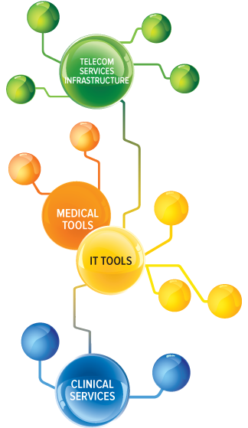
Three Vital Components
1
Telecom Services Infrastructure
  Telecom services specs
  Uniquely designed networks
IT & Medical Tools
  Manage, monitor, support & secure
  Equipment
  Interoperability
Clinical Services
  The “health” in telehealth
2
3
Image: c 2018 TeleQuality Communications

Slide 6
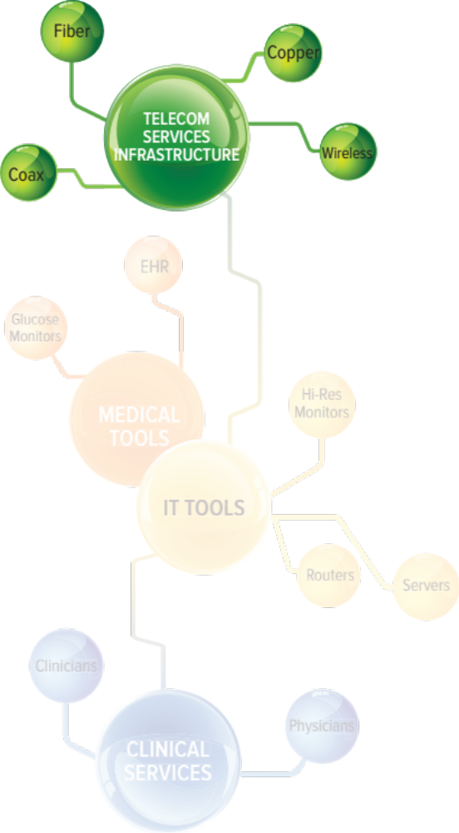
Telecom Services Infrastructure
Minimum required speeds- 10 Mbps
Uniquely designed networks for rural markets
- Ethernet over copper (EoC)
- Redundant networks over different routes/channels
- Creative designs to maximize funding
Image: c 2018 TeleQuality Communications

Slide 7
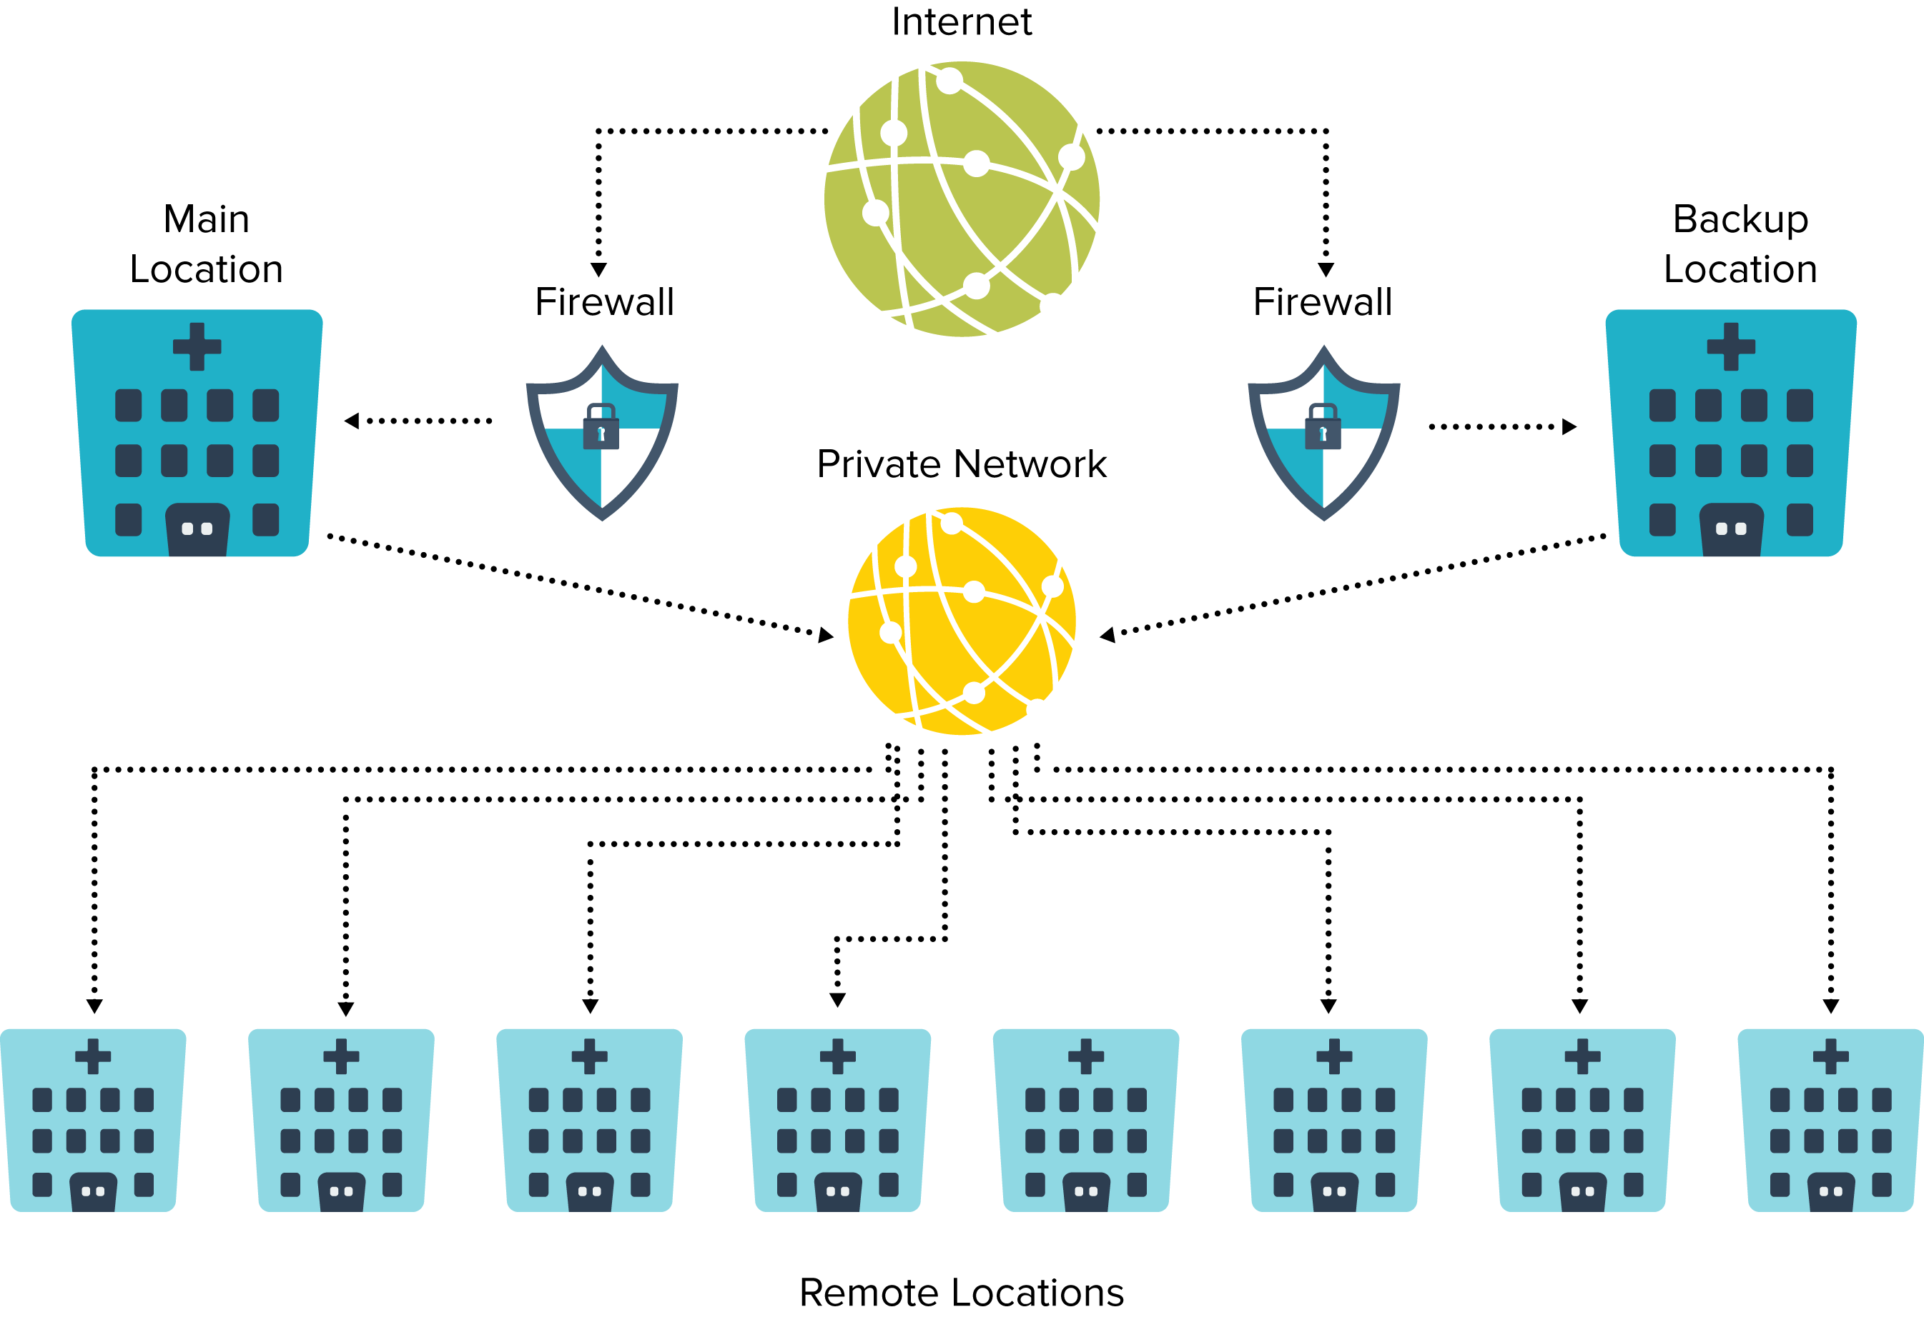
Example: Unique Network Design
Image: c 2018 TeleQuality Communications

Slide 8
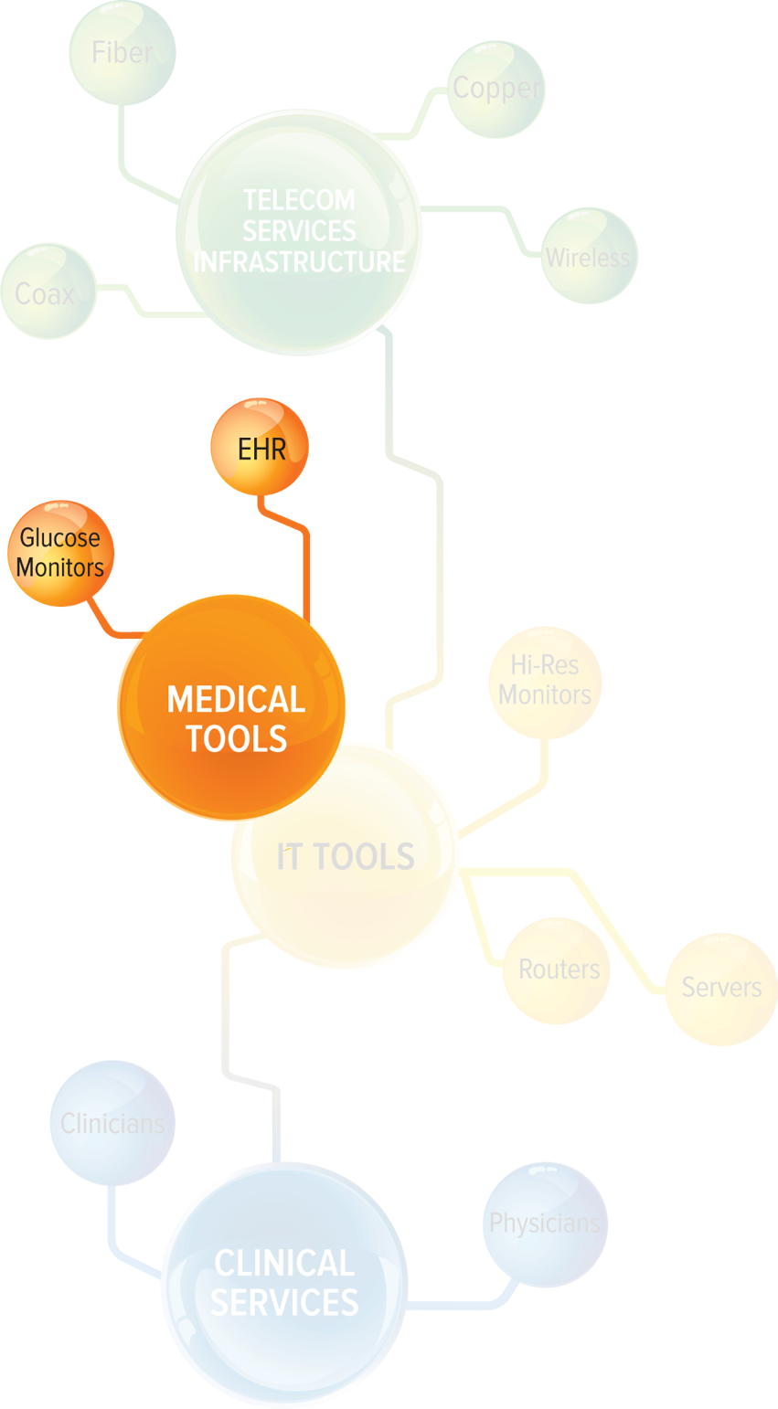
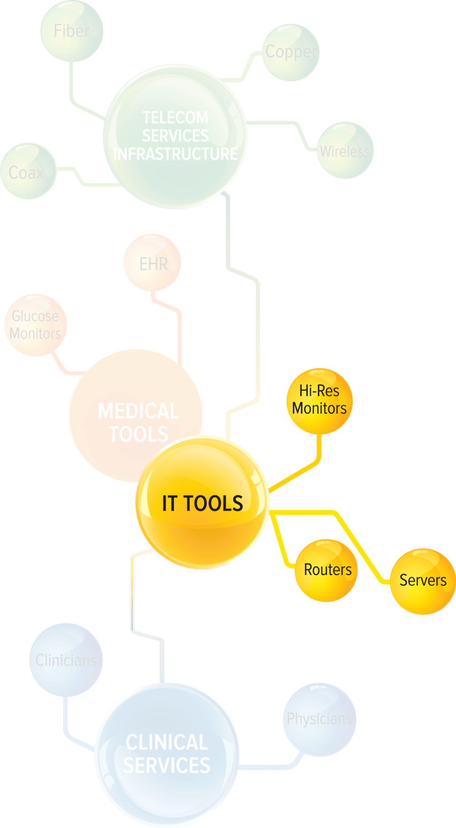
IT and Medical Tools
IT Tools
- Manage
- Monitor
- Support
- Secure
Medical Tools
- Equipment and plans
- Interoperability
Image: c 2018 TeleQuality Communications

Slide 9
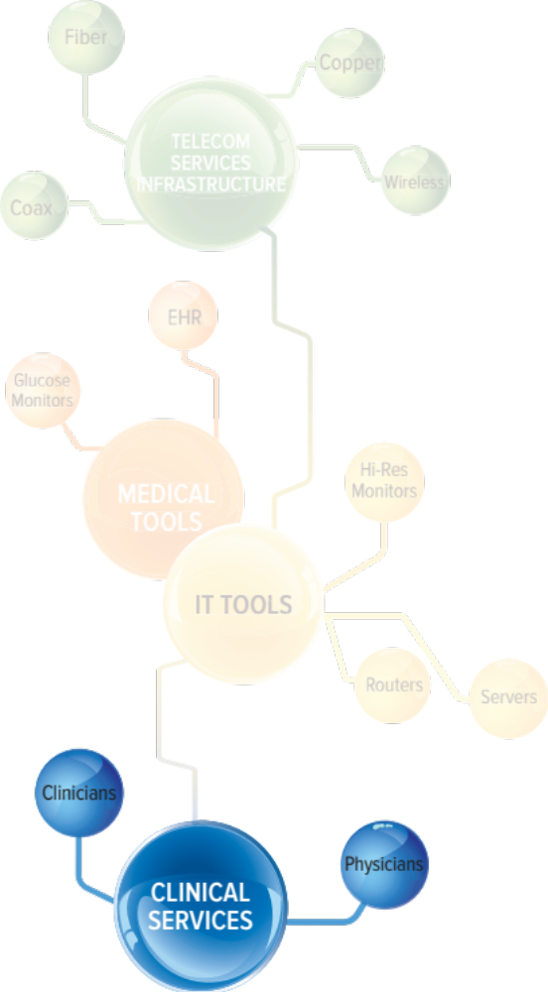
Clinical Services
Telehealth services provided by:
- Radiologists
- Cardiologists
- Skilled healthcare workers
Workflow patterns
- Learning to incorporate technology
into exams & processes
Image: c 2018 TeleQuality Communications

Slide 10

The USF & RHC Program
Understanding The Universal Service Fund and the Rural Health Care Program

Slide 11
Some Important Notes
The Universal Service Fund and the Rural Healthcare Program can be confusing for new-timers. We are here to educate.
TeleQuality Communications and its parent company, ENA:
  not affiliated with the Universal Service Administrative Company (USAC) which collects and distributes the Universal Service Fund
  not involved in any review or approval processes conducted by USAC
  not involved in the filing process for individual healthcare providers

Slide 12
What is the Universal Service Fund?
Based on the principle of universal service
Communications Act of 1934
  Established universal service in legislation
  Created the Federal Communications Commission (FCC)
  Universal service helped make telephone lines ubiquitous
Telecommunications Act of 1996
  Updated the Communications Act of 1934
  Expanded USF to include advanced services such as high-speed Internet broadband
Source: https://www.fcc.gov/general/universal-service

Slide 13
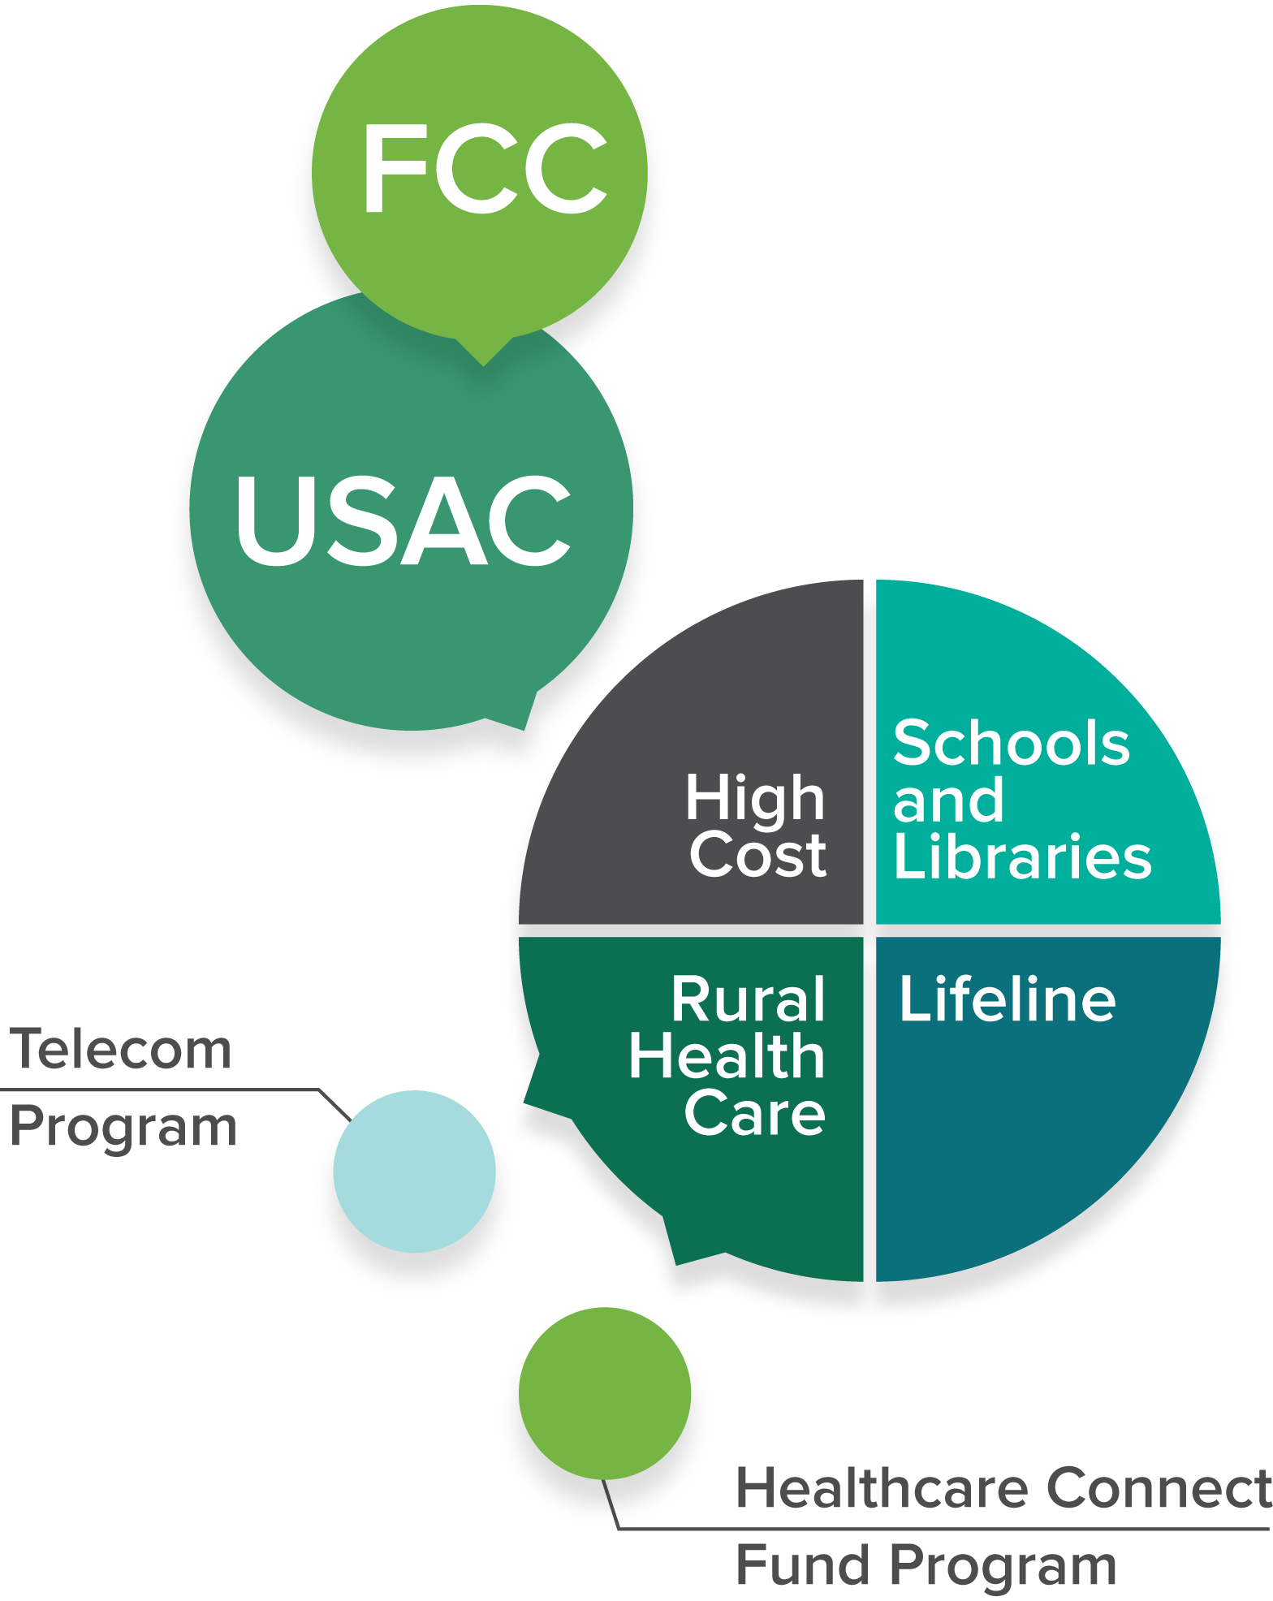
Who Distributes the USF?
The Universal Service Administrative Company (USAC) collects and distributes the Universal Service Fund.
USAC was created in 1997 as a subsidiary of the National Exchange Carrier Association.
USAC is an independent, not-for-profit corporation designated by the FCC as the administrator of all four support programs.
Image: c 2018 TeleQuality Communications

Slide 14
Program Comparison
Telecommunications Program
Healthcare Connect Fund
Savings
  Funds the difference between rural & urban connectivity costs
Eligible Expenses
  Telecommunications service
Savings
  Funds a flat rate of 65% for requested services
Eligible Expenses
  Telecommunications service
  Broadband service
  Network equipment
  HCP-constructed & owned network facilities (consortia only)
  Fiber builds

Slide 15
Program Examples
Services for a 100 Mb circuit funded through the RHC Telecommunications Program
Services for a 100 Mb circuit funded through the RHC Healthcare Connect Fund
Rural Rate = $6,000/month
Urban Rate = $260/month
USF Funds = $5,740/month
Rural Rate = $6,000/month
USF Funds = $3,900/month
$6,000/mo. - $5,740/mo. = $260/month
$6,000/mo. - $3,900/mo. = $2,100/month
Rural Rate
Monthly Recurring Cost for Services
Monthly Cost to HCP After Funding
Rural Rate
Monthly Recurring Cost for Services
Monthly Cost to HCP After Funding

Slide 16
Resources and Links
Federal Communications Commission (FCC)
  Universal Service- https://www.fcc.gov/encyclopedia/universal-service
  Rural Health Care Program- https://www.fcc.gov/encyclopedia/rural-health-care
Universal Service Administrative Company (USAC)
  Rural Health Care Program- http://www.usac.org/RHC/
  Determining Rurality- http://www.usac.org/rhc/telecommunications/tools/Rural/search/search.asp
  USAC 2017 Annual Report- http://www.usac.org/_res/documents/about/pdf/annual-reports/usac-annual-report-2017.pdf
  USAC Webinars for further information http://usac.org/rhc/telecommunications/outreach/webinar.aspx

Slide 17






Interested in learning more?
USAC Contact Info:
rhc-assist@usac.org
202-776-0200
email: funding@telequality.com
phone: 210-408-0388
www.telequality.com
THANK YOU
*TeleQuality Communications is not affiliated with The Universal Service Administrative Company which collects and distributes the Universal Service Fund.

