Slide 1
RHC Compliance Update
Mississippi Rural Health Association
May 3, 2019
Patty Harper, CEO/Principal
InQuiseek Consulting

Slide 2
So, what are we going to talk about?
Mississippi RHC Trivia
Types of CMS Regulations/Guidance
Appendix G/Appendix Z
Top Survey Deficiencies for 2018
Compliance Challenges & Successes

Slide 3
Mississippi RHC Trivia

Slide 4
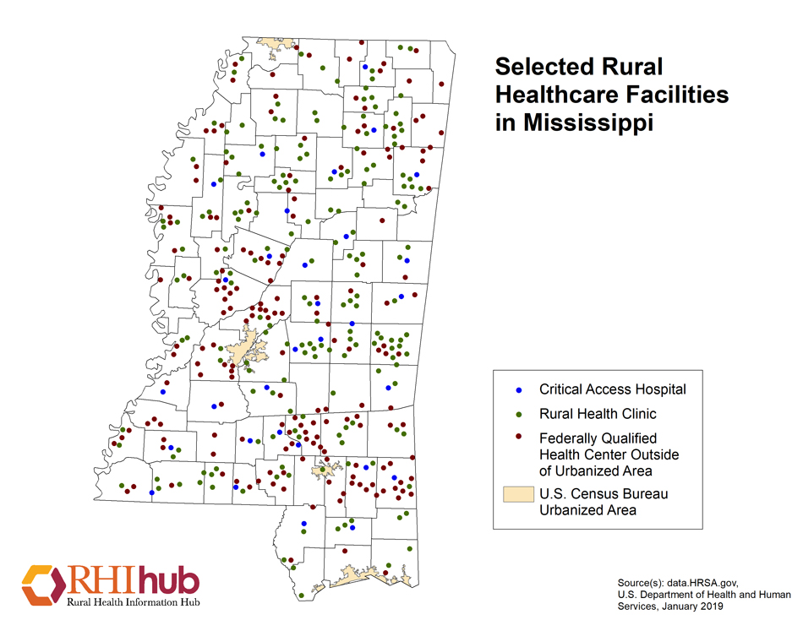
RHCs in Mississippi
183 per RHIhub, January 2019
179 per QCOR, May 1, 2019

Slide 5
Mississippi RHC Survey Statistics 2017-2019**
Survey Activity for Mississippi
Calendar Year | 2017 | 2018
Mississippi | 18 or 9.7% | 30 or 16.2%
Mississippi: Complaint | 1 or 0.5% | 0 or 0.0%
National | 814 or 18.7% | 814 or 18.0%
National: Complaint | 34 or 0.7% | 32 or 0.6%
Only 1 survey YTD in 2019 as of 5/01/2019

Slide 6
Mississippi RHC Survey Statistics 2017-2019**
Total Survey Deficiency Count
Calendar Year | 2017 | 2018
Mississippi | 6 (S) 1 (C) | 19 (S) 4 (C)
National | 1,342 (S) 127 (C) | 1,789 (S) 141 (C)
No surveys YTD in 2019 as of 4/29/2019

Slide 7
Mississippi RHC Survey Statistics 2017-2019
RHCs Overdue for Survey as of May 1, 2019
Calendar Year | # of Clinics | % of Clinics
Mississippi | 110 | 61.5%
National | 2,324 | 52.5%

Slide 8
**Data Source
S&C's Quality, Certification and Oversight Reports (QCOR)
https://qcor.cms.gov/main.jsp
Survey data and statistics are available on this site for all CMS certified facility types.

Slide 9
When a surveyor cannot find evidence (written proof, observation, interviewing, inspection, auditing, etc.) that the certification standards are being met, you receive a deficiency. Each survey “tag” or standard is tied back to the 42 CFR §491 conditions for RHC certification. Each deficiency is referenced to a regulation subpart, tag or AO standard because it has not been evidenced.
How or why do I get a survey deficiency?

Slide 10

Surveyors are people who come to the task from different backgrounds and perspectives. Even though they have the same standards or conditions to evaluate and the same regulation to govern their surveying, it’s not always as objective or as much of a science as you would think it would be.
Are all surveyors the same?
Is a surveyor a surveyor regardless?

Slide 11
RHC can be surveyed for initial or subsequent certification by either the state agency or by one of the two deemed AO’s. States do not currently have priority federal funding to conduct initial surveys. Mississippi is also currently behind on RHC re-certification surveys. Using an AO gets you surveyed quicker but there is a cost for the service. The deemed authorities are also accreditors so they evaluate RHCs at a higher level. It may be worth the expense to have on-time surveys.
Should I use the state to survey my RHC or should I use an Accreditation Organization?

Slide 12


RHC Accreditation Organizations
https://www.cms.gov/Medicare/Provider-Enrollment-and-Certification/SurveyCertificationGenInfo/Downloads/MPD-RHCs-FQHCs.pdf
Accreditation Organizations with CMS-Approved RHC Deemed Status Programs Currently there are two:
American Association for Accreditation of Ambulatory Surgery Facilities (AAAASF)
https://www.aaaasf.org/
The Compliance Team
https://thecomplianceteam.org/

Slide 13
Federal Regulations and Guidance for Medicare & Medicaid Providers

Slide 14
Code of Federal Regulations
The CFR is a complete volume of all federal regulations for all sectors and is legally binding. The annual edition is updated every Oct 1st . eCF is more up-to-date.
Title 42 applies to Public Health
  Chapter I: Department of Health & Human Services
  Chapter IV: Centers for Medicare & Medicaid Services, HHS
  Chapter V: Office of Inspector General, HH
First published as Proposed Rules with a comment period and then published as Final Rules.
CMS publishes notices and links on their website.

Slide 15
Links to the Federal Register and the eCFR
Federal Register
https://www.federalregister.gov/
eCRF- Title 42
https://gov.ecfr.io/cgi-bin/ECFR

Slide 16
Main Federal Regulations
Medicare Program
42 CFR §405
Federal Healthcare for the Aged and Disabled
42 CFR §420
Program Integrity-Medicare
42 CFR §455
Program Integrity- Medicaid

Slide 17
Main Federal Regulations
Critical Access Hospitals
42 CFR §485
Subpart F
Conditions of Participation

Slide 18
Main Federal RHC/FQHC Regulations
42 CFR §405, Subpart X
42 CFR §491
Conditions for certification
42 CFR §413.65
Provider Based Status

Slide 19
42 CFR §413.65
RHCs as Provider-Based Facilities
Less than 50 Beds
Relationship Between the Parent Hospital and RHC
PB Attestation Voluntary

Slide 20
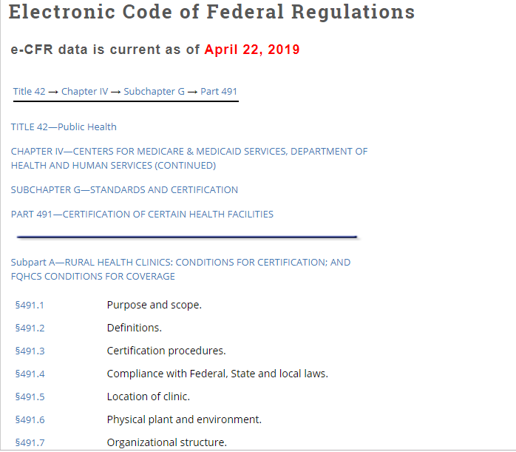
CFR 491
Title Subpart

Slide 21
Regulatory
42 CFR §491
RHC Certification Requirements
Location
Compliance
Staffing/Personnel/HR
Physical Plant/Environment
Provision of Services
Emergency Preparedness
Medical Management
Annual Evaluation
Emergency Preparedness

Slide 22
42 CFR §491:1 THRU §491:12
These section contains all the regulations concerning the conditions of certification and recertification of Rural Health Clinics. This is where the certification and accreditation standards originate. However, the sub-regulatory sources of information are often easier to interpret and more “user-friendly”. The CFR is legally binding. Sub-regulatory guidance must be taken into consideration by Medicare Contractors and Administrative Law Judges and they must explain rulings to the contrary, but they are not obligated to uphold sub-regulatory guidance.
Be mindful of published and effective dates when referring to regulations and sub-regulatory guidance. A Google search can result in an outdated publication.
Text in red indicates the updated portions of the publications.
RHC and FQHC guidance are often in the same documents. Use caution.

Slide 23
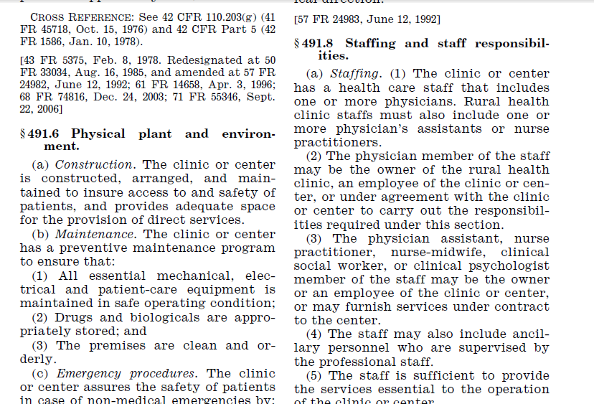


Slide 24
Sub-regulatory/Administrative
CMS Internet-Only Manuals
Policy Benefit Manual, Chapter 13
https://www.cms.gov/Regulations-and-Guidance/Guidance/Manuals/Downloads/bp102c13.pdf
Claims Processing Manual, Chapter 9
https://www.cms.gov/Regulations-and-Guidance/Guidance/Manuals/Downloads/clm104c09.pdf

Slide 25
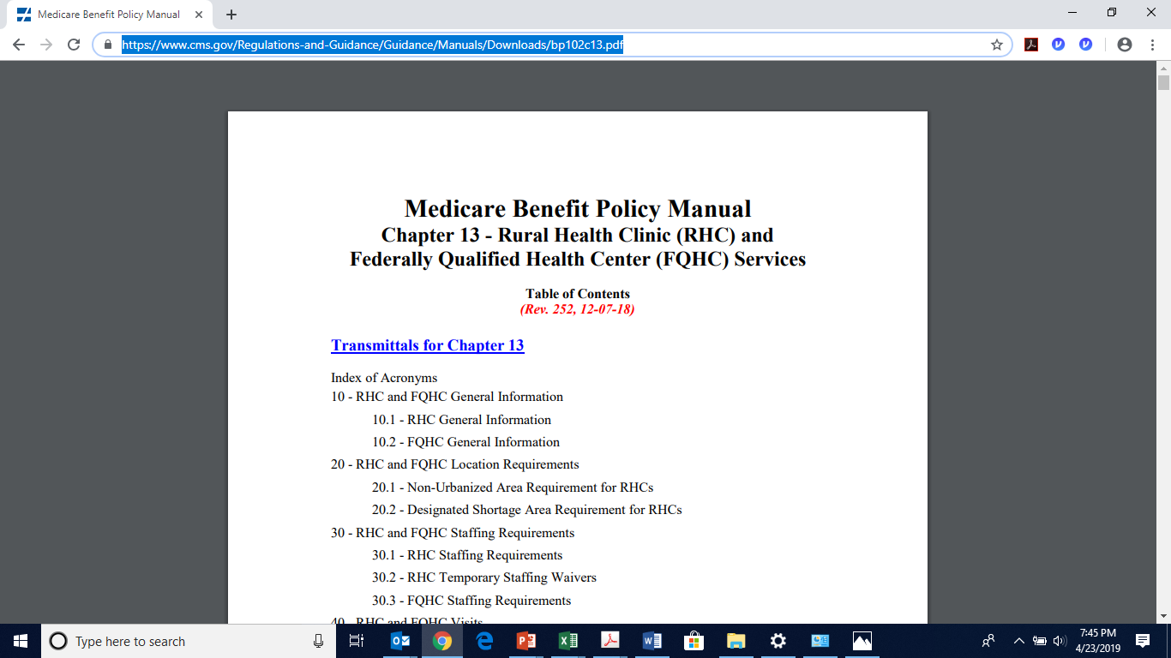
Sub-regulatory

Slide 26
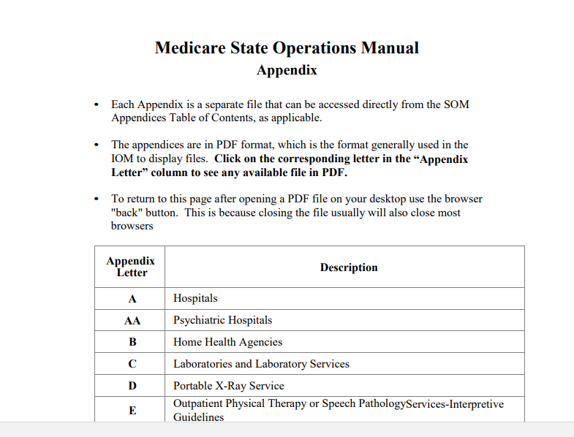
State Operations Manuals
Sub-regulatory

Slide 27
Sub-regulatory
The State Operation Manuals which apply to RHCs are:
Appendix G--Guidance for Surveyors: Rural Health Clinics
42 CFR §491.1 through §491.11
https://www.cms.gov/Regulations-and-Guidance/Guidance/Manuals/downloads/som107ap_g_rhc.pdf
Appendix Z—Emergency Preparedness for all Provider Types, Interpretive Guidance
42 CFR §491.12
https://www.cms.gov/Regulations-and-Guidance/Guidance/Manuals/downloads/som107ap_z_emergprep.pdf

Slide 28
Top RHC Deficiencies for 2018

Slide 29
Top 25 RHC Survey Deficiencies Nationwide in 2018**
Tag | Deficiency | Nationwide % of Surveys
J0043 | Drug Storage and Handling | 19.1%
J0123 | Provider Review of Policies | 11.2%
J0042 | Preventative Maintenance | 10.9%
J0160/ J0161 | Annual Program Eval Condition or Standard | 8.5% (S) 4.8 % (C)
J0044 | Environment Clean and Orderly | 8.4%

Slide 30
Top 25 RHC Survey Deficiencies Nationwide in 2018**
Tag | Deficiency | Nationwide % of Surveys
E0037 | EPP Training | 8.2%
J0152 | Complete Medical Records | 8.2%
E0004 | Developing EPP | 8.0%
J0136 | Emergency Care/Kit | 7.4%
J0135 | Required RHC laboratory services | 7.1%

Slide 31
Top 25 RHC Survey Deficiencies Nationwide in 2018
Tag | Deficiency (paraphrased) | Nationwide % of Surveys
J0039 | EPP Testing | 6.7%
J0124 | Written Patient Care Policies | 6.3%
E0036 | EPP Training and Testing Program | 6.3%
E0001 | All Elements of EPP Not Evidenced | 6.3%
E0009 | EPP Collaboration | 6.1%

Slide 32
Top 25 RHC Survey Deficiencies Nationwide in 2018**
Tag | Deficiency (paraphrased) | Nationwide % of Surveys
E0006 | Plan Based on All Hazard Risk Assessment | 6.0%
J0041 | Clinic safe and adequate space | 5.6%
J0101 | Physician Review of Charts | 5.2%
E0032 | EPP Alternate Means of Communication | 5.2%
E0024 | EPP Volunteers | 4.5%

Slide 33
Top RHC Survey Deficiencies Nationwide in 2018**
Tag | Deficiency | Nationwide % of Surveys
E0022 | EPP Written Policies and Procedures | 4.4%
E0029 | EPP Communication Plan | 4.4%
E0020 | EPP Evacuation | 4.0%
E0013 | EPP Written Policies and Procedures | 4.0%

Slide 34
EPP Requirements
EPP
Risk Assessment and Planning
Policies and Procedures
Communication Plan
Training and Testing

Slide 35
No written organization structure or policies
No organizational chart
No Disclosure of Ownership
No Disclosure of Medical Directorship
No Disclosure of Provider-Based Relationship with Parent Hospital
Failure to update 855A and CMS-29 forms when changes in key personnel or ownership occur.
Clinic not held out or represented as entity enrolled in Medicare
Common
Administrative Deficiencies

Slide 36
Multi Use Vials :
  Not labeled/dated
  Not left in patient care areas
Single Use Vials: Should not be labeled, used only once.
No Unsecured Sharps or Needles in patient care areas.
No reuse of single use items-sterile packing, sterile water
Expired Drugs (have inventory system)
Sample Drugs logged by patient with lot #
Controlled Drugs Storage and Reconciliation
Emergency Kit
Common
Drug Storage, Handling and Administration Deficiencies

Slide 37
Records do not contain all elements found in §491.10
Physician review of NP charts not evidenced
No audits of records per §491.10
Incomplete records for nursing home patients
No General Consent to Treatment
No Informed Consent to Treatment (procedures)
Common
Medical Record Deficiencies

Slide 38
No Annual Program Evaluation conducted within 12 months.
Not all elements of annual program evaluation included in annual program.
No NP/PA staffing at least 50% of the patient care hours.
Providers not in clinic during all posted patient care hours.
No posted hours
Employee/provider files not complete
Other Common RHC Deficiencies

Slide 39
OIG Excluded Party Database
Checked PRIOR to hire; periodically thereafter.
Check all alias, AKA, maiden, previous married names
OIG Database Search
https://exclusions.oig.hhs.gov/
Mississippi Excluded Party Search
https://medicaid.ms.gov/providers/provider-terminations/

Slide 40
First, always ask:
Is what we want to do going to cause a compliance problem? Always assume that it might until you know it won’t.
Examples:
Rebranding or renaming the clinic
Moving or rearranging space in the clinic
Adding visiting specialists or non-RHC services
Use of social media/web site discrepancies
**You can do these things, just make sure you do them correctly.

Slide 41
What are your biggest compliance challenges?
Knowing the RHC regulations
Finding Information and Updates
Culture that is not compliance-driven
Policies and Procedures that aren’t actually being followed
Keeping evidence updated
Knowing what to do when
Provider Buy-in/Pushback
Little fish in a big pond?
Staff turnover or burnout

Slide 42
Share how you have had a compliance success
What has worked?
What hasn’t?

Slide 43

Follow-up questions or comments can be directed to:
Patty Harper
InQuiseek Consulting
318.243.2687
pharper@inquiseek.com
www.inquiseek.com

