Slide 1


HIPAA Compliance
Does NOT Work
Bruce McCully, CISSP

Slide 2
I am Your Security / Computer Expert
This material does not constitute legal advice and covers only federal law.
For legal advice pertaining to HIPAA/HITECH compliance, contact your personal attorney.

Slide 3
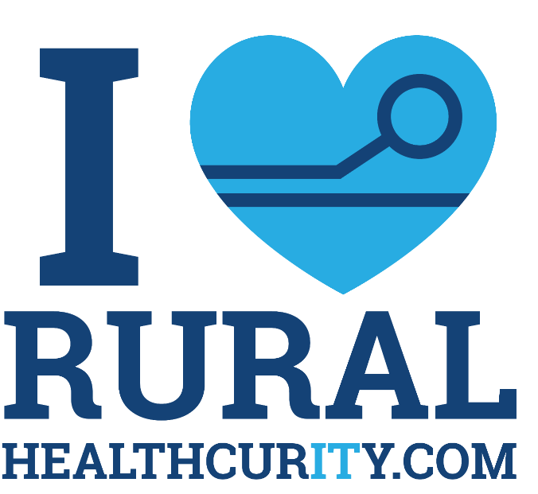

Slide 4

Ready?

Slide 5


Slide 6
72,602 words

Slide 7
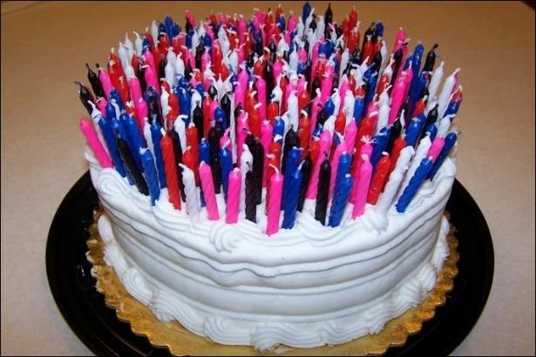
HIPAA Turned 19!
(that’s like turning 90 in tech years)
Notes:
90 year old woman

Slide 8
WHY?

Slide 9

Enforcement

Slide 10

Guidelines

Slide 11

Prevention

Slide 12
Quick and Dirty HIPAA Compliance
Restrict access to PHI?
Policies and procedures for managing and assessing risk of PHI?
Termination procedures?
Disaster recovery plan (tested plan)?
Security officer on team?
Staff HIPAA training?
Business Associates and BAAs?
Limit physical access to PHI?
Record of hardware containing PHI?
Notes:
Spending a large chunk of IT budget on compliance…. IT and Security Officers spend innumerable amount of time making sure they can check off boxes. But the effort is only for satisfying a checklist…

Slide 13
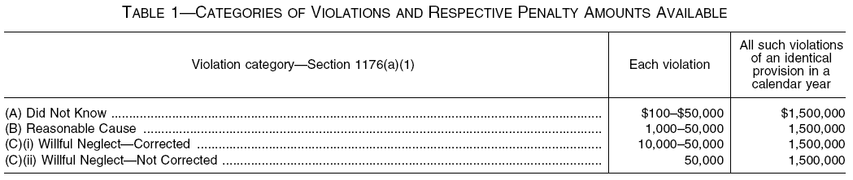


Slide 14

Fines.

Slide 15


Slide 16
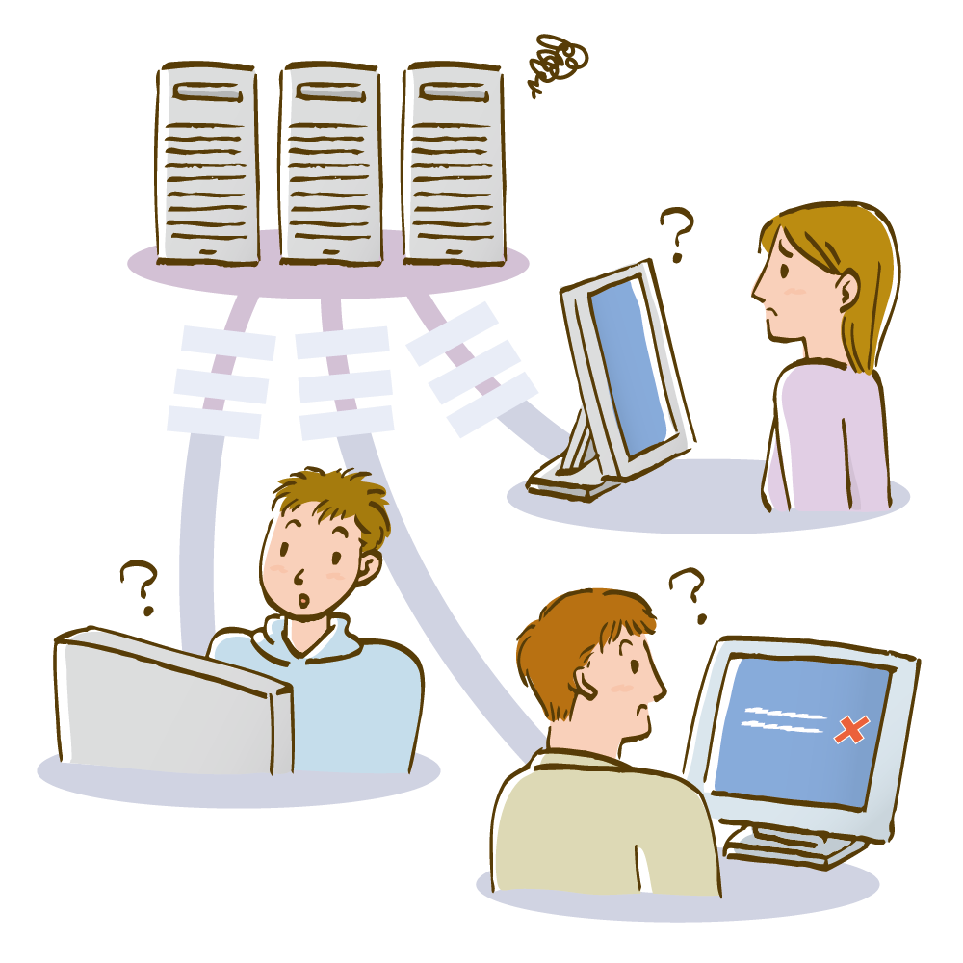
Most Important?
Bob sits in his office, face in hands.

Slide 17
Patient Safety.

Slide 18
Patient Trust.

Slide 19
Employee Trust.

Slide 20
“But We’re Small...
Nobody Would Bother To Hack Us, Right?”
Wrong!
One in five organizations fall victim to cybercrime each year and that number is GROWING.
(Source: National Cyber Security Alliance)
Small organizations are low-hanging fruit because they don’t believe they are a target, and therefore have very loose or no security systems and protocols in place. (Think about your contractors!)
Half of all cyber attacks are aimed at SMBs.
(Source: Forbes Article, “5 Ways Small Businesses Can Protect Against Cybercrime”)

Slide 21
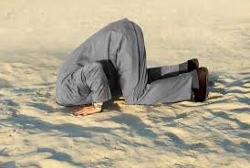
These are all large organizations – they don’t want my data – Right?
71% of security breaches target rural healthcare
20,765 records are stolen on average per data breach
$201 is the average cost per record stolen in a data breach
60% of hospitals fail after a data breach
IT Director / EHR

Slide 22
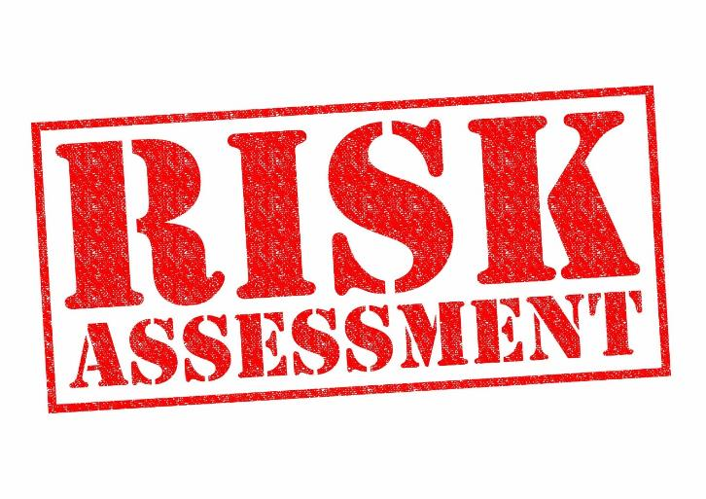

Slide 23


The Problem with HIPAA Assessments?
Check lists don’t always catch everything!
Missing pieces if security isn’t thought through
Not sufficient without context
Hospitals are passing HIPAA risk assessments, YET are still getting attacked by ransomware!
HIPAA Requirements ARE NOT updated regularly!

Slide 24

The OTHER Problem with HIPAA Risk Assessments?
Notes:
Without HIPAA Compliance you won’t receive your full Medicare reimbursements!

Slide 25

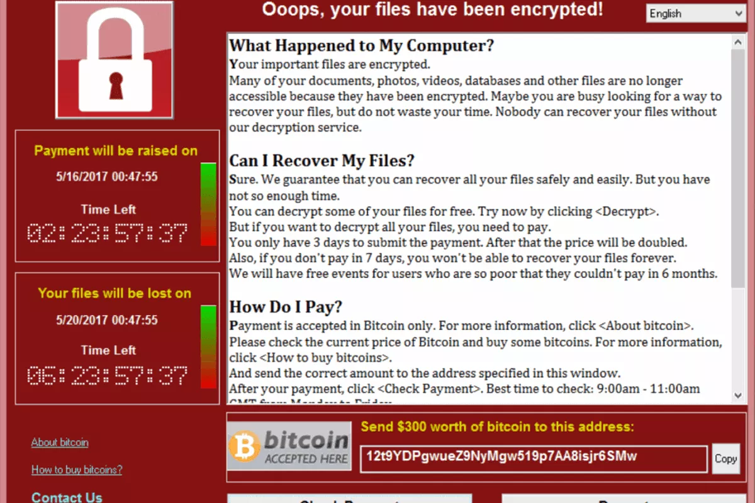
Hospitals are Passing HIPAA Assessments with Flying Colors YET Still Get Ransomware Infections!

Slide 27
“My IT Guy Says I’m Safe”

Slide 28
“My IT Guy Always Figures It Out”

Slide 29
“I Have Backups”

Slide 30
“I’m In The Cloud”

Slide 31

We have always remained compliant with the current regulations concerning our IT systems and have spent untold dollars to take care of our data. In fact, we completed a full security evaluation in November 2017.
On or about the 15th of January 2018, our company was attacked by ransomware. On the 8th page of Bruce’s book, the first paragraph asks you to speculate on how you would react if this happened to you. I can tell you that I no longer have to wonder. We were helpless. Our company was stopped in its tracks. We had over 400 computers and 30 plus servers that had almost every file encrypted. Our IT capabilities were quickly overwhelmed. By the grace of God, we were introduced to Bruce’s team.
Bruce and his group immediately sent a disaster recovery team to mitigate the issues and then to repair our systems. I do not believe another company could have done what they did for us. They have worked around the clock to recover our data and to get us back in business. We have truly found a partner for our future.
Sydney Sawyer
CEO, Lackey Memorial Hospital

Slide 32

What Are We Protecting?

Slide 33

Eye Spy PHI
https://ocrportal.hhs.gov/ocr/breach/breach_report.jsf
Affinity Health Plan – Photocopier Hard Drive Not Securely Wiped
$1,215,780
NAS Insurance Services –
Records Placed In Recycling Bin
Legal and Patient Notification Costs $85,000
Triple-S Management Corp. –
$6.8 Million For Improperly Handling Medical Records of 70,000 Patients
Phoenix Cardiac Surgery – Internet Calendar $100,000
Alaska Dept. of HHS – Unencrypted USB
$1,700,000

Slide 34

Bottom Line
PHI is everywhere!
Who Wants My PHI and WHY?

Slide 35
Who Depends on Medical Records?
Radiology?
Nursing?
ER?
Pulmonary?
Dietary?
Medical Records?
.
.
.
Medical Billing?

Slide 36
Who Depends on Medical Records?
Radiology?
Nursing?
ER?
Pulmonary?
Dietary?
Medical Records?
.
.
.
Medical Billing?
EVERYONE!

Slide 37


Regulatory compliance
Public relations
Post-breach customer protection
Attorney fees
Customer breach notification
Cybersecurity improvement
Technical investigation
Loss of intellectual property
Insurance premium increases
Value of lost patients
Increased cost to raise debt
Impact of operational disruption
Impact of data destruction
System recreation

Slide 38


Slide 39

Cash Flow is Critical for Keeping the Lights ON!
(Business side of healthcare depends on medical records too!)
$50K ransom, why not pay it? $2M in AR wrapped up in Encrypted Files

Slide 40
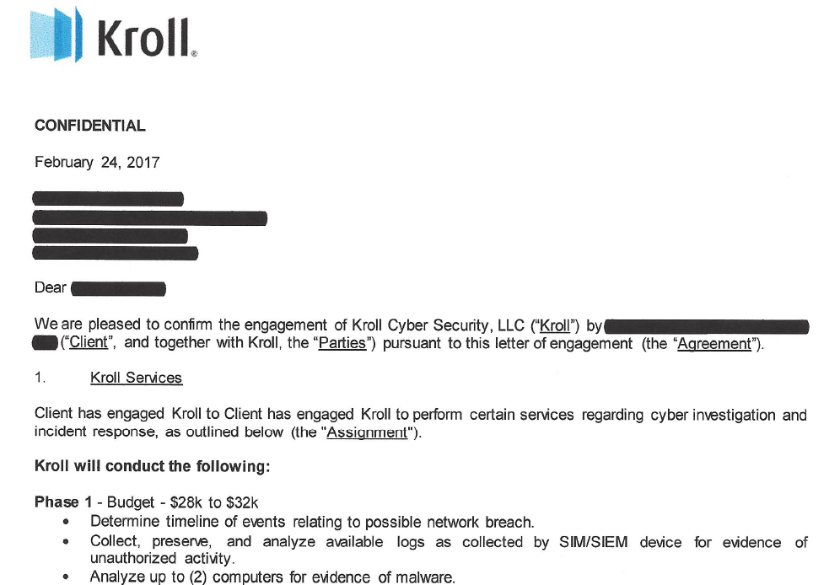

Slide 41
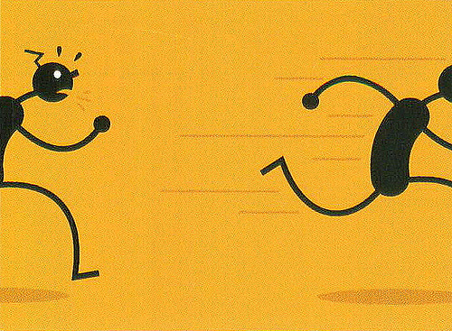
Why Healthcare is Behind on Cybersecurity?
Poor training
Hard to recruit
Hard to retain
IT not specialized on healthcare
Focused on passing a test (HIPAA) NOT on securing their patient data
Unencrypted backups that could be accessed by anyone in the organization…

Slide 42
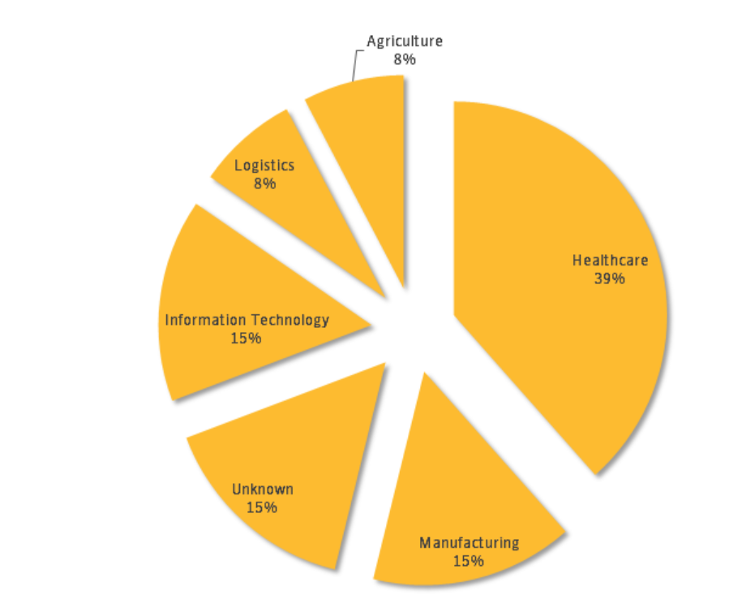
Eyes On The Prize: Healthcare
Majority of cyberattacks targeting healthcare!
Attacks on healthcare in 2018 up by 25%
Targeted hospital cyber attacks: 477 successful attacks
Hospital spending on HIPAA: $100 Billion

Slide 43
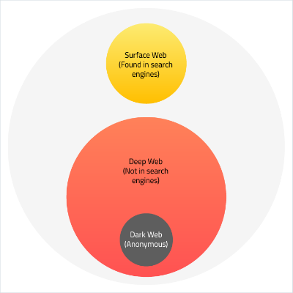
What is the Dark Web?
Notes:
57 billion pages at the start of November 2017. The part of the internet indexed by Google and other search engines is known as “Visible Web” or “Surface Web.” Despite the enormous size in human terms, the Surface Web is merely a fraction of the entire web, and it’s pretty small—less than 10 percent.
Safe Haven For Criminal Activity?

Slide 44
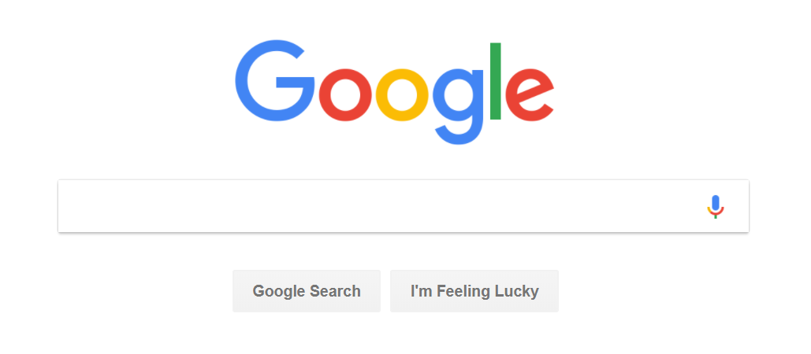
Finding Data on the Dark Web?
http://3g2upl4pq6kufc4m.onion/

Slide 45
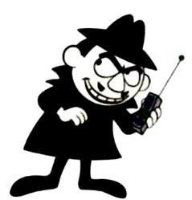

The Digital Underground’s Thriving Black Market
Credit card details: $2 to $90
Social Security Numbers: $30
Date of Birth: $11
Health Records: $1,200
Your Data (Ransom): $10,000+
Anyone can easily buy training, tools, and services for committing fraud, hacking systems, buying stolen credit cards, setting up fake web sites, etc.
Trojan Kit for as little as $1,000
Notes:
https://arstechnica.com/security/2016/02/hospital-pays-17k-for-ransomware-crypto-key/ - Hospital pays 17K to get access to their files after 10 day lockout by cyber criminals.
http://www.businessinsider.com/heres-how-much-your-personal-data-costs-on-the-dark-web-2015-5

Slide 46
16:04 @BB>> HEY - I WANT INTO A NETWORK.
16:50 @BB>> HEY - I WANT INTO A NETWORK. HELP ME?
17:12 @BB>> WANT INTO A NETWORK. HELP ME?
17:14 @TZ>> y0u 0ff3r1n6?
17:15 @BB>> BIT COIN. HAVE NAME. HAVE IP.
17:21 @TZ>> 7yp3 0f n37w0rk?
17:22 @BB>> WINDOWS. NAT FIREWALL. WANT ACCESS.
17:35 @TZ>> 0.02 b7c 4 d4y

Slide 47
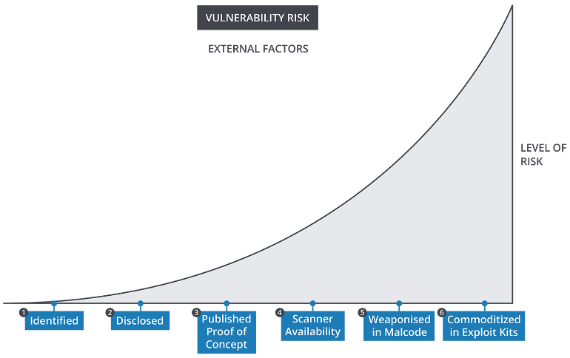
Growing Hacks From Unloved Networks
Notes:
https://arstechnica.com/security/2016/02/hospital-pays-17k-for-ransomware-crypto-key/ - Hospital pays 17K to get access to their files after 10 day lockout by cyber criminals.
http://www.businessinsider.com/heres-how-much-your-personal-data-costs-on-the-dark-web-2015-5

Slide 48
Attacks are Targeting MANY Vulnerabilities in Your Systems
hacked
accidentally published
leaked
magnitude of cyber threats
lost or stolen media
lost or stolen computers
inside job
poor physical security
time

Slide 49
One Little Flaw Leads to a BIG Hack
Vulnerability
Notification
Dark Web Chatter
Exploit Created
Recruitment
Campaign
Disaster

Slide 50
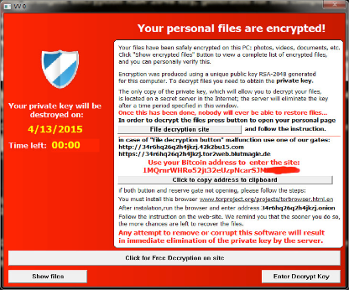
One Recent Case: SamSam
Day 1: Infection– 300 Users Down
Day 2: Fiddle thumbs
Day 3: Fiddle thumbs
Day 4: Called for help
.
.
.
Day 6: Data Recovery
.
.
.
Day 15: Remediation Recovered
15 Days to get critical services back online
(Medical Billing)
IT Director middle of EHR rollout.

Slide 51
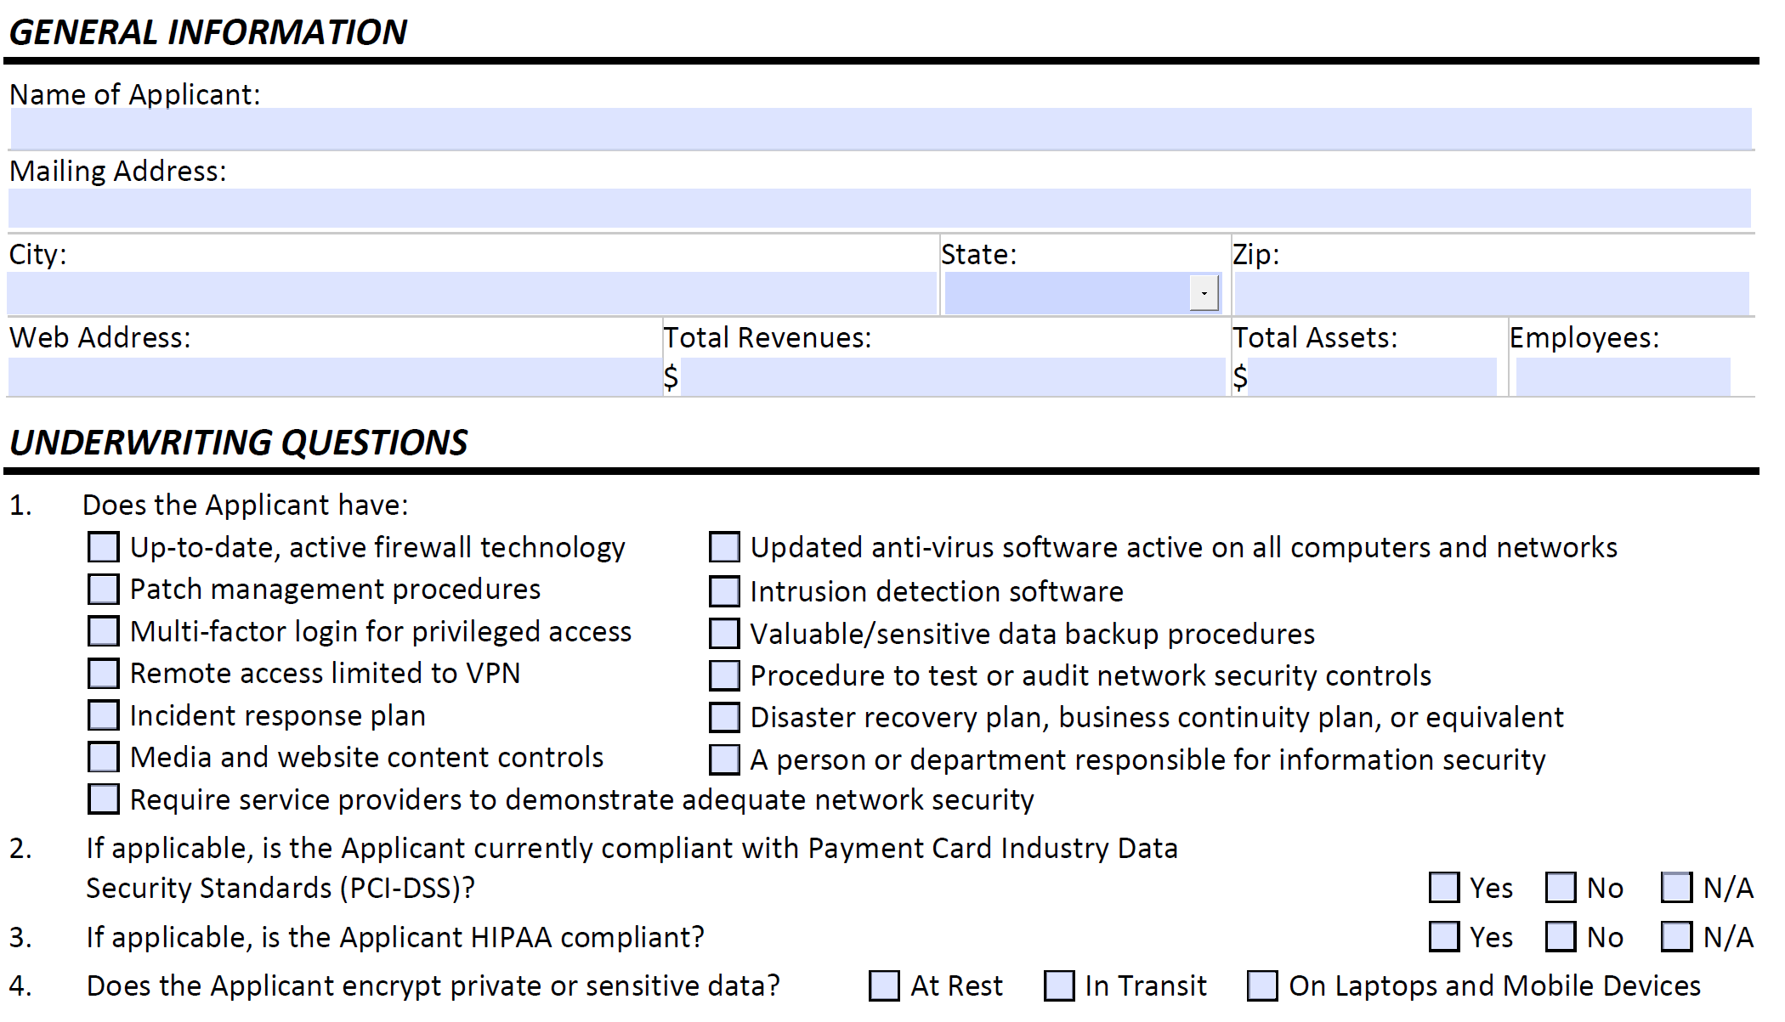

BUT, I have Cyber Insurance!

Slide 52

How Ransomware Infects Healthcare
Network-Wide Attacks
  Patches
  Ports
  People
  Perimeters

Slide 53

Security NOT a Focus in Most Hospitals
Physical PHI (Medical Billing, Medical Records)
Electronic PHI (unlocked computers, no encryption)
Failed Integrations
No Accountability
Issues with Interfaces

Slide 54

Door Openers for Ransomware

Slide 55
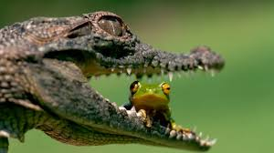
Hospitals – Here’s the Scary Part…
75% of small businesses (under 250 employees) believe that they are safe from hackers!

Slide 56
Business Associates are Your Achilles Heel…
75% of small businesses (under 250 employees) believe that they are safe from hackers!
AND MANY OF THEM
HAVE ACCESS TO
YOUR PHI!
Controller / Bank

Slide 57

$400,000 because you don’t have your BAA up-to-date?
http://www.healthcareitnews.com/news/care-new-england-pays-400000-hipaa-fine-lost-phi-business-associate-breach
My EHR is cloud based! I’m safe, right?
22% of ransomware is traceable to cloud vendors.

Slide 58
Ready to Improve?

Slide 60

Bring context to checklists and frameworks
Change Our Culture!

Slide 61
CHANGE CULTURE?
EDUCATE
Get staff interested in security
Build alliances

Slide 62
CHANGE CULTURE?
LEARN FROM MISTAKES
Share real life events.
What went wrong?
How do we prevent
this next time?

Slide 63
CHANGE CULTURE?
REWARD
Engage your team with metrics.
Set goals.
Celebrate
small wins.

Slide 64
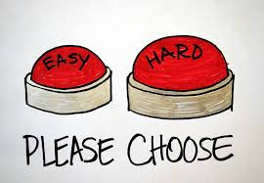
Notes:
Get The Easy Tech First: patching

Slide 65
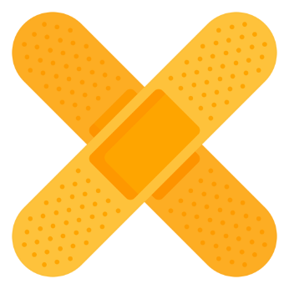
Patch Management Tracking
Most ransomware caused by unpatched machines– including big attacks like Equifax!
“Too many damn patches!”
Legacy vulnerabilities remain unpatched
Most cyberattacks targeting unpatched systems lag at least a month after a security patch is released (plenty of time to apply it!).

Slide 66
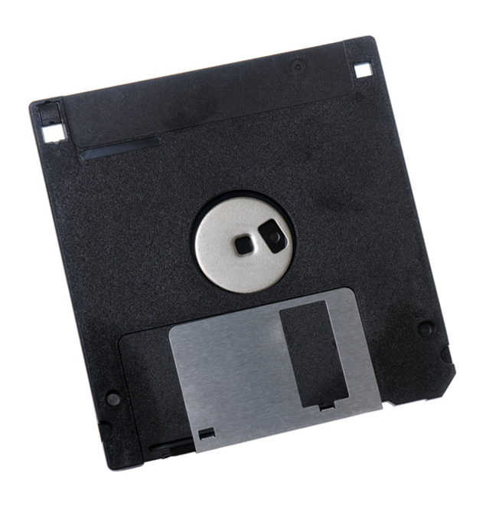
Backing Up Data OFF Network
Onsite vs Offsite backups?
Scheduled backups?
Test the backup?
Disaster recovery (what if your laptop is stolen)?

Slide 67


Slide 68

Understandable Policies
Making policies easy to follow and remember
Dealing with BYOD
Keeping sensitive data encrypted
Eliminating or limiting risks

Slide 69
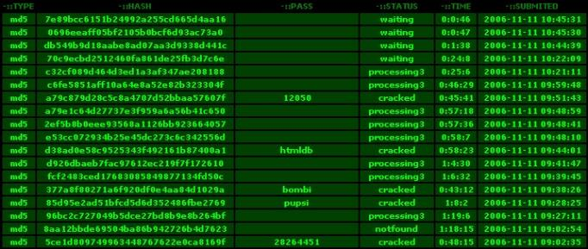
Hacked Passwords
Hackers have lists of hacked password
(Your password may be more commonly used than you’d think.)

Slide 70

Smart Firewalls
Heuristic-trained firewalls
Encapsulate ALL sensitive data
Channels through firewall for vendors
Monitor network and capable detecting suspicious activity
Right configuration is key!

Slide 71
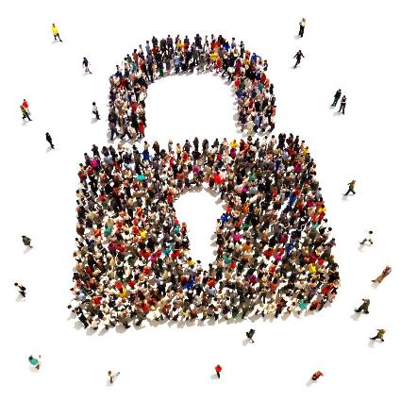
Educate Your Team:
Know How To Recognize A Scam
http://www.dynedge.com/email-phishing-scams-are-getting-more-sophisticated-is-your-team-prepared/

Slide 72
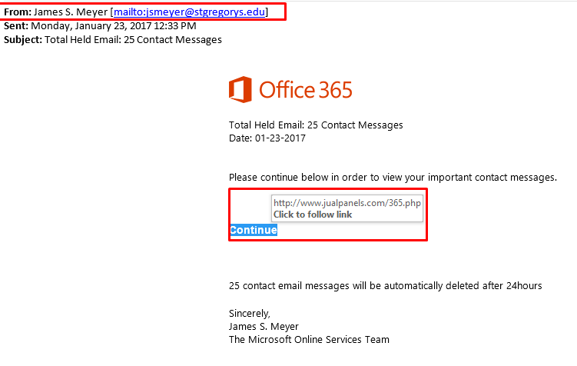

Slide 73
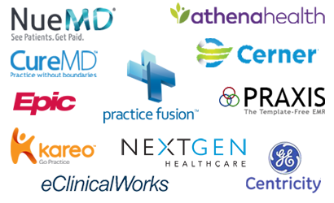
Protecting EHR Data
EHR vendors don’t necessarily keep data secure
BUT many expect you to have your security in order (written explicitly in their contracts)
EHR systems are inherently buggy (some hospital staff may have unsafe workarounds!)
How do you make sure your PHI is protected inside in your EHR system?

Slide 74

Don’t Just “Check a Box”
No Golden Checklist for Cybersecurity.
Know the Context for Your Security.
Revise Your Security Checklists As-You-Go (no checklist is complete or even comprehensive).
Experts Rely on Checklists as Reminders, NOT an End-All for Resolving Security Weaknesses.

Slide 75
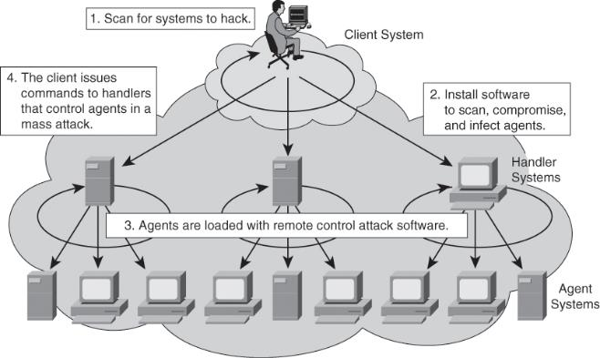
Identify and Prioritize Your Vulnerabilities

Slide 76
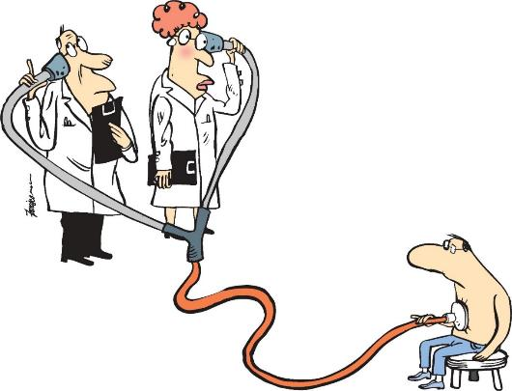

Slide 77

Due to the recent ransomware attacks on healthcare and breaches in our community, we decided we should do an assessment with Bruce and his team after seeing Bruce’s ransomware presentation at a local IT managers meeting. I wanted a better idea of how secure our hospital was from ransomware.
Bruce’s team provided a detailed report and, most importantly, spent time to explain it. I am happy I decided to invite our CFO to the meeting. It was good for him to have someone else explain our risks other than me in terms that he understood.
Bruce’s team explained everything at an executive level for our CFO, then turned around and broke down the details for my entire technical team. Bruce’s team brought to light security concerns my technical team or I were not aware of. Even if you have had a recent HIPAA risk assessment, I’d suggest you have the Healthcurity team out for a ransomware assessment. Certainly worth the investment.
Brian Howell
IT Director, War Memorial Hospital

Slide 78

Next Step…
Learn How You Are Doing
Performing 3 FREE Network Assessments

Slide 79
RECAP

Slide 80
What are the Main Causes of Economic Loss?
Allianz Security Study 2015

Slide 81
What is Preventing Organizations from Being Better Prepared against Cyber Risks?
Allianz Security Study 2015

Slide 82
$400,000 because you don’t have your BAA up-to-date?
http://www.healthcareitnews.com/news/care-new-england-pays-400000-hipaa-fine-lost-phi-business-associate-breach
Are you auditing your Business Associates?

Slide 83
Next Step…
Learn How You Are Doing
Performing 3 FREE Network Assessments

