Slide 1
Mississippi Rural Health Association
Jackson, Mississippi
May 3, 2019

Slide 2
Disclaimer
All Current Procedural Terminology (CPT) only are copyright 2018 American Medical Association (AMA). All rights reserved. CPT is a registered trademark of the American Medical Association. Applicable Federal Acquisition Regulation/ Defense Federal Acquisition Regulation (FARS/DFARS) Restrictions Apply to Government Use. Fee schedules, relative value units, conversion factors and/or related components are not assigned by the AMA, are not part of CPT, and the AMA is not recommending their use. The AMA does not directly or indirectly practice medicine or dispense medical services. The AMA assumes no liability for data contained or not contained herein.
The information enclosed was current at the time it was presented. Medicare policy changes frequently; links to the source documents have been provided within the document for your reference. This presentation was prepared as a tool to assist providers and is not intended to grant rights or impose obligations.
Although every reasonable effort has been made to assure the accuracy of the information within these pages, the ultimate responsibility for the correct submission of claims and response to any remittance advice lies with the provider of services.
Novitas Solutions’ employees, agents, and staff make no representation, warranty, or guarantee that this compilation of Medicare information is error-free and will bear no responsibility or liability for the results or consequences of the use of this guide.
This presentation is a general summary that explains certain aspects of the Medicare program, but is not a legal document. The official Medicare program provisions are contained in the relevant laws, regulations, and rulings.
Novitas Solutions does not permit videotaping or audio recording of training events.

Slide 3
Join Our Email List Today
Stay current with Medicare by receiving emails twice a week
Available email lists (not all-inclusive):
  Jurisdiction H
  Part B Electronic Billing
  Novitasphere Portal
  ABILITY| PC-ACE
  Medicare Remit Easy Print (MREP) Users
JH Providers join using:
  http://www.novitas-solutions.com/webcenter/portal/MedicareJH/pagebyid?contentId=00007968

Slide 4
Today’s Presentation
Agenda:
  2019 Medicare Updates and Reminders
    RHC Reminders
    RHC Top Claim Submission Errors
  Utilizing the Novitasphere Portal
Objectives:
  Identify and understand the current 2019 Medicare updates
  Understand the benefits of the Novitasphere Portal

Slide 5
Acronym List 1
Acronym | Definition
AIR | All Inclusive Rate
BHI | General Behavioral Health Integration
CCM | Chronic Care Management
CMS | Centers for Medicare & Medicaid Services
CNM | Certified Nurse-Midwife
CoCM | Psychiatric Collaborative Care Model
CPT | Current Procedural Terminology
CWF | Common Working Files
EIDM | Enterprise Identity Management
EHR | Electronic Health Records
ERA | Electronic Remittance Advice

Slide 6
Acronym List 2
Acronym | Definition
FAQ | Frequently Asked Questions
HCPCS | Healthcare Common Procedure Coding System
HETS | HIPPA Eligibility Transaction System
HMO | Health Maintenance Organization
IPPE | Initial Preventive Physical Exam
IVR | Interactive Voice Response
NP | Nurse Practitioner
MBI | Medicare Beneficiary Identifier
MLN | Medicare Learning Network
QMB | Qualified Medicare Beneficiary
PA | Physicians Assistant

Slide 7
Acronym List 3
Acronym | Definition
PPS | Prospective Payment System
RA | Remittance Advice
RHC | Rural Health Clinic
RTP | Return to Provider
SSA | Social Security Administration
TCM | Transitional Care Management

Slide 8
  2019 Medicare Updates and Reminders

Slide 9
Update to the RHC PPS
MM10989:
  Effective: January 1, 2019
  Implementation: January 7, 2019
Key Points:
  RHC PPS base payment rate is $84.70
    2019 base payment rate reflects a 1.5 percent increase

Slide 10
Care Coordination Services and Payment for Rural Health Clinics (RHCs)
MM10175:
  Effective: January 1, 2018
  Implementation: January 2, 2018
Key Points:
  Payment for care coordination services in RHCs by establishing two new G codes for use by RHCs :
    General Care Management HCPCS G0511:
      This code can only be billed once per month per beneficiary, and could not be billed if other care management services are billed for the same time period
    Psychiatric CoCM HCPCS G0512:
      This code can only be billed once per month per beneficiary, and could not be billed if other care management services are billed for the same time period
Current Procedural Terminology (CPT) only copyright 2018 American Medical Association. All rights reserved.

Slide 11
General Care Management Requirements (G0511)
RHCs can bill new General Care Management when:
  Practitioner furnishes a comprehensive E/M, AWV, or IPPE:
    Within one year of commencing care management services
  Beneficiary Consent:
    Obtained during or after the initiating visit
    Prior to care coordination services by RHC practitioner or clinical staff:
      Written or verbal, must be documented in the medical record
Eligible patients:
  Option A:
    Multiple (two or more) chronic conditions expected to last at least 12 months, or until the death of the patient and place the patient at significant risk of death
  Option B:
    Any behavioral health or psychiatric condition treated by the RHC practitioner:
      Including substance use disorders:
        Clinical judgment of the RHC practitioner, warrants BHI services
Current Procedural Terminology (CPT) only copyright 2018 American Medical Association. All rights reserved.

Slide 12
General Care Management Requirements (G0511) (cont.)
      Minimum of 20 minutes of care
Can only be billed once per month/per patient and by only one physician
RHCs cannot bill for CCM services for a beneficiary during the same service period as billing any other care management (outside of the RHC AIR) for the same beneficiary
Informing the patient that only one practitioner can furnish and be paid for the service during a calendar month
Comprehensive care plan is established implemented revised or monitored
Beneficiary must be able to receive notification and consent
Patients must be given a written or electronic care plan
Current Procedural Terminology (CPT) only copyright 2018 American Medical Association. All rights reserved.

Slide 13
General Care Management Requirements (G0511) EHR
Care plan must be a structured recording using EHR technology:
  Demographics
  Problems
  Medications/medication allergies
  Creation of a structured clinical summary record
  A full list of problems, medications and medication allergies in the EHR must inform the care plan, care coordination and ongoing clinical care
Access to care management services 24/7 that provides the beneficiary with a means to make timely contact with health care practitioners
Continuity of care with a designated practitioner or member of the care team with whom the beneficiary is able to get successive routine appointments
RHCs would continue to be required to meet the RHC Conditions of Participation and any additional RHC payment requirements
Coordinate with all health care providers:
  Documentation of communication
Current Procedural Terminology (CPT) only copyright 2018 American Medical Association. All rights reserved.

Slide 14
General Care Management Comprehensive Care Management
Eligibility requirements of Option B:
  Initial assessment or follow-up monitoring:
    Use of applicable validated rating scales
  Behavioral health care planning:
    Including revision for patients who are not progressing or whose status changes
  Facilitating and coordinating treatment:
    Psychotherapy, Pharmacotherapy, Counseling and/or Psychiatric consultation
  Continuity of care with a member of the care team

Slide 15
Psychiatric CoCM (G0512)
RHCs can bill Psychiatric CoCM when:
  Practitioner furnishes a comprehensive E/M, AWV, or IPPE:
    Within one year of billing the CCM
  Beneficiary Consent:
    Obtained during or after the initiating visit
    Prior to care coordination services by RHC practitioner or clinical staff:
      Written or verbal, must be documented in the medical record
  First calendar month:
    Minimum of 70 minutes:
      Under direction of RHC practitioner
  Subsequent calendar months:
    Minimum of 60 minutes:
      By RHC practitioner and/or Behavioral Heath Care Manager (under general supervision)
Can only be billed once per month/per patient and by only one physician
RHCs cannot bill for CCM services for a beneficiary during the same service period as billing any other care management (outside of the RHC AIR) for the same beneficiary
Current Procedural Terminology (CPT) only copyright 2018 American Medical Association. All rights reserved.

Slide 16
Psychiatric CoCM (G0512) Requirements
Eligible patients:
  Any behavioral health or psychiatric condition treated by the RHC practitioner:
    Including substance use disorders
    Clinical judgment of the RHC practitioner, warrants BHI services
Required elements:
  Psychiatric CoCM requires a team that includes the following:
    RHC (physician, NP, PA, or CNM):
      Directs the behavioral health care manager or clinical staff
    Oversees the patients care:
      Prescribing medications
      Providing treatments for medical conditions
      Referrals to specialty care when needed
Continues to oversee ongoing oversight, management, collaboration and reassessment
Current Procedural Terminology (CPT) only copyright 2018 American Medical Association. All rights reserved.

Slide 17
Psychiatric CoCM (G0512) Behavioral Health Care Manager
Behavioral Health Care Manager:
  Assessment and care management:
    Including the administration of validated rating scales
    Behavioral health care planning in relation to behavioral/psychiatric health problems:
      Including revision for patients who are not progressing or whose status changes
      Provision of brief psychosocial interventions ongoing collaboration with the RHC practitioner
      Maintenance of the registry
Acting in consultation with the psychiatric consultant
Available to provide services face-to-face with the beneficiary
Continuous relationship with the patient
Collaborative, integrated relationship with the rest of the care team
Available to contact the patient outside of regular RHC hours as necessary to conduct the behavioral health care manager’s duties
Current Procedural Terminology (CPT) only copyright 2018 American Medical Association. All rights reserved.

Slide 18
Psychiatric CoCM (G0512) Psychiatric Consultant
Psychiatric Consultant:
  Participates in regular reviews of the clinical status of patients receiving CoCM services
  Advises the RHC practitioner regarding diagnosis:
    Options for resolving issues with beneficiary adherence and tolerance of behavioral health treatment
  Making adjustments to behavioral health treatment for beneficiaries who are not progressing
  Managing any negative interactions between beneficiaries’ behavioral health and medical treatments
  Facilitate referral for direct provision of psychiatric care when clinically indicated
Current Procedural Terminology (CPT) only copyright 2018 American Medical Association. All rights reserved.

Slide 19
Communication Technology Based Services and Payment for RHC and FQHCs
MM10843:
  Effective: January 1, 2019
  Implementation: January 7, 2019
Key Points:
  RHCs can receive payment for Virtual Communication services when:
    At least five minutes of communication technology based or remote evaluation services are furnished
      RHC practitioner
    Patient who has had an RHC billable visit within the previous year
      Medical discussion or remote evaluation is for a condition not related to an RHC service provided within the previous seven days
      Medical discussion or remote evaluation does not lead to an RHC visit within the next 24 hours or at the soonest available appointment

Slide 20
Virtual Communication Billing
Payment for virtual communication services in RHCs by establishing a new G code for use by RHCs:
  Virtual Communication Services HCPCS G0071
G0071 can be billed either alone or on the same claim as a billable visit:
  Virtual communication services are not billable if an RHC visit was furnished within the previous seven days or the next 24 hours or soonest available appointment
Coinsurance and deductibles apply
Face-to-face billing requirement waived
  For 2019, the payment amount for code G0071 will be $13.69 (average of HCPCS codes G2012 and G2010)
Current Procedural Terminology (CPT) only copyright 2018 American Medical Association. All rights reserved.

Slide 21
Virtual Communication FAQs
Question:
  Are there any limitations on the number of times HCPCS code G0071 (Virtual Communication Services) can be billed for a single beneficiary?
Answer:
  No frequency limitations at this time
Question:
  Is beneficiary consent required before virtual communication services can be furnished?
Answer:
  Beneficiary consent should be obtained before virtual communication services are furnished in order to bill for the service
Virtual Communication FAQs
Current Procedural Terminology (CPT) only copyright 2018 American Medical Association. All rights reserved.

Slide 22
RHC Medicare Benefit Policy Manual Chapter 13 Updates
MM11019:
  Effective: January 1, 2019
  Implementation: January 2, 2019
Key Points:
  Chapter 13 of the Medicare Benefit Policy Manual is being updated and revised for RHCs :
    RHC PPS Update
    Care Management in RHCs as finalized in the Calendar Year (CY) 2019 Physician Fee Schedule Final Rule
    Virtual Communication Services

Slide 23
Update to Medicare Deductible, Coinsurance and Premium Rates for 2019
MM11025:
  Effective Date: January 1, 2019
  Implementation Date: January 7, 2019
Key Points:
  2019 Part A – Hospital Insurance:
    Deductible: $1,364.00
    Coinsurance:
      $341.00 a day for 61st-90th day
      $682.00 a day for 91st-150th day (lifetime reserve days)
      $170.50 a day for 21st-100th day (Skilled Nursing Facility coinsurance)
  2019 Part B –Medical Insurance:
    Deductible: $185.00 a year
    Coinsurance: 20 percent
Additional Reference:
  2019 Medicare Parts A & B Premiums and Deductibles Fact Sheet

Slide 24
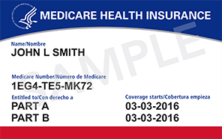
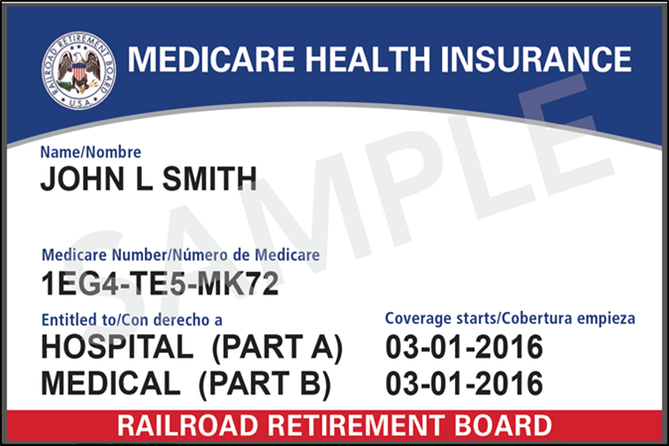
New Medicare Card
New Medicare card:
  Health and Human Services (HHS) logo
  Gender and signature line removed

Slide 25
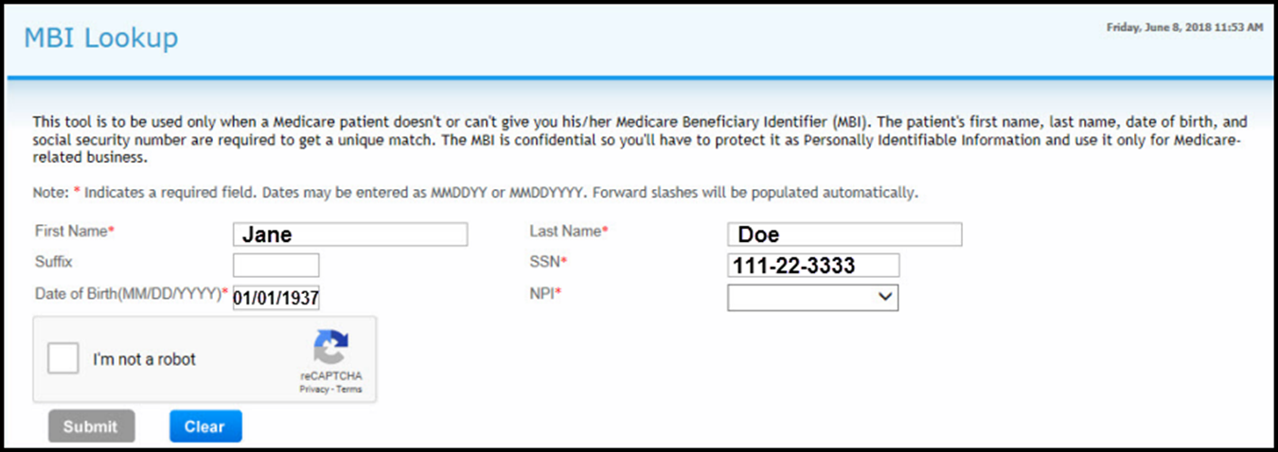
MBI Lookup
Select the MBI Lookup from the left navigation bar
Select your NPI from the drop down box
Complete the “I’m not a robot” verification once every 5 searches

Slide 26
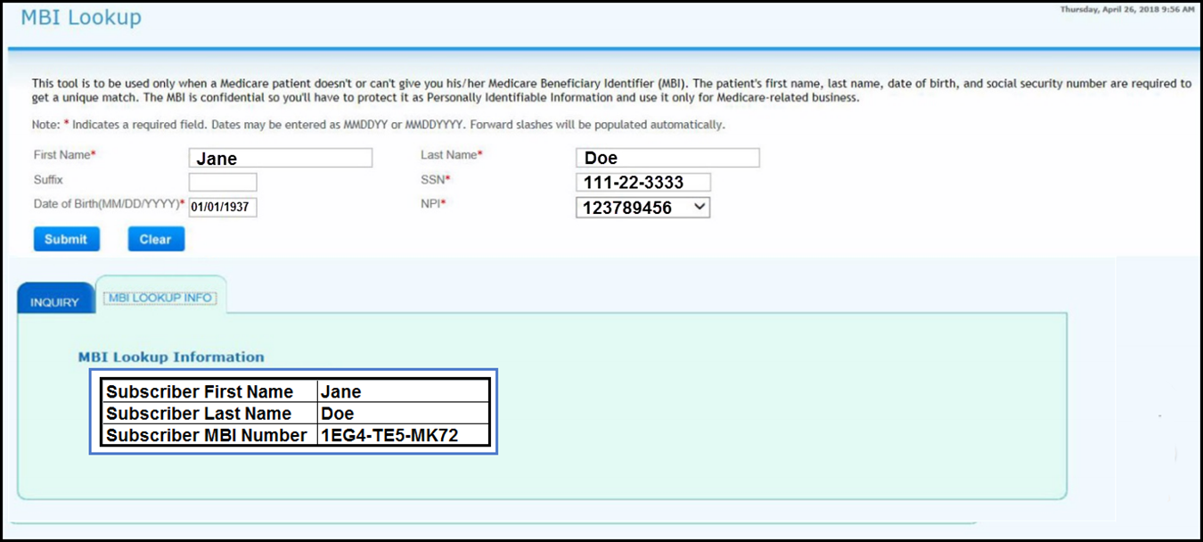
MBI Lookup Results

Slide 27
RHC Top Claim Submission Errors

Slide 28
Top Claim Submission Errors
JH Reason Codes
38200
U5233
C7010
32402
38031
W7091
U5061

Slide 29
Reason Code 38200/38031
Duplicate rejection:
  The newly submitted claim is a duplicate to a previously submitted outpatient claim
Research:
  Verify claims history to determine if another claim was submitted for this date of service:
Reason code action:
  If the posted claim is incorrect:
    Submit an adjustment correcting the information

Slide 30
Reason Code U5233
RTP error:
  No Medicare payment can be made because the statement covered period falls within or overlaps an enrollment period in a risk HMO
Research:
  Verify the statement covered period
  Verify the patients eligibility
Reason code action:
  Bill the claim to the beneficiaries HMO on file

Slide 31
Reason Code C7010
RTP error:
  The edited outpatient claim has a from/through date that overlap a hospice election period
Research:
  Verify the statement covered period:
    Hospice election period verified through Novitasphere, Fiscal Intermediary Shared System (FISS), HETS or Interactive Voice Response (IVR)
Reason code action:
  Related to the terminal illness:
    Bill the Hospice
  Unrelated to the terminal illness:
    Resubmit the claim to Medicare with the appropriate condition code 07

Slide 32
Reason Code 32402
RTP error:
  Invalid revenue code for a HCPCS code reported or HCPCS is not valid for the date on which services were provided
Research:
  Verify the revenue code billed
  Verify the HCPCS code billed
  Verify the “from” and “through” dates
Reason code action:
  Once revenue, HCPCS and/or from and through dates verified and corrected F9 claim for processing

Slide 33
Reason Code W7091
RTP error:
  Non RHC services
Research:
  https://www.cms.gov/Regulations-and-Guidance/Guidance/Manuals/Downloads/bp102c13.pdf section 60
Reason code action:
  Bill Part B CMS 1500 claim form

Slide 34
Reason Code U5061
Rejection:
  Invalid Health Insurance Claim number, not found in the Common Working File crosswalk
Research:
  Verify with the beneficiary for their valid Medicare number:
    Verify the Medicare number using, Novitasphere, Fiscal Intermediary Shared System (FISS), HIPPA Eligibility Transaction System (HETS) or Interactive Voice Response (IVR)
Reason code action:
  Resubmit claim with corrected Medicare number

Slide 35
  Utilizing the Novitasphere Portal

Slide 36
What is Novitasphere?
Free, secure web-based portal
Part A – Access to Eligibility, Claim Submission with File Status, ERA, Medical Review Record Submission, and Audit and Reimbursement Cost Reports Submission
Part B - Access to Eligibility, Claim Information and Remittance Advice, Claim Submission with File Status, ERA, Claim Correction, Secure Messaging and a Mailbox
Live Chat feature
Dedicated Help Desk- 1-855-880-8424
For demonstrations and more information:
  JH Providers:
    http://www.novitas-solutions.com/webcenter/portal/Novitasphere_JH/

Slide 37
Reminder: Keep your Novitasphere Access Active
Tips to maintain access:
  Set a recurring reminder on your calendar or phone
  Use the buddy system!
    Remind your colleagues to keep their access active, and ask them to remind you too
  Call for help:
    If you are having trouble successfully logging in, contact the Novitasphere Help Desk
    The Help Desk can assist with password issues, locked Multi-Factor Authentication (MFA) devices, and adding additional MFA devices
  Sign up for the Novitasphere email lists:
    We don’t want to see you lose your access – so we issue monthly reminders
  Check your vacation schedule!
    Log in before leaving if you will be out of the office for an extended time

Slide 38
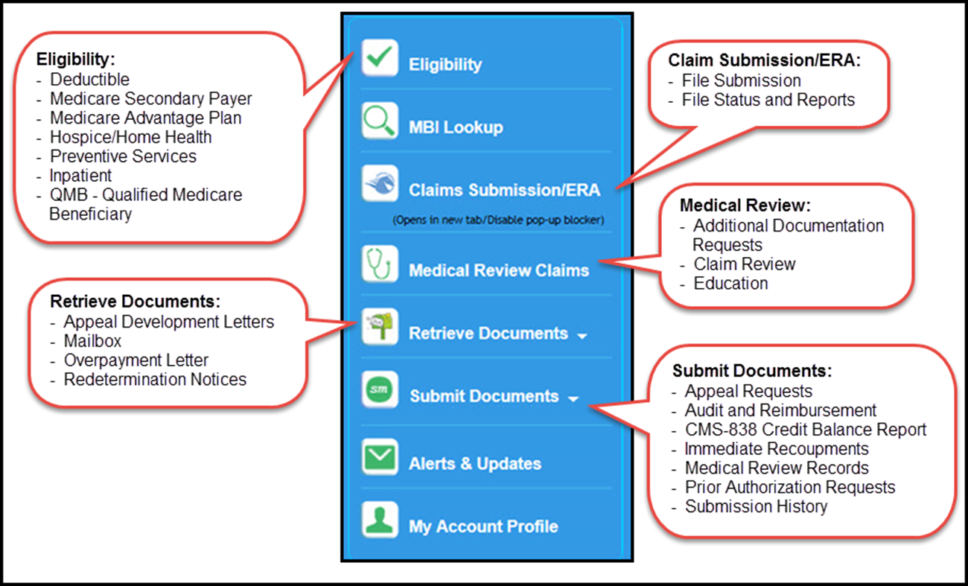
Novitasphere Feature List

Slide 39
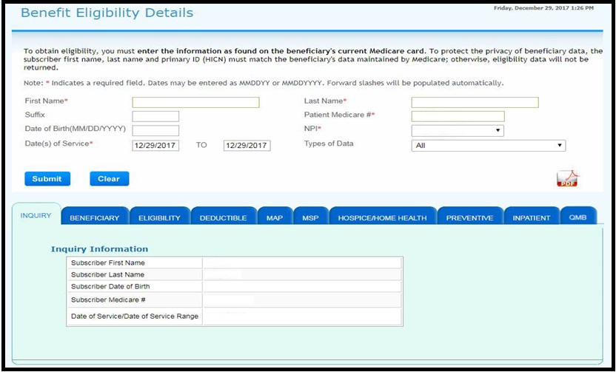
Benefits & Eligibility

Slide 40
Eligibility Information
Eligibility
  Part A and B Eligibility Effective and Termination Dates
  End Stage Renal Disease (ESRD) dates and information
Deductible
  Part B Total Deductible Remaining for Calendar year
  Occupational, Physical and Speech Therapy amounts applied to the capitation limits
  Rehabilitation Session counts
Medicare Advantage Plan (MAP)
  Contract Name, Number, Address and Telephone Number
  Plan number and Plan Name
  Type of Medicare Advantage Plan
  The Bill Option code of the Plan type
  Effective and Termination Dates
Medicare Secondary Payer (MSP)
  The reason Medicare is secondary
  Effective and Termination Dates
  MSP Diagnosis Codes
  Name of Insurance Company and Address
Hospice/Home Health
  Certification codes and dates
  Home Health Episode Start and End Dates
  Home Health Episode termination date
  Provider NPI Number of the Home Health Facility
Preventive Services
  Number of Smoking Sessions remaining for the Preventive Service Procedure Code
  Medicare Diabetes Prevention Program (MDPP) usage
  Preventive Technical and Professional Dates
  Deductible Applied for the Calendar Year
  Deductible Remaining for the Calendar Year
  Coinsurance Remaining for the Calendar Year
Inpatient
  Date of earliest and latest billing activity for the spell of illness
  Hospital Information
  Skilled Nursing Facility Information
QMB
  QMB Effective and Termination Dates
  QMB Deductible and Coinsurance Remaining
  QMB Inpatient Spell, Hospital Information and SNF Information

Slide 41
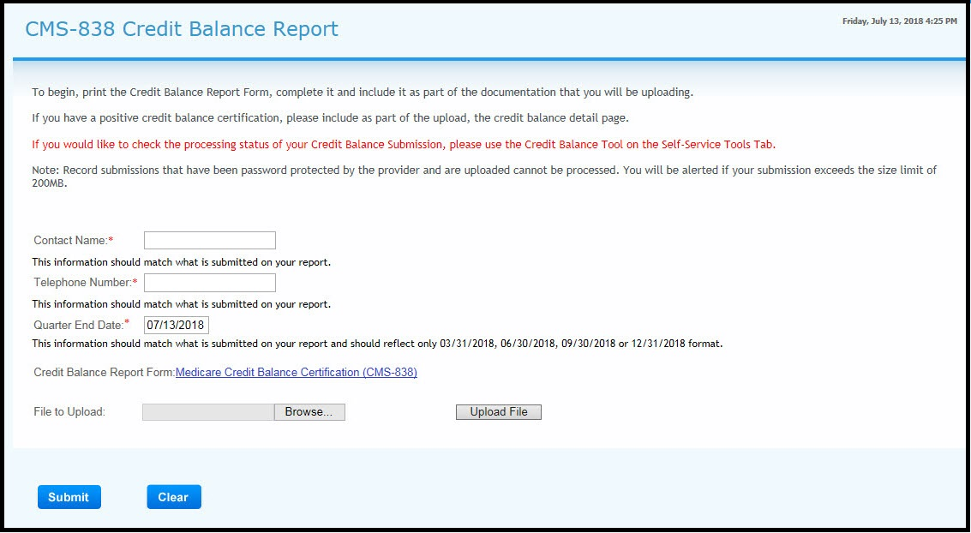
CMS-838 Credit Balance Report

Slide 42
Novitasphere References
Novitasphere Provider Portal Enrollment Overview Training Module:
  JH Providers:
    http://novitas-solutions.com/cs/idcplg?IdcService=GET_FILE&RevisionSelectionMethod=LatestReleased&dDocName=00082245&allowInterrupt=1
EIDM Registration Instructions:
  JH Providers:
    http://www.novitas-solutions.com/webcenter/spaces/MedicareJH/page/pagebyid?contentId=00024651
Novitasphere Portal Enrollment Forms:
  JH 8292PJH:
    http://www.novitas-solutions.com/webcenter/spaces/MedicareJH/page/pagebyid?contentId=00081357
  JH 8291PJH:
    http://novitas-solutions.com/cs/idcplg?IdcService=GET_FILE&RevisionSelectionMethod=LatestReleased&dDocName=00094673&allowInterrupt=1

Slide 43
Summary
Provided the latest news, updates, reminders and top claim submission errors
Demonstrated the user-friendly functionality of the Novitasphere Portal

Slide 44
Thank You
Kim Robinson
  Education Specialist, Provider Outreach and Education
  Kim.Robinson@novitas-solutions.com
  442-400-7523
Janice Mumma
  Supervisor, Provider Outreach and Education
  janice.mumma@novitas-solutions.com
  717-526-6406
Stephanie Portzline
Manager, Provider Engagement
Stephanie.Portzline@novitas-solutions.com
717-526-6317

