Slide 1

A CASE STUDY OF
EC-HEALTHNET RESIDENCY
PROGRAM
PRESENTED BY :
JAMES L. VALENTINE, D.O.
FACULTY – EC-HEALTHNET
TIMOTHY W. THOMAS, MBA,MRHF
CHIEF FINANCIAL OFFICER, EC-HEALTHNET

Slide 2
Can the Establishment of a Rural Medical Residency Increase Access to Primary Care Physicians and Function as a Driver to Economic Growth and Development to the Region and State?

Slide 3
INTRODUCTION

Slide 4
EC-HealthNet is comprised of a consortium of hospitals in East Central Mississippi and West Alabama created for the establishment of a regional residency program predicated on five core components:

Slide 5
Establishing a community-based residency program provides the greatest opportunity to train and recruit physicians into the region.
Acknowledgement that the traditional sole/tertiary hospital residency program is neither practical nor financially feasible within the region.
Consortium of regional medical facilities provides the best approach to cost sharing and cost effectiveness.
The advent of the William Carey University College of Osteopathic Medicine (WCUCOM) provides a golden opportunity to attract medical students into the region for community-based residency training.
A residency program can have a significantly high return on investment for the economic development of the region

Slide 6
EC-HealthNet anticipates significant improvement in the recruitment and retention of Primary Care Physicians in the region through the Residency Program.
Evidence indicates that 75% of family medicine resident physicians who train in rural practice remain in rural setting.
Evidence also indicates that 50% of residents stay within a 75 mile radius of training site, after having been immersed in this care environment for the entire length of their residencies and establish roots in the community.
Notes:
Lewin group report 2011

Slide 7
Increased access to primary care will improve the health and quality of life of the residents of East Central Mississippi and West Alabama.
In addition to the potential health benefits to the resident population in the region, there is also significant economic impact. For each physician retained in the region and state, the annual economic impact for Mississippi is calculated at approximately $1.8 million (National Economic Impact of Physicians 2018).

Slide 8
ORGANIZATION

Slide 9
EC-HealthNet is the host organization for the EC-HealthNet Residency Consortium. EC-HealthNet is a 501(c)(3) non-profit corporation governed by its Board of Directors, which consists of appointed representatives from each of the seven (7) participating hospital member organizations. The board members have equal votes of one per organization.

Slide 10
The EC-HealthNet geographic region is located in East Mississippi and West Alabama and concentrated in a 40 mile radius around the hub, Meridian, Mississippi. The region encompasses the following 7 counties and populations (Census 2010):
Lauderdale, MS 80,261
Newton, MS 21,720
Neshoba, MS 29,676
Kemper, MS 10,456
Sumter, AL 13,763
Choctaw, AL 13,859
Clarke, MS 16,732

Slide 11
The EC-HealthNet Residency Consortium consist of the following member hospitals:
Tertiary Care Hospitals
Anderson Regional Medical Center North – Meridian, MS
Rush Foundation Hospital – Meridian, MS
Primary Acute Care Hospitals
Anderson Regional Medical Center South – Meridian, MS
Critical Access Hospitals
Laird Hospital – Union, MS
John C Stennis Memorial Hospital – Dekalb, MS
H C Watkins Memorial Hospital – Quitman, MS
Choctaw General Hospital – Butler, AL

Slide 12
RESIDENT TRAINING DATA

Slide 13
In August 2013, EC-HealthNet received accreditation from the American Osteopathic Association (AOA) for a Family Medicine residency program for up to 18 residents. The program received ACGME accreditation in Oct 2017 and now accepts both AOA (D.O.) and ACGME (M.D.) medical residents for training.
EC-HealthNet accepted its first class of residents in July 2014 for Academic Year 2014-2015. Since that time, the Program has completed 4 resident classes (25 residents) and graduated 2 classes (10 residents). The focus of this case study relates to those 10 program graduates.

Slide 14
TABLE 1:
Resident data that tracks resident graduates post program status to identify practice type, state, and city. Also categorizes and calculates percentages of post program status by rural, primary care, region (East Central Mississippi – EC MS), and state (Mississippi - MS). As evidenced, the program reflects significant success in graduating physicians into rural and primary care settings primarily located in Mississippi.

Slide 15
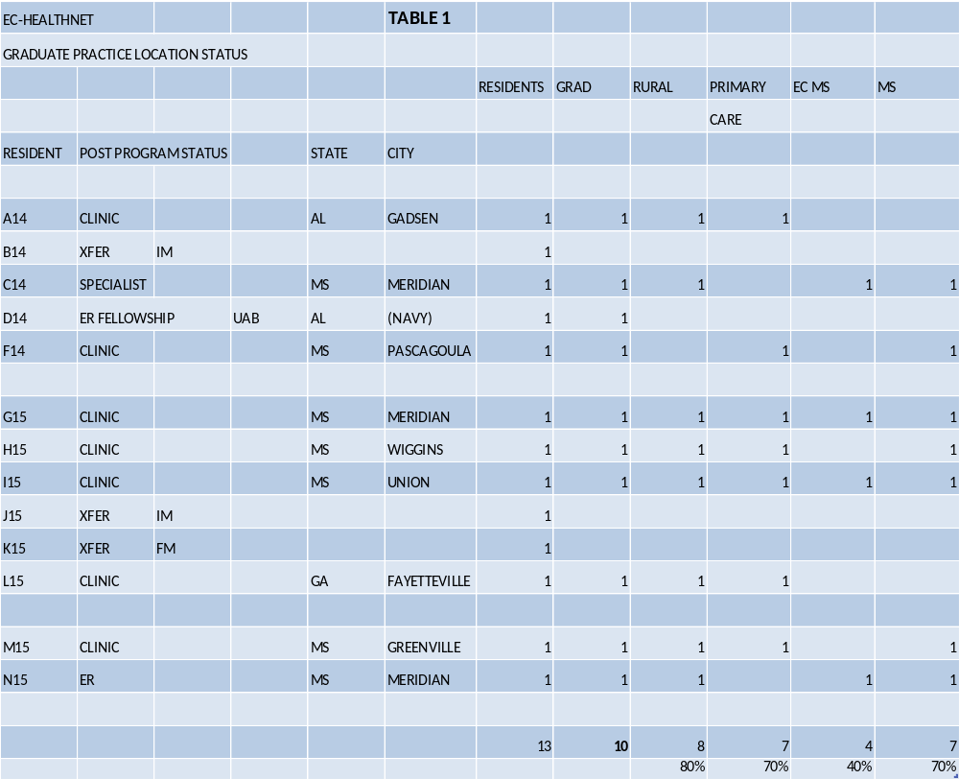

Slide 16
TABLE 2:
This table tracks residency program cost data. Cost is allocated and assigned to each resident by training year in order to calculate a projected return on investment for the program by various groupings. Note that the table also reflects cost related to transfer residents for inclusion in ROI calculations. The ROI cost per graduate resident (10) from the program is calculated at $431K.

Slide 17
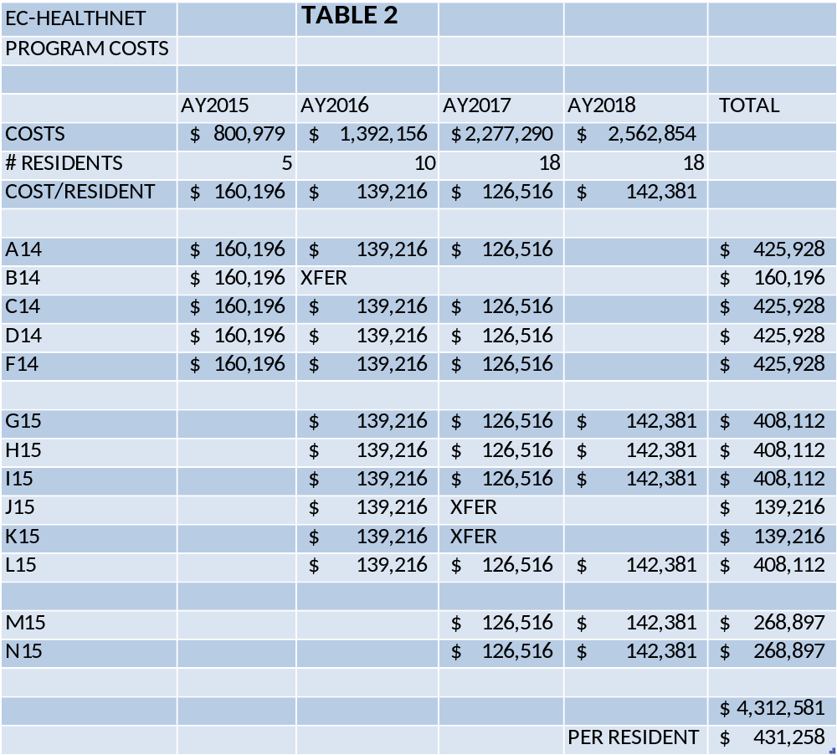

Slide 18
TABLE 3:
This table reflects the total ROI for all program graduates (over 11:1).
ROI is expressed in both dollars and ROI ratio ($ return per $1 invested). ROI is conservatively calculated on only a three year basis to match the resident training period.

Slide 19
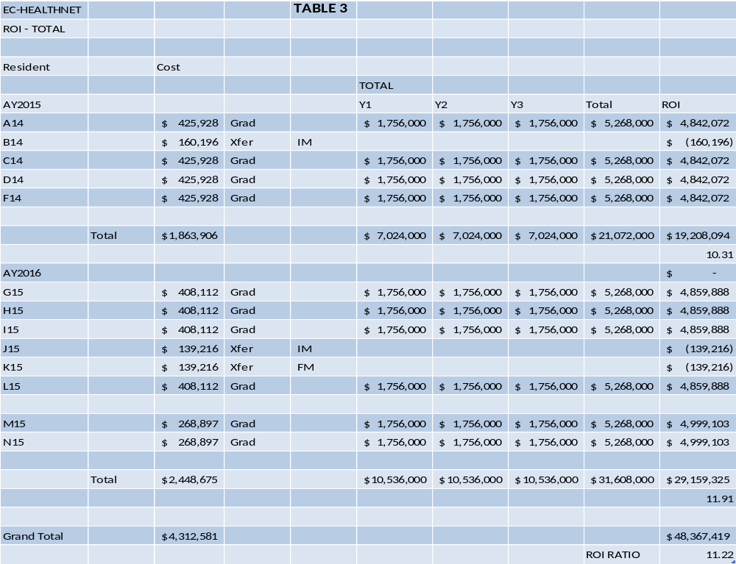

Slide 20
TABLE 4:
This table reflects the Mississippi ROI for all
program graduates (over 7:1).

Slide 21
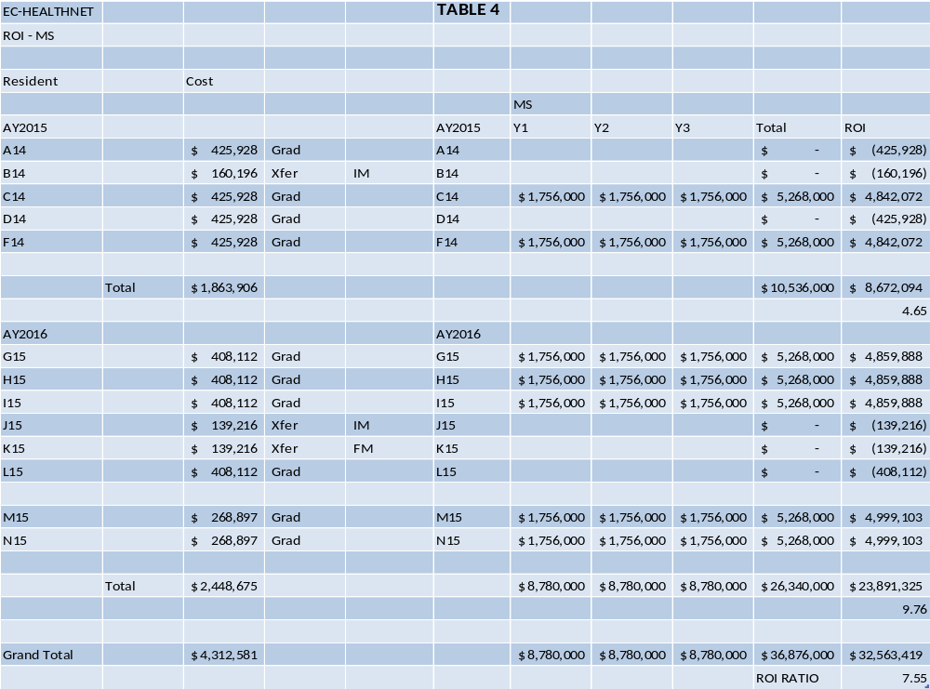

Slide 22
TABLE 5:
This table reflects the East Central Mississippi ROI for all program graduates (approximately 4:1).

Slide 23
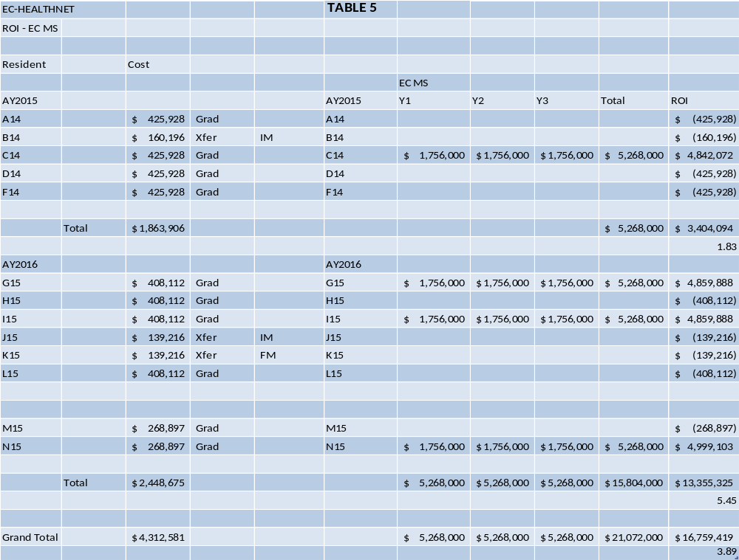

Slide 24
Summary Findings

Slide 25
Physician Placement:
80% of program graduates currently practice in rural site (Table 1)
70% of program graduates currently practice in primary care setting (Table 1)
40% of program graduates currently practice in East Central Mississippi region (Table 1)
70% of program graduates currently practice in the state of Mississippi (Table 1)

Slide 26
Economic Impact and ROI:
Return on investment (ROI) ratio:
Total Program - 11.22 (Table 3)
Mississippi - 7.55 (Table 4)
East Central Mississippi Region - 3.89 (Table 5)

Slide 27
An investment in a Residency Training Program in East Central Mississippi has been significantly effective in the:
Successful placement of primary care physicians in rural area
Successful recruitment of primary care physicians in the region and state
Significantly high return on investment
Strong economic impact to the region, state, and country

Slide 28
www.echealthnet.com

