Slide 1


Getting Physicians and Executives to say “Yes” to the Quality Agenda
Mississippi Rural Health Association
October 31, 2018
©2018 nThrive, Inc. All rights reserved.

Slide 2

About the speaker
MACRA & Bundled Payments subject matter expert (SME) with extensive technical savvy and communication skills.
20 years technical experience with software architecture, database administration, and hands-on software development.
15 years leadership experience and program development in the private and political sector.
Over 5 years experience with quality reporting, continuing medical education, and health care analytics.
Moshe Starkman
Senior Director, Value-based Reimbursements
CREDIT: Much of the change management text is from
https://www.strategy-business.com/article/rr00006

Slide 3

What is the “Quality Agenda”?
Moving away from fee-for-service (volume) payments and towards managed costs
and quality promoting payment models.
A mandate to increase secure information sharing, patient access, improve the patient experience, and manage costs through technology, reformed payment models and practice improvement.
©2017 nThrive, Inc. All rights reserved.
3

Slide 4

Outcomes that matter to patients
Value =
Cost
– Michael Porter
Notes:
CARL
Producing Value in healthcare is a MANDATE today. It’s usually defined as quality in relation to cost. Howeever, something to keep in mind is the emerging realization that the way patients perceive value is an emerging priority.

Slide 5
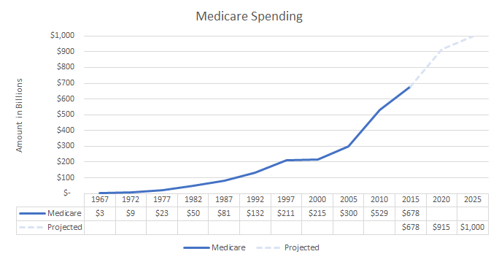
The retirement boom of the 21st century!
©2018 nThrive, Inc. All rights reserved.
Notes:
Medicare payment methods have been inflationary, prompting considerable legislative activity in subsequent years to control escalating costs.
Sources:
https://www.cms.gov/research-statistics-data-and-systems/statistics-trends-and-reports/nationalhealthexpenddata/nhe-fact-sheet.html
http://healthblog.ncpa.org/mission-impossible-obamacare%E2%80%99s-planned-cuts-in-medicare-spending/#sthash.D8BX6Wc2.dpbs

Slide 6
Quality impacts 3 major aspects of health care
Reimbursements: Payments that are based on established expectations and a degree of accountability on the part of the provider. i.e. shared risk!
Revenue: Fewer fee-for-volume payments in favor of managed costs and quality improvement through value-oriented reimbursement models.
Technology: Mandates to increase secure information sharing and patient access through an emphasis on cloud-based technology and practice improvement.
©2018 nThrive, Inc. All rights reserved.
Notes:
Revenue: hospital inpatient revenues diminish under MACRA due to losses that will result from physicians responding to payment models in ways that reduce the use of hospital care, such as avoiding admissions and re-admissions. Hospitals can make their margin through reducing costs, increasing outpatient revenues, and improving the management of the health of the populations they serve.
Technology: promoting interoperability

Slide 7
Value-Based Care Reduced Costs by 5.6%, Improves Care Quality
Payers are seeing value-based care models start to achieve the Triple Aim as fee-for-service declines to just 37.2 percent of reimbursements in 2018.

Slide 8
Value-based Care adoption
Per a recent KPMG study, 46 percent of healthcare executives and managers expect value-based reimbursement contracts to improve their organization’s profitability.
This is up from just 23 percent two years ago.
©2017 nThrive, Inc. All rights reserved.

Slide 9
It’s been almost 4 years and successful.
Why isn’t value more popular?

Slide 10
Sometimes math isn’t enough!
Risky driving
Winning the lottery
Distracted driving accounts for approximately 25% of all motor vehicle crash fatalities.
“It won’t happen to me.”
The odds of winning is roughly 1 in 259 million for Mega Millions and 1 in 292 million for its cousin, Powerball.
“Hey, you never know!”
Notes:
-- according to data scientists at Allstate.

Slide 11


Challenges Facing Rural Health Care
The Quality Payment Program (QPP) will play an instrumental role in continuing to improve access to care and population health for patients living in rural areas by encouraging providers to deliver data-driven, value-based services.
©2017 nThrive, Inc. All rights reserved.
Notes:
Rural practices tend to employ many non-physician clinicians who may be subject to MIPS; unlike with PQRS where the program was physician focused.

Slide 12
Rural Challenges: Technology & Access
Many rural health care organizations struggle with numerous health IT challenges.
For example, “lower-than-average EHR adoption rates among rural providers and critical access hospitals (CAHs) make it difficult to engage in risk stratification, preventative health strategies, and population health management programs.”
Additionally, some providers lack reliable access to broadband internet required for timely and consistent health information exchange, patient engagement, and telehealth.
©2017 nThrive, Inc. All rights reserved.

Slide 13
Rural Challenges: Return on Investment (ROI)
Do the upside incentives justify the investment costs?
Scenario:
You bill $100,000 in Medicare Part B charges and see 201 Medicare beneficiaries.
To FULLY participate in MIPS; technology upgrades, staff training, analytics, and admin overhead will cost roughly $40,000 in year 1 and $15K in subsequent years.
The upside incentive in Year 2 is 5%, i.e. $5,000. In 2019 the upside incentive is $7,000 and in 2020 it’s $9,000.
©2017 nThrive, Inc. All rights reserved.

Slide 14
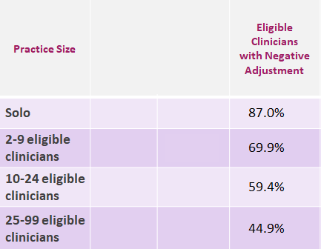
MACRA Proposal: Table 64
On page 676 of the MACRA
Practice Size | Clinicians | Physician Fee Schedule Allowed Charges (S Mil) | Eligible Clinicians with Negative Adjustment | Eligible Clinicians with Negative Adjustment | Percent Eligible Clinicians with Positive Adjustment | Clinicians with Positive Adjustment | Clinicians with No Adjustment
Solo | 102,788 | $12 458 | 87.0% | 89,383 | 12.9% | 13,302 | 103
2-9 eligible clinicians | 123,695 | $18 697 | 69.9% | 86,519 | 29.8% | 36,887 | 289
10-24 eligible clinicians | 8,207 | $9 934 | 59.4% | 48,213 | 40.3% | 32,737 | 257
25-99 eligible clinicians | 147,976 | $12 868 | 44.9% | 66,515 | 54.5% | 80,588 | 873
100 or more eligible clinicians | 305,676 | $18,648 | 18.3% | 56,045 | 81.3% | 248,626 | 1,005
Overall | 761,342 | $72,606 | 45.5% | 346,675 | 54.1% | 412,140 | 2,527
Notes:
The House of Representatives voted 392-37 on March 26, 2015 to permanently repeal the sustainable growth rate (SGR) formula for Medicare physician reimbursement, putting the bill's fate in the hands of the Senate. (Source: http://clerk.house.gov/evs/2015/roll144.xml)
In a historic move on April 14th, 2015, the Senate voted 92-8 to permanently repeal the sustainable growth rate (SGR) formula for physician reimbursement under Medicare.
Yeas - 46 Republican, 44 Democrats, and 2 Independents
Nays – 8 Republicans

Slide 15
Rural Challenges: Quality Reporting Demands
Do you have the resources to keep up with evolving quality reporting requirements from both CMS and private payers?
Data collection and management
Analytics, reports, and data submission
Keeping track of different requirements for each quality reporting entity.
©2017 nThrive, Inc. All rights reserved.

Slide 16
Health Care Leadership: Trustees / CEO
Situation: The transition from fee-for-service to value-based health care essentially repositions health care from a product model to a service model. This significantly changes the business metrics of hospital management for both short and long term practice operations.
Action: Trustees and hospital executives need to periodically weigh the financial risks and benefits of participating in risk-based programs. The decision on which path to take and at what level can significantly alter the eventual outcomes.
Impact: Succeeding under value-based care requires that a population-health oriented mentality become part of the corporate vision and mission.
Discussion topic: What role does hospital leadership play in the transition to value-based payment models?
©2017 nThrive, Inc. All rights reserved.

Slide 17
But wait… there’s more!
Notes:
Get in front of the data. Make sure it’s accessible, reliable, and actionable. Easy to use, non-technical technology IS the answer.

Slide 18
Technology in Value-Based Care & Patient Engagement
eHealth Initiative’s research and work on value-based care was supported by Availity, the nation’s largest real-time health information network.
“The challenge for today’s healthcare provider is unleashing healthcare data that facilitates consumer-centered engagement and real-time information-sharing with patients, payers and other providers.” said Russ Thomas, CEO of Availity. “However, our data-driven world makes unraveling the complexities of measuring value and assessing risk possible.”
Credits: eHealth Initiative
https://www.ehidc.org/articles/role-technology-value-based-care-patient-engagement
Notes:
Washington, D.C. – March 21 – eHealth Initiative
Twelve executives, primarily from provider organizations and health information networks (HINs), were interviewed for this research project.

Slide 19
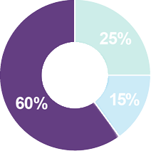
Value-based Care is Driving Technology Investments!
A recent survey by Damo Consulting on “Healthcare IT Demand in 2018” showed that value-based care initiatives accounted for over 60 percent of why our U.S. health care providers are investing in technology in 2018.
Data and analytics were by far the biggest area identified by survey respondents (76 percent).
Credits: Healthcare Informatics
https://www.healthcare-informatics.com/news-item/value-based-care/survey-value-based-care-top-driver-health-tech-spending-2018

Slide 20
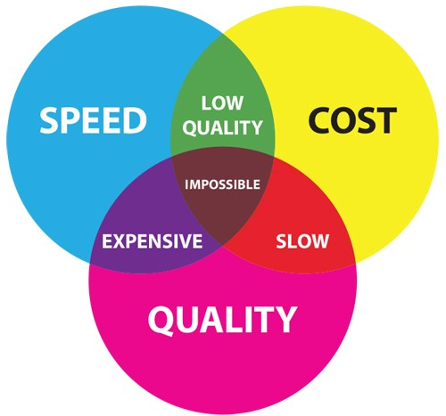
Project Management Triangle
©2018 nThrive, Inc. All rights reserved.

Slide 21


Cost OR Quality
Reduce
Costs
Increase
Accessibility
Technology
and Analytics
are doing
the impossible!
Value-
Based
Care
Strong Health IT
& Reliable Data
CDI & ICD-10
Improve
Outcomes
©2018 nThrive, Inc. All rights reserved.

Slide 22
What would you do if you were… CTO?
Situation: Technology is a central component of valuable health care and increased patient engagement. The Promoting Interoperability category of MIPS, for example, is specifically designed to encourage EHR upgrades and promote technology utilization and patient access.
Action: Almost equal in scope to the paradigm shift from fee-for-service to fee-for-value is the shift from HIT as a solution to HIT as a service. Technology leaders are going to have to go beyond training internal staff and begin to consider how best to engage patient populations to create stronger provider-patient relationships.
Impact: In an age of increasingly digital health care, the technology employed by a health system is almost as important as the staff that use it.
Discussion topic: How could technology make you (or has made you) a more proficient and or effective provider of health services?

Slide 23
Technology in Value-Based Care & Patient Engagement
On March 21, 2018, eHealth Initiative released a report on the impact of healthcare reimbursement policies on technology and revenue cycle. Analytics was prominent theme and interviewees felt strongly about the value of data in improving patient outcomes.
“One of the most interesting findings from our interviews is the impact that industry consolidation is having on providers’ data-sharing habits,” said Jennifer Covich Bordenick, Chief Executive Officer of eHealth Initiative & Foundation. “Executives are rethinking how to manage and share data, specifically they are seeing the value of outsourcing and sharing data more broadly. We needed this to happen for value-based care practices to spread, and it looks like it is happening.”
Credits: eHealth Initiative
https://www.ehidc.org/articles/role-technology-value-based-care-patient-engagement
Notes:
Washington, D.C. – March 21 – eHealth Initiative
Twelve executives, primarily from provider organizations and health information networks (HINs), were interviewed for this research project.

Slide 24
What would you do if you were… CIO?
Situation: The widespread adoption of electronic medical records has repositioned the focus of health data away from “how do I capture this information?” to “what more can I do with it?” Additionally, the IoT (Internet of Things) has ushered in an era of unparalleled data collection and supplemental patient information. More data capture and greater clinical detail increases the risk of error.
Action: The sophistication of contemporary analytics tools, all the way up to machine learning, aka artificial intelligence, drastically increases the need for sound data collection practices and a very strong emphasis on quality control. Position your health system to see beyond descriptive data through predictive data analytics and intelligence augmenting solutions.
Impact: Identifying the root causes of errors and eliminating inaccuracies to the fullest extent possible is even more important than ever before.
Discussion topic: Do you trust your data at face value?
Notes:
VBR will compel leadership to consider not only current performance scores but how those scores compare to national trends as well.

Slide 25
Where do we go from here?
Change Management Considerations
Notes:
Get in front of the data. Make sure it’s accessible, reliable, and actionable. Easy to use, non-technical technology IS the answer.

Slide 26
People are resistant to change
Any significant transformation creates “people issues.” New leaders will be asked to step up, jobs will be changed, new skills and capabilities must be developed, and employees will be uncertain and resistant.
A formal approach for managing change — beginning with the leadership team and then engaging key stakeholders and leaders — should be developed early, and adapted often as change moves through the organization.
Changes should be based on a realistic assessment of the organization’s history, readiness, and capacity to change.
“Failing to plan is planning to fail.”
Notes:
Credits: https://www.strategy-business.com/article/rr00006
Dealing with these issues on a reactive, case-by-case basis puts speed, morale, and results at risk.
This demands as much data collection and analysis, planning, and implementation discipline as does a redesign of strategy, systems, or processes.

Slide 27



Key Areas and Roles Affected by Value
LEADERSHIP NEEDS TO BE ENGAGED AND ALIGNED
CLINICAL
FINANCIAL
TECHNOLOGY
Chief Medical Officer
Chief Medical Information Officer
VP/Dir. of Physician Services
Director of Quality
Physician Group Leadership
Chief Financial
Officer
Vice President
Revenue Cycle
Director of HIM
Chief Technology Officer
Chief Information Officer
IT Director
Director/Manager
of Analytics
©2018 nThrive, Inc. All rights reserved.
Notes:
The Quality Payment Program is not something that is owned by one department to manage on its own. Many department leaders and associated staff must understand value-drive health care — Clinical, Financial and Technology groups within an organization, all are affected by MACRA and they all must understand how to best meet the requirements.

Slide 28
Start at the Top
Because change is inherently unsettling for people at all levels of an organization, when it is on the horizon, all eyes will turn to the CEO and the leadership team for strength, support, and direction.
Leaders must embrace the new approaches first to both challenge and motivate the rest of the institution.
The executive team also needs to understand that, although its public face may be one of unity, it, too, is composed of individuals who may need to be supported.
Notes:
Credits: https://www.strategy-business.com/article/rr00006

Slide 29
Example of misalignment
The senior team of a large transportation company rolled out an initiative to improve the efficiency and performance of its corporate and field staff before addressing change issues at the officer level.
The initiative realized initial cost savings but stalled as employees began to question the leadership team’s vision and commitment.
Six Sigma – D. M. A. I. C.

Slide 30
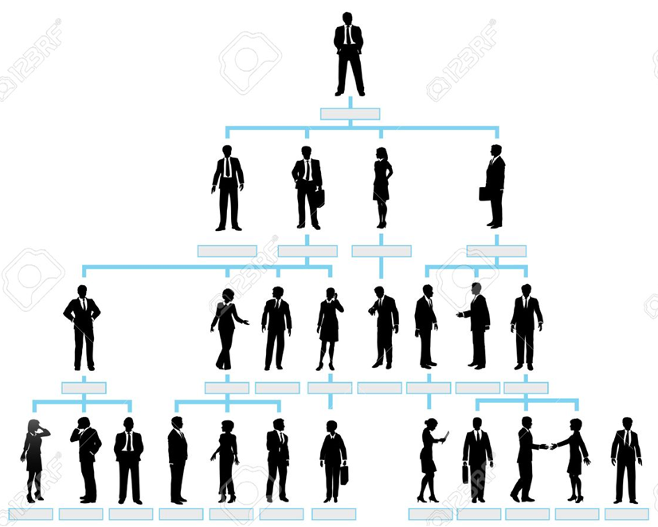
Involve every layer
As transformation programs progress from defining strategy to implementation they affect different levels of the organization.
At each level of the organization,
the leaders who are identified
and trained must be aligned to
the company’s vision, equipped
to execute their specific mission,
and remain motivated to
make change happen.
Notes:
Credits: https://www.strategy-business.com/article/rr00006

Slide 31
Make the formal case
Individuals are inherently rational and will question to what extent change is needed, whether the company is headed in the right direction, and whether they want to commit personally to making change happen.
The articulation of a formal case for change and the creation of a written vision statement are invaluable opportunities to create or compel leadership-team alignment.
Notes:
https://www.strategy-business.com/article/rr00006

Slide 32
Threat/ Opportunity Matrix
Threat
Opportunity
(If we don’t change)
(If we do change)
Short
Term
Long
Term

Slide 33
Create ownership
Ownership is created by involving people in identifying problems and crafting solutions. It is reinforced by incentives and rewards. These can be tangible (for example, financial compensation) or psychological (for example, camaraderie and a sense of shared destiny.)
Notes:
https://www.strategy-business.com/article/rr00006

Slide 34


Keep moving towards value!
Notes:
CC: This is what the process looks like for providers. We know the need for infrastructure and software for technology compliance and to get performance analytics. But I cannot emphasize enough the importance in investing in MACRA education at all levels of your clinically integrated network, hospital, group practice, or self.

Slide 35
Create ownership (cont’d)
At a large health-care organization that was moving to a shared-services model for administrative support, the first department to create detailed designs for the new organization was human resources. Its personnel worked with advisors in cross-functional teams for more than six months. The work was top-notch but the executives realized they hadn’t invested enough individual time in the design process.
This process created a forum for top executives to work as a multifaceted team, creating a sense of alignment and unity that the organization hadn’t felt before.
Notes:
https://www.strategy-business.com/article/rr00006

Slide 36
Communicate the message
Too often, change leaders believe that others naturally understand the issues, feel the need to change, and see the new direction as clearly as they do.
Successful change programs reinforce core messages through regular, timely advice that is both inspirational and practicable.
Communication channels should be established to provide employees the right information at the right time and to solicit their input and feedback; this will also create a greater sense of ownership, as described previously.
Notes:
https://www.strategy-business.com/article/rr00006

Slide 37
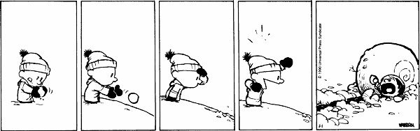
Assess the cultural landscape
Change programs pick up speed and intensity as they cascade down, making it critically important that leaders understand and account for culture and behaviors at each level of the organization.
Identify the core values, beliefs, behaviors, and perceptions that must be taken into account for a successful change to occur.
Notes:
https://www.strategy-business.com/article/rr00006

Slide 38
Change-Risk Analysis
Individual/Role
Desired Behaviors
Considerations
Actions
*Option: write the actual behaviors you are observing at this stage of the project

Slide 39
Prepare for the Unexpected
No change program goes completely according to plan, e.g. anticipated resistance does not materialize.
Effectively managing change requires continual reassessment of its impact and the organization’s willingness and ability to adopt the next wave of transformation.
Real data should drive decision-making processes to enable change leaders to make the adjustments necessary to maintain momentum and drive results.
ADAPT
PLAN
CHECK
DO

Slide 40
Prepare for the unexpected
A leading U.S. health-care company was facing competitive and financial pressures from its inability to react to changes in the marketplace. A diagnosis revealed shortcomings in its organizational structure and governance, and the company decided to implement a new operating model.
In the midst of detailed design, a new CEO and leadership team took over. The new team was initially skeptical, but was ultimately convinced by a solid, data-driven case for change. Adjustments were made to the speed and sequence of implementation, but the fundamentals of the new operating model remained unchanged.
Notes:
https://www.strategy-business.com/article/rr00006

Slide 41

Speak to the individual.
Change is both an institutional journey and a very personal one.
Team leaders should be as honest and explicit as possible. People will react to what they see and hear around them, and need to be involved in the change process. change.
Most change leaders know that people need support but there is a natural tendency to focus on the plans and processes while sometimes forgetting the personal needs of team members.
Notes:
https://www.strategy-business.com/article/rr00006

Slide 42
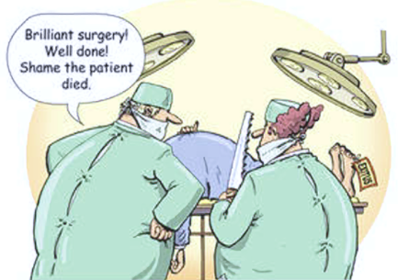
Ensure your goals are clear and measured the same.

Slide 43
Change is not easy
But with good planning, clear and meaningful communication, and a managed execution it can be done with excellence and move your organization forward.
Notes:
That statement makes as much sense to me as it does to you!

Slide 44






Education:
A Variety of education tools is important
Mobile
E-Learning
Courses
Assessments
Informational
Flyers
Performance
Analytics
On-Demand
Webinars
SUBJECT MATTER EXPERTISE AND CONTENT DEVELOPERS
44
©2017 nThrive, Inc. All rights reserved.
Notes:
The variety of roles in your organization means that each may have different learning needs. For example, a busy clinician may have time to squeeze in a 20 minute mobile e-learning course, but not time to spend 2 hours in a conference room for in-person training. Learning assessments are also a valuable tool for ensuring that the training provided was effective, and the staff member is prepared for his or her role in the transition.

Slide 45
Who else is impacted?
Patients
Payers
Providers
Notes:
CARL

Slide 46

“Failing to plan is planning to fail.” Gen. Eisenhower
Without a comprehensive approach to value-driven health care, providers will not be positioned to successfully compete for positive incentives and may, at worst, see a reduction in both payment reimbursements and patient loyalty.
©2018 nThrive, Inc. All rights reserved.
Notes:
Picture of a cold hiker; possibly in the snow.

Slide 47
Questions?
Or email Moshe Starkman at
mstarkman@nthrive.com
Notes:
Please feel welcome to reach out.

Slide 48
Additional Roles & Considerations
From CEO to hands-on clinicians, the move towards value impacts everyone.
©2017 nThrive, Inc. All rights reserved.

Slide 49
What would you do if you were… CFO?
Situation: Value-based care will affect revenues. For example, consider the impact of expanding preventative care to significantly reduce preventable admissions (under MACRA, providers will not be paid for preventable readmissions). Further consider that you’re incentivized to reduce acute care costs since hospital spending is included in the MIPS performance measures cost category and will account for between 10% and 15% of your final score.
Action: As more care shifts to lower-cost settings, including ambulatory care and telehealth services, your organization must take steps to rebalance or otherwise identify new revenue sources.
Impact: Whether in the form of an internal build, 3rd party outsourcing, or a blend thereof, value-driven health care compels finance leaders to invest in analytics and at times consulting services.
Discussion topic: Where can hospitals or other high-cost centers find alternative revenue?
©2018 nThrive, Inc. All rights reserved.

Slide 50
Health Care Leadership: Dir. Phys. Services
Situation: Enabling your hospitals to compete with traditionally lower-cost alternatives is going to be key to physician recruitment and improved overall performance scores under the Quality Payment Program.
Action: As group reporting and Alternative Payment Models become the norm, it is increasingly important that every member of the team understands and complies with your QPP goals and practice adjustments.
Impact: It may be necessary or advisable to setup an incentive and rewards program to further encourage learning and compliance on the part of the practitioners.
©2017 nThrive, Inc. All rights reserved.

Slide 51
Health Care Leadership: VP/Dir. or Quality
Situation: Program directors must now support employed and affiliate physicians to ensure they are scoring their best under MIPS to both achieve incentives and or bonuses and to maintain strong performance scores on the publicly accessible physician compare website.
Action: Maintain a strong QPP education program to be an influential leader of your system’s VBR initiatives.
Impact: Giving sufficient focus and attention to valuable health care, i.e. the quality to cost balance, may require the establishment of a new value focused role within a health system.
©2017 nThrive, Inc. All rights reserved.
51

Slide 52
Health Care Leadership: Clinicians
Situation: Solo and small practices are acutely disadvantaged under MACRA’s regulatory requirements. Many do not have the bandwidth to support the administrative needs and few have the resources to utilize an EHR that meets the technology standards.
Action: Forming Clinically Integrated Networks (CINs) will enable smaller practices to share resource costs, spread performance risk across multiple providers, and collectively procure better technology to support their practices.
Impact: Employed eligible clinicians (ECs) are required to report their performance scores under MIPS. And though one may report directly to CMS via claims, history has shown that investing in the support of a registry both significantly increases the chances of reporting success and reduces the insecurity that comes with going it alone.
©2017 nThrive, Inc. All rights reserved.
52
Notes:
Action: All of this will force the traditional, “just keep to myself and do my job,” type of providers to consider partnerships and working in a far more collaborative environment.

