Slide 1

How Coding Affects Quality Scores & How Quality Increases Earnings
Healthier Patients. Healthier Providers.
J. Michael Parnell, MSN, RN, FACHE
Director of Provider & Network Strategies
Cara Roberson, RN, MPPA
Director of Quality

Slide 2
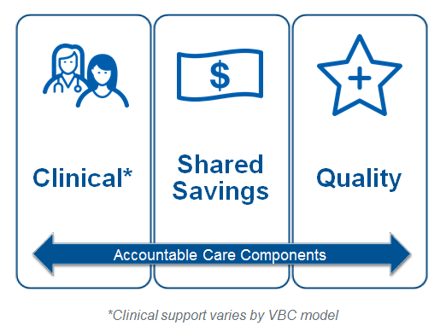
Agenda
Overview of different compensation models - C&S
Difference between assigned and attribution models
The right VBC for your practice
Importance of coding and documentation
Quality metrics (HEDIS®, etc.)
UHC’s quality resources
Why enter into a VBC?
Proprietary Information of UnitedHealth Group. Do not distribute or reproduce without express permission of UnitedHealth Group.
2

Slide 3
Overview of Value-Based Compensation (VBC) Models
OUR SUITE OF VALUE-BASED COMPENSATION MODELS SPAN THE CLINICAL INTEGRATION AND REIMBURSEMENT RISK CONTINUUM. WE MEET PROVIDERS WHERE THEY ARE - ALIGNING OUR VALUE-BASED PAYMENT MODELS WITH THEIR OPERATIONAL SOPHISTICATION AND READINESS TO ACCEPT RISK.
OUR SUITE OF VALUE-BASED PAYMENT MODELS SPAN THE CLINICAL INTEGRATION AND REIMBURSEMENT RISK CONTINUUM. WE MEET PROVIDERS WHERE THEY ARE - ALIGNING OUR VALUE-BASED PAYMENT MODELS WITH THEIR OPERATIONAL SOPHISTICATION AND READINESS TO ACCEPT RISK.
Capitation + PBC
Percent of
Premium
Accountable Care Shared Savings BCR or PMPM
Quality Shared Savings Model
Level of Financial Risk
Pediatric Model
Hospital PBC
Basic Quality Model / CP PCPi
Cost Efficiency
/ Quality PBC
Accountable Care Programs
Fee-for-
Service
Quality PBC
Performance Based Contracts
Degree of Clinical Integration and Accountability
Proprietary Information of UnitedHealth Group. Do not distribute or reproduce without express permission of UnitedHealth Group.

Slide 4
Key Terms
Attributed Membership – Patients who routinely see a PCP for healthcare needs. Attribution is based on claims activity
Assigned Membership – Patients who are assigned to a particular provider who should serve as their primary care provider (PCP). Assignment is based on engagement
Assignment-based compensation models differ from Attribution-based models

Slide 5
Basic Quality Model
Fee for Service
Quality Improvement Payment
Basic Quality Model
BASIC QUALITY MODEL (BQM)
Providers receive fee-for-service reimbursement plus the opportunity to earn incentive payments for improved performance against quality measures; practices performing favorably receive a 75% interim payment six months into each program year with an annual reconciliation
Deployed where States have bonus, sanction or auto-assignment provisions tied to quality measures as well as opportunities to drive STAR rating improvement
A menu of measures has been developed aligned with products/populations being served in each market, State-specific measures and those that favorably impact STAR ratings
Incentive payments are earned by meeting quality performance goals; these may be paid per measure or in aggregate
BQM requires a provider to sign a payment appendix.
Proprietary Information of UnitedHealth Group. Do not distribute or reproduce without express permission of UnitedHealth Group.
5

Slide 6
Basic Quality Model Quality Payments
Max. 10 quality targets per provider
Meaningful Goals
$$$ Per Measure Met

Slide 7
CP-PCPi
Close gaps in care
CP-PCPi
CP-PCPi
Providers receive incentive payments for closing gaps in care. Payment made annually.
Deployed where States have bonus, sanction or auto-assignment provisions tied to quality measures as well as opportunities to drive STAR rating improvement
There is no limit to the number of measures that are included in the incentive.
Incentive payments are earned per care gap closed; paid as flat dollar amount per gap closed.
CP-PCPi is an incentive notification and does not require provider to sign a payment appendix.
Proprietary Information of UnitedHealth Group. Do not distribute or reproduce without express permission of UnitedHealth Group.
7

Slide 8
CP-PCPi Quality Payments
No max. number of quality targets
Meaningful Goals
$$$ Per Measure Met

Slide 9
Pediatric Model
Fee for Service
Quality Performance Payment
Pediatric Model
BCR Efficiency Performance
BCR Quality Performance
PEDIATRIC MODEL
Pediatric practices managing traditional TANF/CHIP populations typically have little shared savings opportunities on a total cost of care basis. This model focuses on our quality and cost goals. United has created a program to reward pediatric providers for their performance against Quality and Affordability goals for United’s pediatric members.
At least 2 out of 4 Quality Performance must be met to qualify for the PMPM bonus. The PMPM is paid per measure and paid annually
If an additional BCR Quality Performance Measure is met, the provider will be eligible for the BCR Efficiency Bonus
At the end of the measurement period, providers with a BCR between 80-85% will receive an additional PMPM. If the BCR is under 80% the PMPM amount increases. The PMPM amounts are determined by the health plan and paid annually.

Slide 10
Pediatric Quality Measures
Fee for Service
Quality Performance Payment
Pediatric Model
BCR Efficiency Performance
BCR Quality Performance
The four critical pediatric quality measures are selected that align with the greatest opportunity
for improvement or state specific revenue opportunities.
Measures must be selected from this list.
Performance Measures for Quality Bonus: (SELECT 4 MEASURES) | Target | PMPM
Adolescent Well Care Visits | [__._]% or higher | $X.XX
Annual Dental Visit | [__._]% or higher | $X.XX
Childhood Immunization Status | [__._]% or higher | $X.XX
Lead Screening in Children | [__._]% or higher | $X.XX
Well Child Visits in the First 15 Months of Life: 6 or More | [__._]% or higher | $X.XX
Well Child Visits in the Third, Fourth, Fifth, and Sixth Year of Life | [__._]% or higher | $X.XX
A provider needs to meet or exceed 2 or more measures to earn the Quality Bonus.
The Quality Bonus is a PMPM paid annually per measure
Proprietary Information of UnitedHealth Group. Do not distribute or reproduce without express permission of UnitedHealth Group.
10

Slide 11
Pediatric Quality Measures
Fee for Service
Quality Performance Payment
Pediatric Model
BCR Efficiency Performance
BCR Quality Performance
The provider can earn an Efficiency Bonus Payment by meeting or exceeding the BCR Quality Performance Measure. If the Performance Measure is met, the providers BCR Range at the end of the measurement period will determine the amount of the Efficiency Bonus Payment
BCR Quality Performance Measure - Gate for Efficiency Bonus Payment
Children and Adolescents’ Access to Primary Care Practitioners | [__._]% or higher
BCR Range | PMPM for Efficiency Bonus Payment (Example)
BCR greater than or equal to 85% | $0 PMPM
BCR between 84.9% and 80% | $1.00 PMPM
BCR less than 80% | $2.00 PMPM
Proprietary Information of UnitedHealth Group. Do not distribute or reproduce without express permission of UnitedHealth Group.
11

Slide 12
Quality Shared Savings Model:
Upside or Upside/Downside
Fee for Service
Quality Improvement Payment
Shared Savings
Quality Shared Savings Model
QUALITY SHARED SAVINGS MODEL (QSS)
Providers receive fee-for-service reimbursement plus the opportunity to earn incentive payments for improved performance against quality measures; practices performing favorably receive a 75% interim payment six months into each program with an annual reconciliation
Bonus opportunities are based on savings accrued against total cost of care (BCR) or clinical efficiency metrics
A menu of measures has been developed aligned products/populations being served in each market, State-specific measures and those that favorably impact STAR ratings
Up to ten measures and performance thresholds are determined at the practice level
Incentive payouts as well as shared savings distribution are based on reaching quality improvement targets
Proprietary Information of UnitedHealth Group. Do not distribute or reproduce without express permission of UnitedHealth Group.
12

Slide 13
QSS Quality Payments
$$$ Per Measure Met
Meaningful Goals
Max. 10 quality targets per ACO

Slide 14
Accountable Care Shared Savings:
BCR, Clinical Efficiency, and PMPM Models
Fee for Service
Clinical Integration Payment
PMPM Model
Shared Savings
w/ Quality Achieved
ACCOUNTABLE CARE SHARED SAVINGS MODEL
Providers receive fee-for-service reimbursement
Plus monthly clinical integration payments for performing activities designed to support practice transformation and population management
Shared Savings opportunities are based on savings accrued by lowered BCR, improved Clinical Efficiency, or reduction in their PMPM spend. Note: Shared Savings payments are reduced by Clinical Integration Payments
The number of quality goals met determines the amount of shared savings

Slide 15
ACSS Model: BCR, Clinical Efficiency, and PMPM
Role of the Accountable Care Community
Accountable Care Shared Savings Model
Accountable Care Community
FTE Support
BCR, Clinical Efficiency improvement, PMPM
Annual Shared Savings payments
Quality Improvements
Percent of Shared Savings pool paid
Accountable Care Shared Savings
Clinical Integration Activities
CIP payments
Practice Transformation
Incentive Payments
Population Care Registry
19

Slide 16
ACSS Model: BCR, Clinical Efficiency, and PMPM
How is a CIP earned?
Goal | Activity | Validation | Compliance Metric
Manage Same Day Access to Care | Maintain a high percentage of convenient open access visits (walk in/ same day) access to care | Weekly data extract of Practice scheduling system showing all United patients scheduled/kept/cancelled in last week | At least XX% of all clinic visits are "walk in" status (or "same day" visit scheduled and kept on same day)
Manage Inpatient Care Transitions | Patients complete a follow up visit with a clinician within 7 calendar days after hospital discharge | Monthly percent of patients with clinician follow up within 7 calendar days of inpatient discharge, using Accountable Care Population Registry notifications as denominator. | At least XX% of patients discharged from inpatient stay are seen by PCP within 7 calendar days of discharge date (excluding normal deliveries)
Manage Emergency Visit Care Transitions | Patients complete a follow up visit with their PCP within 7 calendar days after an Emergency visit | Monthly percent of patients with PCP follow up within 7 calendar days of Emergency Visit, using Accountable Care Population Registry notifications as denominator. | At least XX% of patients discharged from an ED visit are seen by PCP within 7 calendar days of discharge date
Manage High Risk Cohort Patients | High risk patients are seen at least every 90 days to close care opportunities. Complete care opportunities. Complete all high risk patient referrals within 30 days. | Accountable Care Population Registry extract shows patients are seen every 90 days and have no current Care Opportunities older than 30 days | At least XX% of patients in high risk cohorts have no adverse events (Inpatient or ER) for six months following cohort start date
Proprietary Information of UnitedHealth Group. Do not distribute or reproduce without express permission of UnitedHealth Group.
16

Slide 17
ACSS Model: BCR, Clinical Efficiency, and PMPM
PRE quality tiers1 & 3 will be used to identify quality providers (PMPM ONLY)
HEDIS measures selected should be applicable to products and populations being served in each market
State-specific measures and those that favorably impact STAR ratings should be included
3-10 measures are selected; performance thresholds are determined at the practice level
1 Point Per Measure
Meaningful Goals
3-10 targets per ACO
The number of improved performance quality measures earned determines the amount of shared savings/shared deficits distributed – up to 40%.
Provider must meet at least 3 quality point to be eligible to receive any shared savings. (PMPM ONLY)
Targets must be meaningful, e.g., 75th Percentile, not just 2% improvement
17

Slide 18
Which One is Right?
Program | Model | Min. Panel Size | BCR
Quality | CP-PCPi | --- | ---
 | BQM | 500 | ---
ACO | QSS | 1000 | 80-100%
 | ACSS | 1000 | 80-100%
 | ACSS - PMPM | 1000 | 70-80%
Other | Pediatric | 1000 | ---
 | CIP Only | 500 | ---
*Exception process applies if providers fall outside these guidelines

Slide 19
Which One is Right?
OUR SUITE OF VALUE-BASED COMPENSATION MODELS SPAN THE CLINICAL INTEGRATION AND REIMBURSEMENT RISK CONTINUUM. WE MEET PROVIDERS WHERE THEY ARE - ALIGNING OUR VALUE-BASED PAYMENT MODELS WITH THEIR OPERATIONAL SOPHISTICATION AND READINESS TO ACCEPT RISK.
OUR SUITE OF VALUE-BASED PAYMENT MODELS SPAN THE CLINICAL INTEGRATION AND REIMBURSEMENT RISK CONTINUUM. WE MEET PROVIDERS WHERE THEY ARE - ALIGNING OUR VALUE-BASED PAYMENT MODELS WITH THEIR OPERATIONAL SOPHISTICATION AND READINESS TO ACCEPT RISK.
Capitation + PBC
Percent of
Premium
Accountable Care Shared Savings BCR or PMPM
Quality Shared Savings Model
Level of Financial Risk
Pediatric Model
Hospital PBC
Basic Quality Model / CP PCPi
Cost Efficiency
/ Quality PBC
Accountable Care Programs
Fee-for-
Service
Quality PBC
Performance Based Contracts
Degree of Clinical Integration and Accountability
Proprietary Information of UnitedHealth Group. Do not distribute or reproduce without express permission of UnitedHealth Group.

Slide 20
HEDIS®:
Resources, coding, improving vbc outcomes

Slide 21
PATH Program
Offers Providers information specific to UHC members who are due or overdue for specific services.
Reference guides provide a better understanding of the specifications for many of the quality management programs and tools that are used to address the open care opportunities
Coding guides offer detailed information on what billing codes to use to capture the screenings completed.
Patient Care Opportunity Report (PCOR)- a monthly report that includes a list of all open care opportunities for members on the provider panel.
All PATH resources meet the National Committee for Quality Assurance (NCQA) quality standards.
To access the PATH guide online visit UHCprovider.com/path

Slide 22
Reference & Coding Guides
Reference Guides:
  Measure definition including age of eligible population, measurement year, and diagnosis codes
  Also includes medical record documentation tips, best practices for closing care gap, collection method (claims vs. hybrid) and exclusions
Coding Guides:
  Quick tip reference tools to help with the medical coding of select HEDIS® measures.
  Available for Adult Health, Pediatric Health, and Women’s Health
  Includes the measure description, eligible population, and coding information

Slide 23
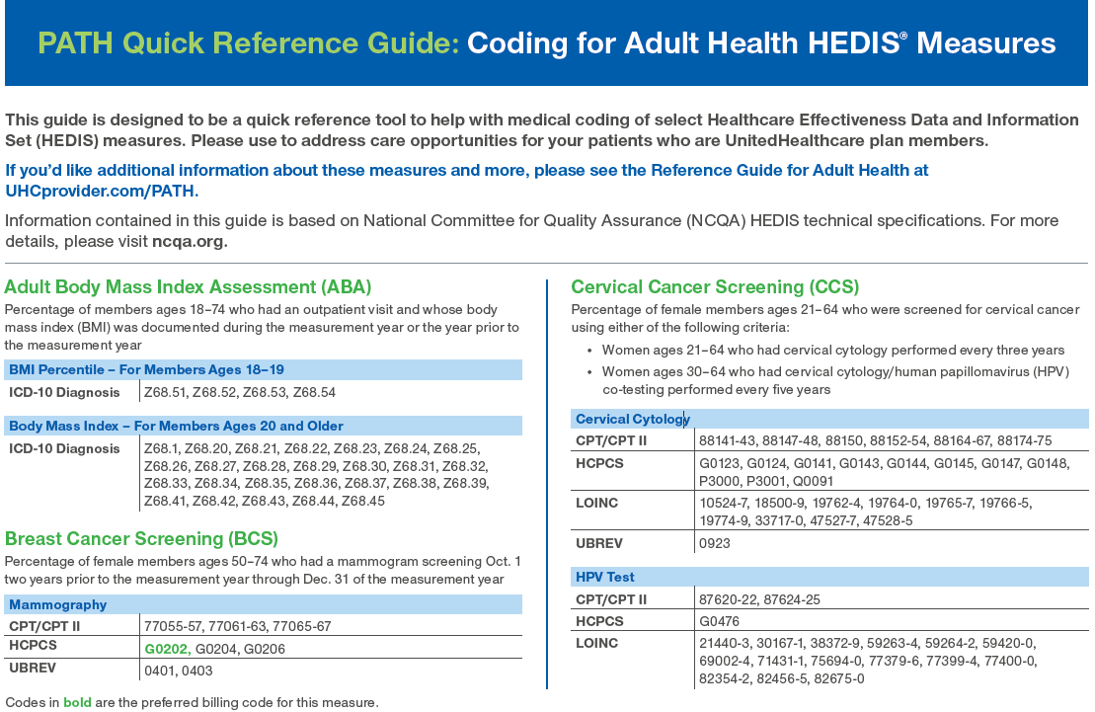
PATH: Coding Guide
https://www.uhcprovider.com/en/reports-quality-programs/path-program.html

Slide 24
Monitoring Performance
Patient Care Opportunity Report (PCOR) helps you quickly identify members with open gaps in care. Contains 4 reports:
  group level summary report
  CP-PCPI summary report
  physician level summary report
  member adherence report
How to access PCOR?
  UHCprovider.com/pcor
  Reports
  physician performance and reporting
  open my reports
Need additional assistance: Health Care Measurement Resource Center at 866-270-5588

Slide 25
Best Practices for
Top Missed Opportunities
Weight assessment and counseling for nutrition and physical activity for children/adolescents
  Including a checklist in a member’s medical record is a good way to make sure that all components of this measure are completed. For example:
    A notation of “well nourished” or a reference to a member’s “appetite” will not meet compliance for nutritional counseling. However, a checklist indicating that “nutrition was addressed” will. A notation of “cleared for gym class” or “health education” will not meet compliance for physical activity counseling. However, a checklist indicating “physical activity was addressed” or evidence of a sports physical will.
Controlling Blood Pressure
  It’s essential that the hypertension diagnosis date and BP reading be on different dates of service. A member will not be compliant without both pieces of medical documentation and a BP reading within the recommended thresholds.
Postpartum Care:
  Postpartum visit must take place between 21-56 days after delivery.
  For women who’ve had a C-section, an incision check two weeks after delivery will not meet compliance.

Slide 26
Why Enter Into a VBC or Incentive Plan?
Improve quality
Leverage your value
  Clinical value
  Geographic value
Data sharing
  Clinical
  Provider performance
  Referral patterns
  Prescription utilization
  Sites of services/Levels of care
Engage Providers

Slide 27
Questions?
J_Parnell@uhc.com.
Cara_Roberson@uhc.com

