Slide 1

2 Minutes Until Showtime
http://video.disney.com/watch/re-micks-the-black-eyed-peas-i-gotta-feeling-4bb3c1c256dd62861cf7f063

Slide 2

Staying Nimble in an Ever- changing Healthcare Environment

Slide 3
Two of the biggest problems that rural hospitals must overcome…
Big Town Mentality
Small Town Reputation

Slide 4
Big Town Mentality
Bigger means better.
Doctors and other healthcare professionals in bigger cities are smarter.
Equipment is more state-of-the-art.
The facilities are nicer.
Specialists and specialty services are only accessible in the cities.

Slide 5
Small Town Reputation
“The ER at that hospital will kill you.”
“The equipment at that place is too old.”
“The rooms are small and the place is dirty.”
“The facilities are old and run down.”
“They don’t have enough staff.”
“The employees don’t care if people go there or not.”

Slide 6
Don’t ignore community perception.
Have you done a gut check lately? Are your fundamental clinical or customer service skills giving your facility a bad name, like “Killer Regional”?
Do you pay anyone to monitor Facebook?
F U.
Have a strategic planning session, perform a SWOT analysis, and find your Rural Healthcare Flair.
The leaders to make this happen are in this room.

Slide 7


Slide 8
What is flair, and why do we need it?
https://www.youtube.com/watch?v=_ChQK8j6so8.
Flair = a special or instinctive aptitude for doing something well; synonyms include talent, gift, and instinct. Perfecting your flair may be the best (only?) chance you have to improve your reputation and keep your doors open.

Slide 9
NSMC’s Rural Healthcare Flair
Good food
Customer Service:
“The Sunflower Way”
3. Cleanliness:
https://www.facebook.com/northsunflowermedicalcenter/videos/10156028419087380/?notif_id=1517961056977002&notif_t=share_wall_create

Slide 10
SWOT at the problem!
Marketing 101
Strengths
Weakness
Opportunities
Threats

Slide 11
Your flair is your STRENGTH. Capitalize on it!
Do you have the best clinical outcomes? Promote any metrics you might have. (The flip side: do patients get transferred or discharged when they could have stayed? Do patients stay when they should have been transferred? Who’s monitoring this?)
Is your facility clean and updated? Advertise this.
Do you have the best hospital food? (Would you eat the food that is served to your patients? Seriously, would you?)
Are your employees nice or simply just not mean?
Would you want your mother or child to be a patient in your facility? Campaign on this platform.

Slide 12
Reflection can help uncover WEAKNESSES.
Don’t sweep weaknesses under the carpet. Your community and competition know what they are regardless of whether you choose to acknowledge them.
Once weaknesses are identified, assign someone accountability to work towards a repair.
Strategic planning is a good opportunity to uncover weaknesses.

Slide 13
Use a strategic planning session to uncover OPPORTUNITIES.
Brainstorming sessions can be life-changing.
Hospitals, like individuals, need goals. I’ll bet you make your employees fill out annual professional development plans. Your facility needs a professional development plan every five years, and you are the person who can make this happen.
Hiring a good facilitator may cost a little money, but can you afford not to do this?

Slide 14
THREATS are always looming.
Remember the Big Town Mentality and the Small Town Reputation?
Cuts to reimbursement are always occurring. Nobody is immune, so just settle in and plan to increase your volume in areas that are currently reimbursement leaders.
(Sidebar-Do you know what your facility’s reimbursement leaders are?)
Your strategic plan can help mitigate threats.

Slide 15
Develop your SWOT team.
Strategic planning meetings are recommended every 5 years. F U frequently.
No ideas are stupid- dream big.
Involve employees and community leaders; you’re all in the same boat.
Use the SWOT analysis and strategic planning session to develop your Rural Healthcare Flair.
Monday, send some emails and get started.

Slide 16
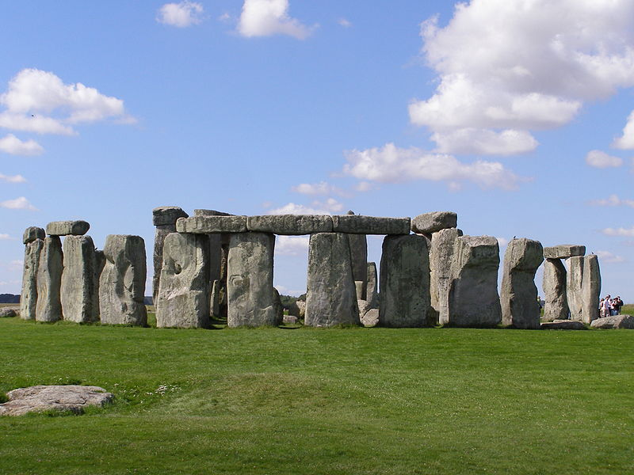
Pillars are important. Questions?

