Slide 1
Molina Healthcare
Provider Training
Date: Presented by:

Slide 2

Objectives
About Molina Healthcare
Molina Healthcare’s Engagement Process
EPSDT
Vaccines for Children
HEDIS & Performance Measurements
Patient Centered Medical Home
Appointments
Medical Records
Provider Resources

Slide 3
About Molina Healthcare
Our Vision
We envision a future where everyone receives quality health care.
Our Mission
Our mission is to provide quality health services to people receiving government assistance.

Slide 4
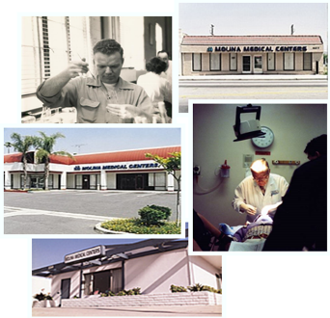
The Molina Story
In 1980, the late Dr. C. David Molina, founded Molina Healthcare with a single clinic and a commitment to provide quality healthcare to those most in need and least able to afford it. This commitment to providing access to quality care continues to be our mission today, just as it has been for the last 35 years.
The Molina Family of Health Plans
Molina Healthcare of California
Molina Healthcare of Utah
Molina Healthcare of Michigan
Molina Healthcare of Washington
Molina Healthcare of New Mexico
Molina Healthcare of Texas
Molina Healthcare of Ohio
Molina Healthcare of Florida
Molina Healthcare of Wisconsin
Molina Healthcare of Illinois
Molina Healthcare of South Carolina
Molina Healthcare of Puerto Rico
Molina Healthcare of New York
Molina Healthcare of Mississippi

Slide 5
Molina Healthcare’s Engagement Process
It is our goal to work with our provider community by offering partnerships to improve health care in Mississippi. To properly do this, our Provider Engagement Manager will review weekly reports to identify areas of opportunity to assist and engage with providers performing EPSDT services.
Our engagement process will include, but is not limited to, the following outreach attempts:
  Phone call or email with supporting documentation outlining member missed services.
  If the first attempt is unsuccessful, an engagement visit will be scheduled with the provider’s office by Provider Engagement, Provider Services and/or Quality.
  Follow-up opportunities to review and discuss outcomes.
1
2
3

Slide 6
How to become an EPSDT Provider
The Division of Medicaid enters into an EPSDT provider agreement with Medicaid providers who wish to participate in the EPSDT program. Participation as an EPSDT screening provider is entirely voluntary.
A physician, physician assistant or nurse practitioner who wishes to become an EPSDT screener must complete all enrollment requirements and sign an EPSDT specific provider agreement with the Division of Medicaid.
An EPSDT provider agreement must be on file prior to providing EPSDT services, billing, and being reimbursed by the Division of Medicaid for services rendered.
For more information, please contact Division of Medicaid by calling (800) 421-2408.

Slide 7
Vaccines for Children
VFC is a nationally sponsored program that provides vaccines at no cost to participating health care providers, thus allowing for eligible children aged eighteen (18) and under to receive free vaccines. Eligible children include children who are enrolled in Medicaid, children without health insurance, and Native American and Alaskan Native children.
Children who have health insurance that does not cover immunizations (underinsured) are also eligible, if they obtain the vaccines from a Federally Qualified Health Center (FQHC) or Rural Health Center (RHC).
Providers may receive VFC vaccine and administer this vaccine at no charge if they are enrolled in the program and agree to follow the most current recommended childhood immunization schedule.
For children enrolled in Medicaid, Molina covers the administration of each vaccine dose at a reimbursement rate set by the Division of Medicaid. When multiple vaccines are given on the same visit, Molina will reimburse for the administration of each vaccine.
When vaccines are given in conjunction with an Early and Periodic Screening, Diagnosis and Treatment (EPSDT) visit or a physician office visit, Molina will reimburse for the administration of the vaccine in addition to the reimbursement for the visit.

Slide 8
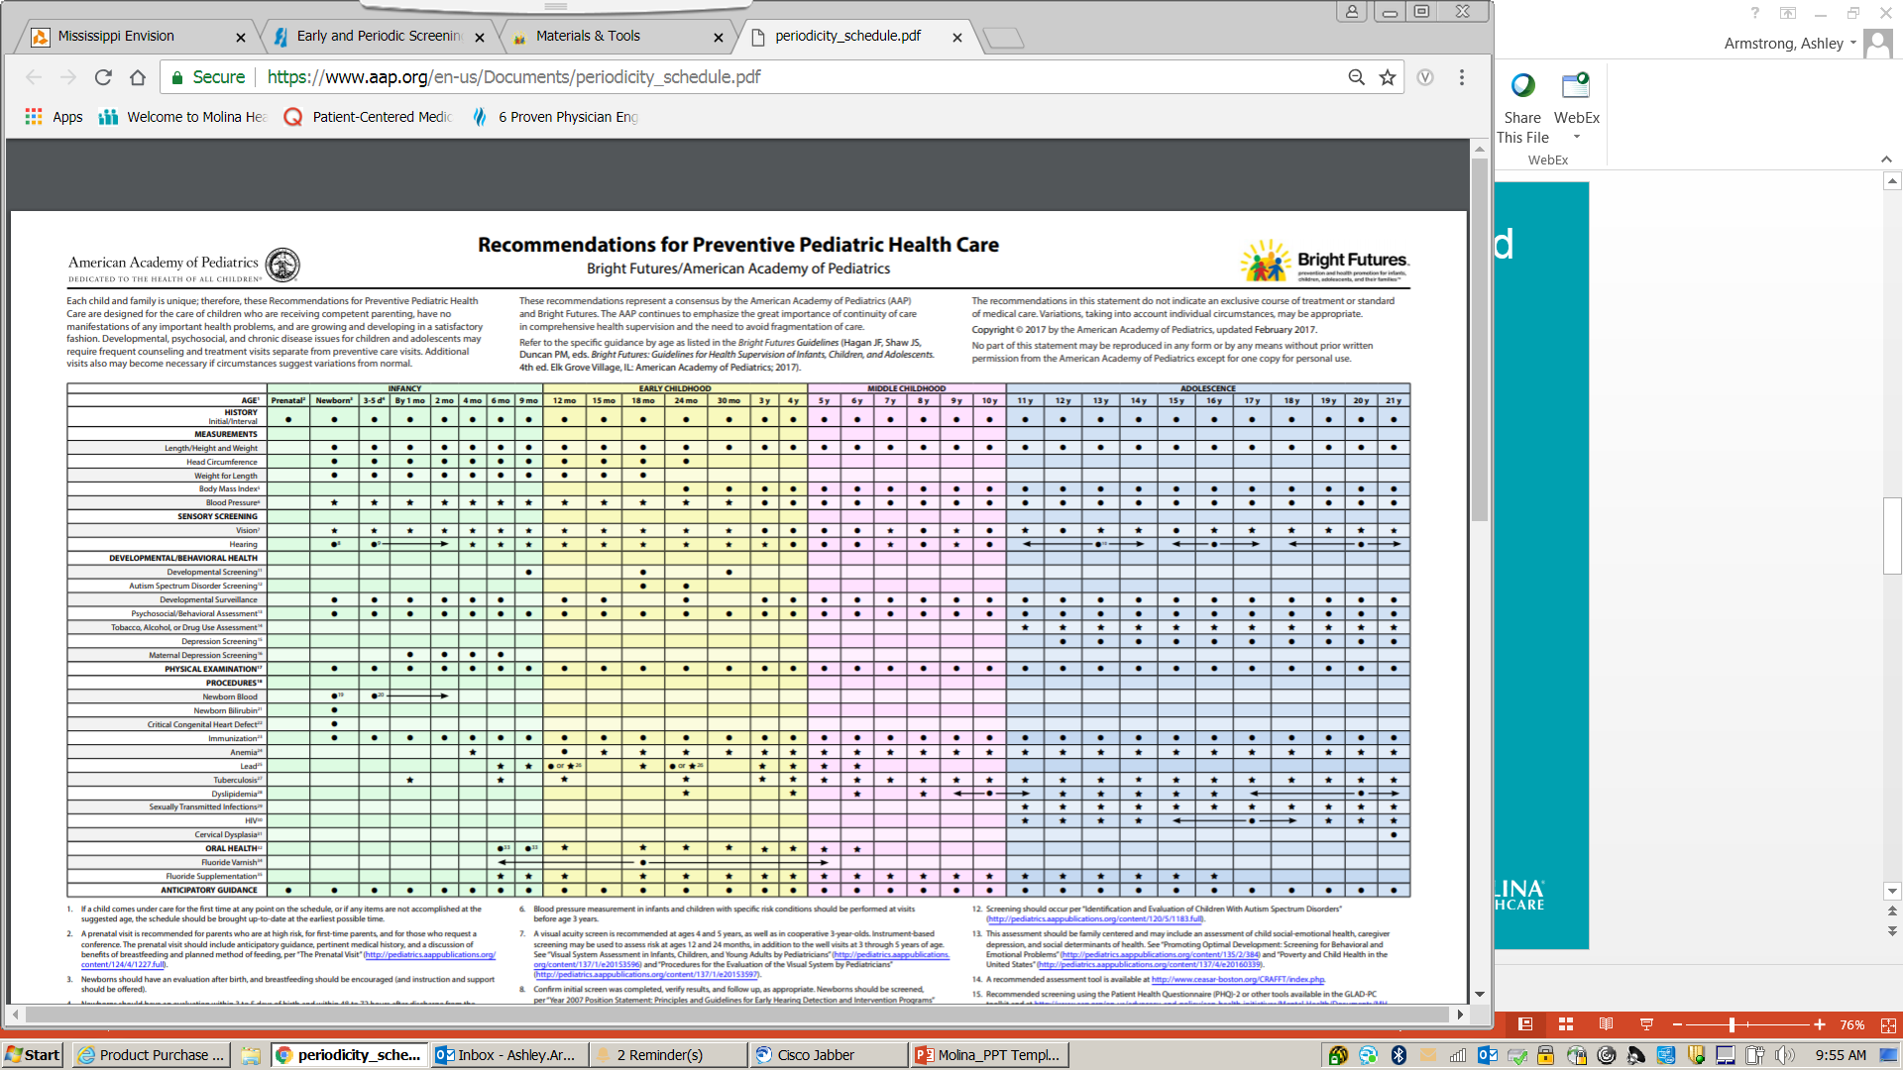
Bright Futures Periodicity Schedule

Slide 9
Appointments for EPSDT Screenings
EPSDT providers must maintain a screening periodicity tracking system for members seen for initial screening and subsequent screenings to ensure screenings are performed timely and in accordance to the periodicity schedule.
Members, guardians and/or legal representatives should be informed of the periodicity schedule at each visit. Scheduling of initial and periodic screening of EPSDT eligible Medicaid members is the responsibility of the EPSDT screening providers, as well as overall care coordination.

Slide 10
Missed/Failed Appointments
EPSDT providers must follow up on missed appointments. If the member fails to keep the scheduled appointment, or the member, guardian and/or legal representative fails to contact the provider to reschedule, an appointment letter or telephone contact must be made providing the member another opportunity to be screened within thirty (30) days of the initial appointment.
Two (2) good faith efforts, defined as an attempt to contact the member, guardian and/or legal representative, are required to reschedule a screening appointment. EPSDT providers must document any missed appointments and the two (2) good faith efforts in the medical record.
Failure of a member, guardian and/or legal representative to keep the second appointment and respond to the provider's attempted contact is considered a declination of that screening only. The provider must continue to maintain periodicity and schedule the member for the next screening due following the same process.

Slide 11
HEDIS & Performance Measurements
The Healthcare Effectiveness Data and Information Set (HEDIS) is a tool used by health plans to measure performance on important dimensions of care and service and consists of 92 measures across 6 domains of care. Because so many plans collect HEDIS data, and the measures are so specifically defined, HEDIS makes it possible to compare the performance of health plans.
Performance measurement is also available to the provider community. Physicians are increasingly participating in performance measurement activities, especially in the context of incentives and/or value based contracting.

Slide 12
HEDIS & Performance Measurements
Effective 2018, HEDIS includes performance measures related to dozens of important health care issues. Selected measures include, but are not limited to:
Antidepressant medication management
Breast cancer screening
Cervical cancer screening
Children and adolescent access to primary care practitioners
Childhood and adolescent immunization status
Comprehensive diabetes care
Controlling high blood pressure
Flu vaccinations for Adults
Medical assistance with smoking and tobacco use cessation
Medication management for people with asthma
Plan all-cause readmissions
Potentially harmful drug-disease interactions in the elderly
Prenatal and postpartum care
Relative Resource Use for People with COPD

Slide 13
Patient-Centered Medical Home
The Patient-Centered Medical Home (PCMH) is a care delivery model in which member treatment is coordinated through their primary care physician to ensure they receive the necessary care when and where they need it, in a manner they can understand.
The PCMH puts patients at the forefront of care. PCMHs build better relationships between members and their clinical care teams.
Proven research shows PCMHs improve quality, the patient experience and staff satisfaction, while reducing overall health care costs.
PCMH

Slide 14
Medical Records Management
All professional and institutional providers participating in the Medicaid program are required to maintain records that will disclose services rendered and billed under the program and, upon request, make such records available to representatives of DOM in substantiation of any and all claims. These records should be retained for a minimum of five (5) years or longer as required by federal or state law.
https://www.medicaid.ms.gov/wp-content/uploads/2014/01/Admin-Code-Part-200.pdf

Slide 15
Provider Resources
Division of Medicaid’s EPSDT Administrative Code can be found at https://medicaid.ms.gov/wp-content/uploads/2014/01/Admin-Code-Part-223.pdf. The EPSDT Provider Reference Guide can be found at https://medicaid.ms.gov/wp-content/uploads/2017/05/Provider-Reference-Guide-223.pdf
Our Provider Call Center is available to answer provider inquires and questions by calling (844) 826-4335, Monday – Friday, 7:30 am – 6:00 pm
Our website is available at MolinaHealthcare.com
For additional assistance or questions, please feel free to reach out to our Provider Services team at MHMSProviderServices@MolinaHealthcare.com or the Manager of Provider Engagement at Ashley.Armstrong@MolinaHealthcare.com

