Slide 1
How to Document the IPPE Exam
By Joanie Perkins, CPC

Slide 2
Required Components
Medical, Social and Family History
Review of Risk Factors
Review of Functional Ability
Exam
End of Life Planning
Educate, Counsel, and Refer based on the Previous Five Components
Educate, Counsel, and Referral for Other Preventive Services in the Form of a Brief Written Plan

Slide 3
Medical, Social and Family History
At a minimum, nurse collects information about….
Past medical/surgical history/Hospital Stays
Current medications and supplements - RX fill history tab – Medication Reconcilation
Family history
History of alcohol, tobacco, and illicit drug use;
Diet; and
Physical activities

Slide 4
Review of Risk Factors
Nursing Staff Reviews the patient’s potential risk factors for depression and other mood disorders by using the PHQ-9 Depression Scale for patients without a current diagnosis of depression or other mood disorders
http://www.cqaimh.org/pdf/tool_phq9.pdf

Slide 5
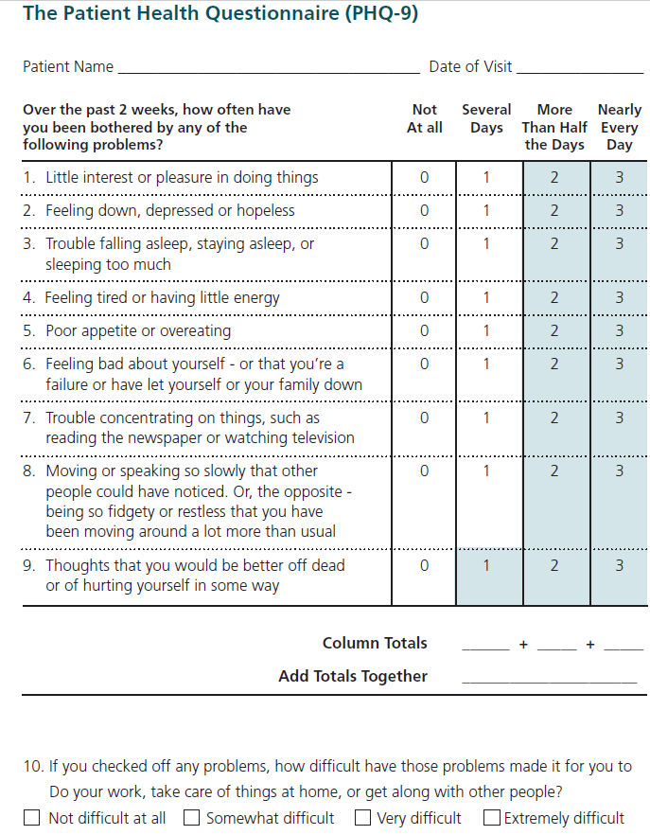

Slide 6
Review of Functional Ability and Level of Safety
At a minimum, collect information about….
Hearing impairment; 25 dcb Pass/fail
Activities of daily living; Lawton ADL scale
Fall risk; MORSE (provider)
Home safety (CDC) Take home for Pt.

Slide 7
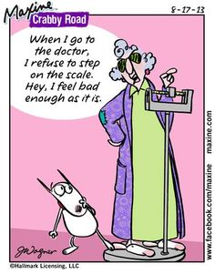
Physical Exam
Obtain the following….
Height, weight, body mass index, and blood pressure; (Nurse/Triage)
Visual acuity screen; and (Nurse/Triage)
Other factors deemed appropriate based on the patient’s medical and social history and current clinical standards. (MD/NP)

Slide 8
End of Life Planning
Verbal or written information provided to the patient about….
The ability to prepare an advance directive in case an injury or illness causes the patient unable to make health care decisions;(Provider) and
Whether or not you are willing to follow the patient’s wishes as expressed in the advance directive.(MD/NP)

Slide 9
Educate, Counsel, and Refer based on the Previous Five Components
Based on the results of the review and evaluation services in the previous five components, provide education, counseling, and referral as appropriate. (MD/NP)

Slide 10
Educate, Counsel, and Refer for Other Preventive Services
Includes a brief written plan, such as a checklist, for the beneficiary to obtain….
A once-in-a-lifetime screening electrocardiogram (EKG/ECG), as appropriate; and
The appropriate screenings and other preventive services that Medicare covers

Slide 11
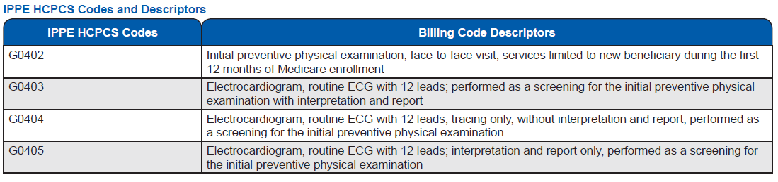
Coding
Use the following Healthcare Common Procedure Coding System (HCPCS) codes when filing claims for the IPPE and screening ECG.

Slide 12
What to Send Home with our Patient
Home Safety Checklist
Advanced Directive Booklet
Medicare-covered Preventive Services
Patient Care Summary
Care Plan with Patient Goals

