Slide 1


Emergency Preparedness Regulations in the Clinic
Kate Hill, RN
VP Clinical Services
October 31, 2018

Slide 2
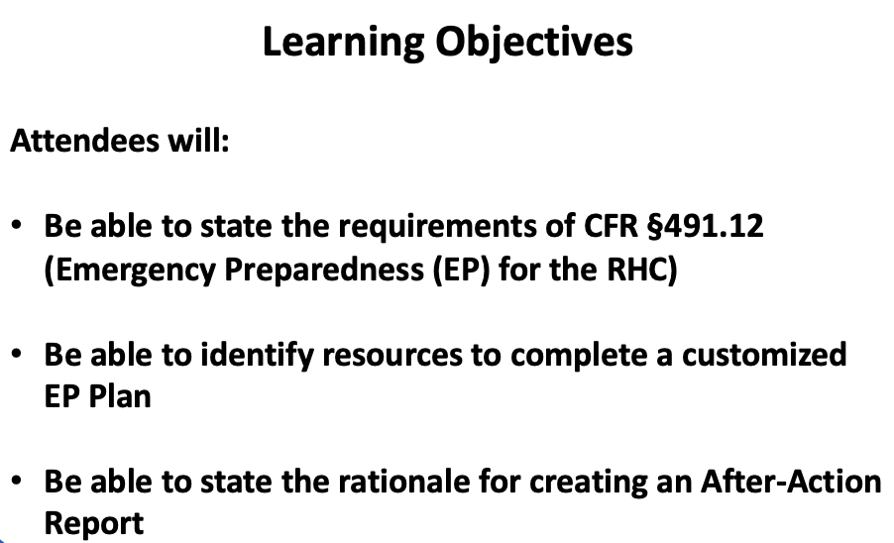

Slide 3
Lessons Learned in 2005
In 2005, only 25% of office-based providers were using electronic medical records. Dorothy Jones, RHIT, health information supervisor at Medical Center of Louisiana in New Orleans, thought removing the bottom rows of records in her hospital’s basement storage facility would be enough to guard against Hurricane Katrina’s punch August 29, 2005.In a matter of hours, 400,000 medical records were reduced to pulp. Entire lifetimes of healthcare documentation were lost forever for many critically and chronically ill patients. EMR is now the standard.

Slide 4
Lessons Learned from Hurricane Katrina
August 29, 2005
In 2005, only 25% of office-based providers were using EHRs.
Dorothy Jones, Health IT Supervisor at Medical Center of LA in New Orleans, thought removing the bottom rows of records in her hospital’s basement storage facility would be enough to safeguard records. In a matter of hours, 400,000 medical records were reduced to pulp.

Slide 5
Lessons Learned from Hurricane Katrina:
August 29, 2005
This healthcare documentation was lost forever. EMR is now the standard for recordkeeping and safeguarding.
To realize the full potential of EHRs as a vital component of emergency preparedness, organizations should consider environmental and technical factors associated with these systems and optimize safeguards related to data preservation, recovery, and exchange.

Slide 6
Lessons Learned in San Bernardino:
December 2, 2015
14 people killed and 22 injured during an active shooter situation.
An emphasis is now put violence de-escalation in healthcare settings.
We now teach healthcare staff to “Run/Hide/Fight” if an immediate threat is encountered.

Slide 7
Lessons Learned 2015
A Lesson Learned from Inland Regional Center, CA:
After 14 people killed and 22 injured, we now teach healthcare staff “Run/Hide/Fight” when immediate threat noted.

Slide 8
Lessons Learn 2017
A lesson learned from the UK’s NHS:
Slashing the budget set for IT updates/security is not acceptable. Malware is a real risk for loss of records and interruption of healthcare service.

Slide 9
Lessons Learned from Hurricane Sandy:
October 22, 2012
In New Jersey, with fewer hospitals in the direct impact zone, the State Regional Extension Center Program planned in advance by contacting providers prior to the storm’s landfall with instructions on how to back up data stored in the their EHRs. This planning assured that patient information would be safe and accessible during and after the storm.

Slide 10
Lessons Learned from Hurricane Sandy
October 22, 2012
While water was impossible to hold back, the availability of health information before, during, and after the storm remained remarkably stable.
Among the users of EHRs in the greater New York City area there was only one report of records being lost, in a small clinic that was actually in the process of converting their paper records into an EHR system. However, there were widespread reports of paper records being lost.

Slide 11
Lessons Learned from Hurricane Sandy:
October 22, 2012
The impact of Hurricane Sandy put many aspects of the Frameworks - particularly the Mitigation, Response, and Recovery components - to the test. It also helped to identify where strategies such as employing an EHR system can cross the frameworks from mitigation to response, and into recovery.
The implementation and regular use of EHR systems is clearly on that list as is the partnership developed between federal, state, local, and private entities involved in disaster planning.
What this experience also shows is that, with only a small amount of additional planning, it is possible to maintain access to an EHR system during a significant event even if a facility has been damaged or destroyed.

Slide 12
Lessons Learned 2013
A lesson learned from Moore Medical Center, OK: Approximately 50 patients/staff and 300 community members survive the EF-5 tornado May 20th, 2013. Displacement for staff/patients. 4 years to rebuild.

Slide 13
Lessons Learned from Moore Medical Center, OK: May 20, 2013
Approximately 50 patients/staff and 300 community members survive an EF-5 tornado.
Healthcare access was disrupted and staff were displaced because it took 4 years to rebuild.
Shelter in place and continuity planning should be addressed.

Slide 14
Lessons Learned from the UK
Malware Attack: May 12, 2017
A malware virus disrupted the use of electronic recordkeeping and the use of several key services for over a day throughout the entire United Kingdom.
WannaCry Malware cost the UK’s National Healthcare Service over $93 Million.
Malware is a real risk for loss of records and interruption of healthcare service. Slashing the budget set for IT updates/security is not acceptable.

Slide 15
Lessons Learned from Hurricane Harvey:
August 25, 2017
Nursing Home with 15 patients stranded in waist-high water.
Healthcare settings must perform risk assessments to determine their emergency plans and procedures.
There must be a way to effectively communicate the organization’s need to coordinate emergency response.

Slide 16
Lessons Learned 2017
What are we learning from Harvey?

Slide 17
Lessons To Be Learned 2017
What are we learning from Harvey?
Nursing Home with 15 patients stranded in waist high water.

Slide 18
Lessons Learned from Hurricane Harvey:
August 25, 2017
There were not enough first responders to assist and evacuate all those in need.
The ”Cajun Navy” responded assisting thousands to get to higher, dry ground.
Previously, government would stop citizens from assisting in emergency efforts, stating it was too high-risk for people without formal training. In times of overwhelming chaos and imminent danger, offers of reasonable help should be considered to preserve life.

Slide 19
What is the Biggest Lesson Learned?
THE EMERGENCY OCCURRENCE
SHOULD NOT BE THE
FIRST TIME YOU THINK ABOUT
WHAT YOU NEED TO DO

Slide 20
RHC Emergency Preparedness (EP)
Proposed by CMS in 2013, new regulations would provide consistent EP requirements, enhance patient safety during emergencies for persons served by Medicare- and Medicaid-participating facilities, and establish a more coordinated and defined response to natural and man-made disasters.

Slide 21
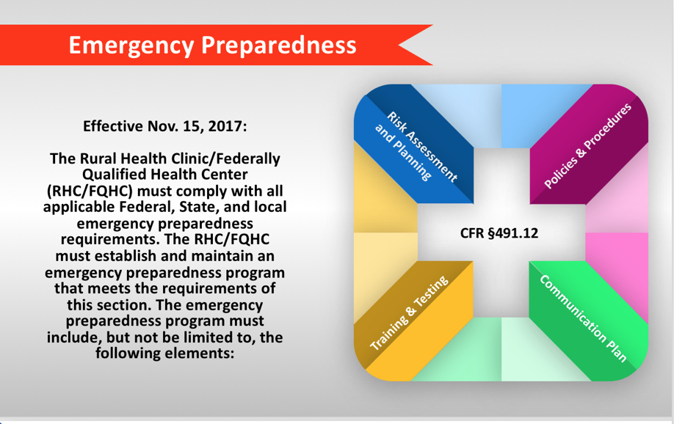

Slide 22
Understanding the Final EP Rule
EP Requirements for Medicare and Medicaid Participating Providers/Suppliers
Published September 16, 2016
Applies to all 17 provider/supplier types
Compliance required for participation in Medicare
Implementation Date November 16, 2017
Notes:
Implementation Date November 15, 2017

Slide 23
EP Interpretive Guidelines
“The Interpretive Guidelines are sub regulatory guidelines, not laws, which establish our expectations for the function states perform in enforcing the regulatory requirements. Facilities do not require the IGs in order to implement the regulatory requirements.
This EP rule is accompanied by extensive resources that providers and suppliers can use to establish their emergency preparedness programs.”
Federal Register /Vol. 81, No. 180 / Friday, September 16, 2016 /Rules and Regulations 63873

Slide 24
Risk Assessment and Planning
(a) Emergency plan. The RHC/FQHC must develop and maintain an emergency preparedness plan that must be reviewed and updated at least annually. The plan must do all of the following:
(1) Be based on and include a documented, facility-based and community-based risk assessment, utilizing an all-hazards approach.
(2) Include strategies for addressing emergency events identified by the risk assessment.
(3) Address patient population, including, but not limited to, the type of services the RHC/FQHC has the ability to provide in an emergency; and continuity of operations, including delegations of authority and succession plans.

Slide 25
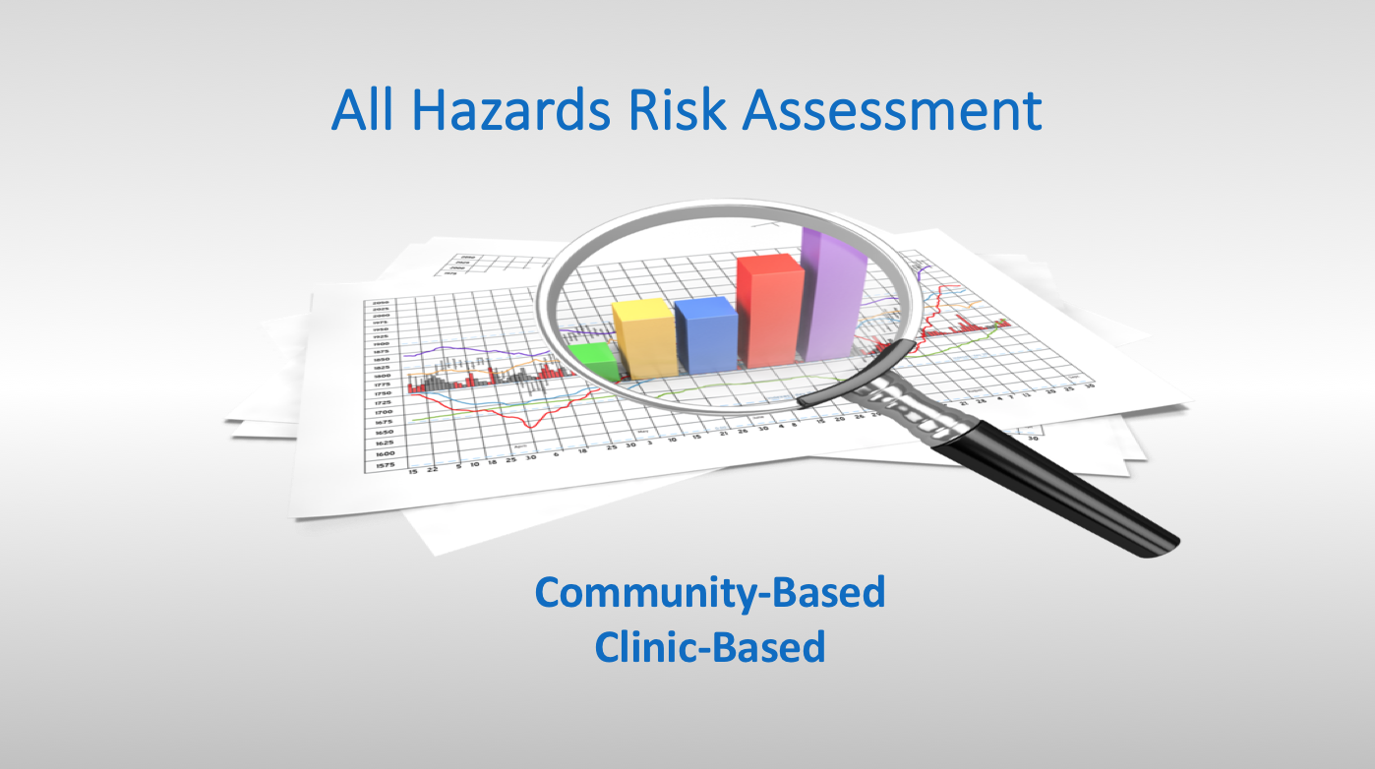

Slide 26
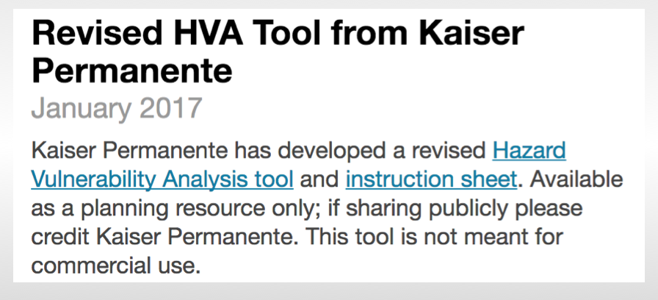
Notes:
Direct the audience to the Kaiser Permanente all hazards list as a starting point. Better for provider-based clinics, as most healthcare organizations are using this tool.

Slide 27
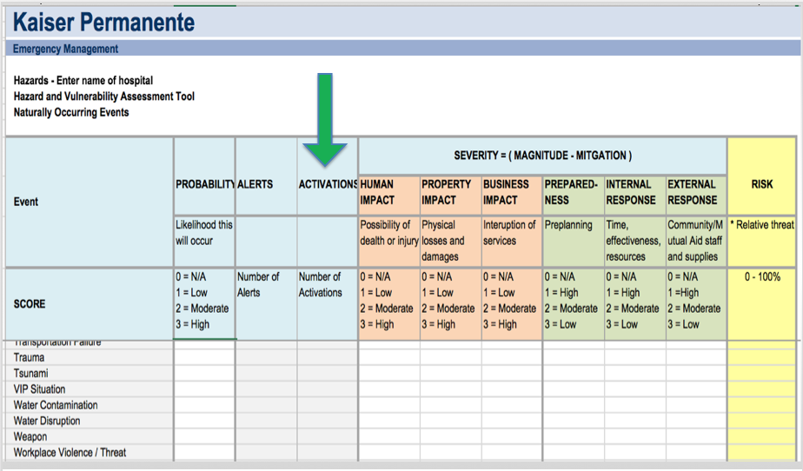
Notes:
Direct the audience to the Kaiser Permanente all hazards list as a starting point. Better for provider-based clinics, as most healthcare organizations are using this tool.

Slide 28
Risk Assessment and Planning
Clinic-Based Hazards Assessment
What top five events are most likely to impact
the services your organization delivers to patients?
Short-term Inclement Weather Events
Power or Water Interruptions
Provider/Staff Illness in a Small Clinic
Technological/Communication Failures
On-site Events Requiring Evacuation (Fire, Threat)

Slide 29
Risk Assessment and Planning
Mississippi County Listing found at MSEMA.ORG
Adams County: Brad Bradford 601-442-7021 | Alcorn County: Ricky Gibens 662-286-7737 | Amite County: Grant McCurley 601-657-1011
Attala County: Danny Townsend 662-289-5322 | Benton County: Jimmy Gresham 662-224-6338 | Bolivar County: Bill Quinton 662-588-3708
Calhoun County: Randy Skinner 662-983-0257 | Carroll County: Gayle Beard 662-237-9386 | Chickasaw County: Linda Griffin 662-448-1012
Choctaw County: Brent McKnight 662-285-6737 | Claiborne County: Marvin Ratliff, Sr. 601-437-4684 | Clarke County: Eddie Ivy 601-776-2256

Slide 30
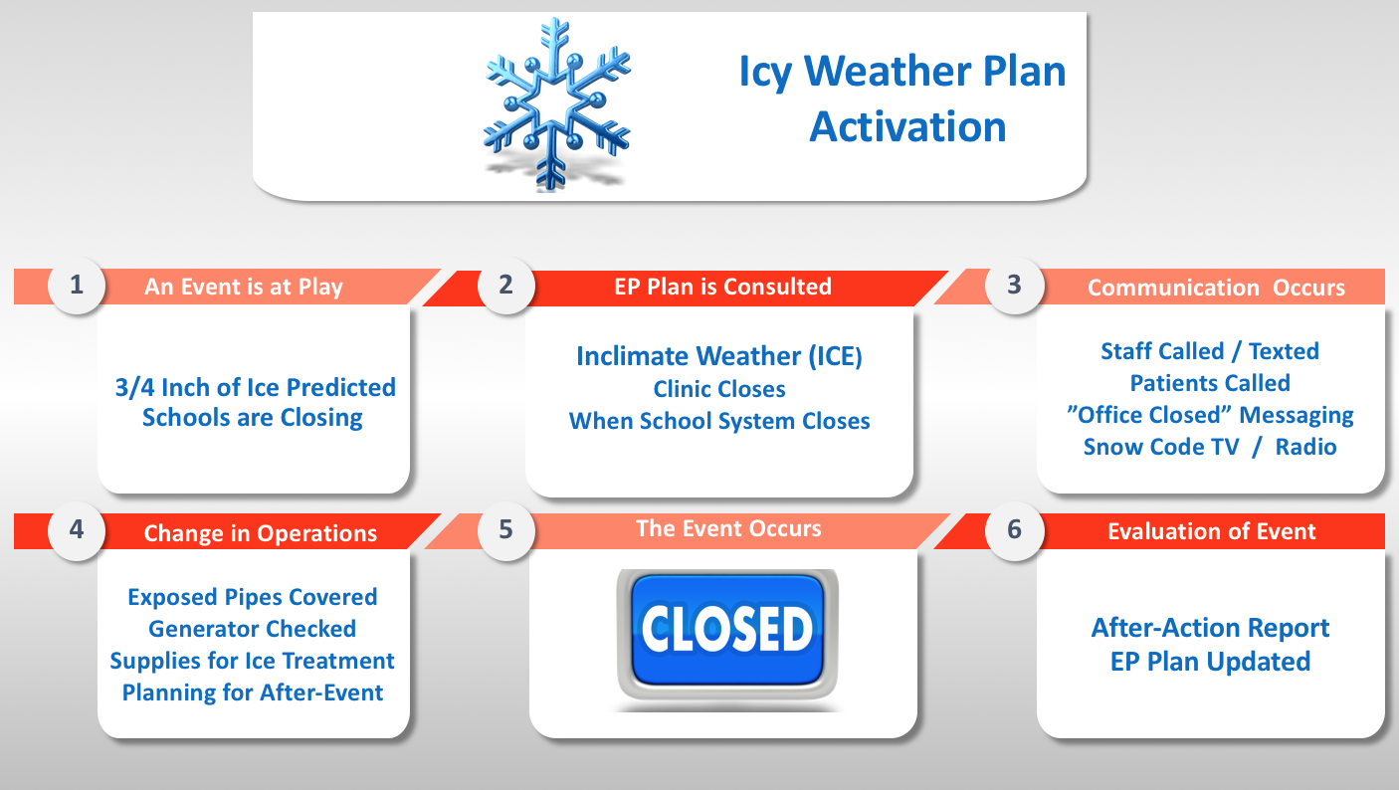
Reviewing an Icy Weather Activation in the Clinic
Notes:
Review the stages of an ice storm activation. In certain areas of the country, clinics may encounter this event every year.

Slide 31
Risk Assessment and Planning
Types of Emergencies
Man Made : Active shooter Chemical Emergencies
Cyber Attack Mass Casualties
Bioterrorism Radiation
Natural Disasters: Tornadoes
Hurricanes
Severe Storms
Public Health: Pandemic Influenza
Zika Virus Outbreak
Biological Hazards

Slide 32
Risk Assessment and Planning
(4) Include a process for cooperation and collaboration with local, tribal, regional, State, and Federal emergency preparedness officials' efforts to maintain an integrated response during a disaster or emergency situation, including documentation of the RHC/FQHC's efforts to contact such officials and, when applicable, of its participation in collaborative and cooperative planning efforts.
Missing Documentation Effort is a Common Deficiency

Slide 33
Risk Assessment and Planning
Interpretive Guidelines:
EP program must describe the RHC's comprehensive approach to meeting the health, safety, and security needs of their staff and patient population during an emergency or disaster situation.
The plan will address how the RHC would coordinate with other healthcare facilities, as well as the whole community during an emergency or disaster (natural, man-made).
The emergency preparedness program must comply with all applicable Federal, State and local emergency preparedness requirements.

Slide 34
Risk Assessment and Planning
Survey Procedure
Interview the RHC leadership and ask them to describe the RHC’s emergency preparedness program.
Ask leadership to identify hazards (e.g. natural, man-made, etc.) that were identified in the RHC’s risk assessment, why they were included and how the risk assessment was conducted.
Ask leadership to describe the following:.
a. The clinic’s patient population that would be at risk during an emergency;
  b. Services the clinic would be able to provide during an emergency; how it continues to provide operations during an emergency; and delegations of authority and succession plans.

Slide 35
Risk Assessment and Planning
Survey Procedure:
Review the plan to verify it contains the following required elements:
  A documented, clinic-based and community-based risk assessment.
  Strategies for addressing emergency events identified by the risk assessment.
  Addresses patient population, including, but not limited to, the type of services the clinic has the ability to provide in an emergency; and continuity of operations, including delegations of authority and succession plans.

Slide 36
Risk Assessment and Planning
Survey Procedure:
  Is there a process for cooperation and collaboration with local, tribal, regional, State and Federal emergency preparedness official’s?
  Is there documentation of the clinic’s efforts to contact such officials?
  Ensure the word “comprehensive” in the RHC’s emergency preparedness program considers a multitude of events, not one potential emergency.
  Verify that the plan is reviewed and updated annually.

Slide 37
Policies and Procedures
Policies and Procedures must address the following:
1. Safe evacuation from the clinic, which includes appropriate placement of exit signs; staff responsibilities and needs of the patients.
2. A means to shelter in place for patients, staff, and volunteers who remain in the facility.
3. A system of medical documentation that preserves patient information, protects confidentiality of patient information, and secures and maintains the availability of records.
4. The use of volunteers in an emergency or other emergency staffing strategies, including the process and role for integration of State and Federally designated health care professionals to address surge needs during an emergency.

Slide 38
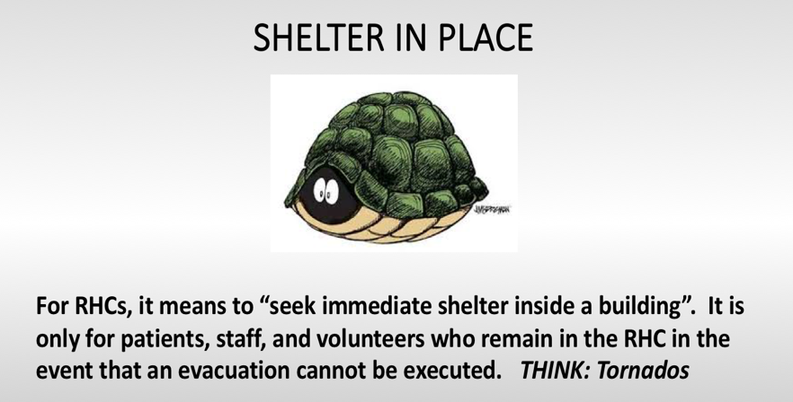

Slide 39
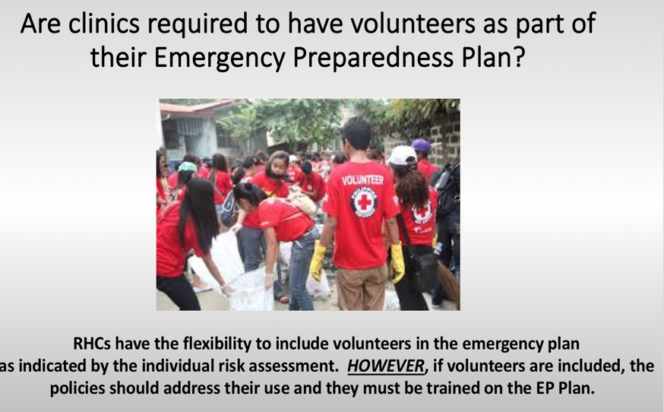

Slide 40
Policies and Procedures
Survey Procedure:
1. Review the written policies and procedures which address the RHC’s emergency plan and verify the following:
  a. Policies and procedures were developed based on the RHC-based and community- based risk assessment and communication plan, utilizing an all-hazards approach.

Slide 41
Policies and Procedures
Survey Procedure:
Verify the RHC’s policies and procedures:
    1. Provide for the safe evacuation of patients from the RHC.
    2. Include how it will provide a means to shelter in place for patients, staff and volunteers who remain in the RHC.
    3. Ensures the medical record documentation system preserve patient information, protects confidentiality of patient and secures and maintains availability of records
    4. Include information for the use of volunteers (if in staffing) and other staffing strategies in its emergency plan.
When surveying the clinic, verify that all exit signs are placed in the appropriate locations to facilitate a safe evacuation.

Slide 42
Communication Plan
The RHC/FQHC must develop and maintain an emergency preparedness communication plan that complies with Federal, State, and local laws and must be reviewed and updated at least annually. The communication plan must include all of the following:
(1) Names and contact information for the following:
  (i) Staff
  (ii) Entities providing services under arrangement
  (iii) Patients' physicians
  (iv) Other RHCs/FQHCs
  (v) Volunteers
Missing Name/Contact Info for other RHCs/FQHCs is a Common Deficiency

Slide 43
Communication Plan
Contact information for the following:
(i) Federal, State, tribal, regional, and local emergency preparedness staff.
(ii) Other sources of assistance.
Primary and alternate means for communicating with the following:
(i) RHC/FQHC's staff.
(ii) Federal, State, tribal, regional, and local emergency management agencies.

Slide 44
Rethinking the Phone Tree
Consider compiling “advanced emergency phone trees”
which list staff members’ home phone numbers, but also:
Mobile numbers for text messaging
Email addresses for mass communication
Emergency family contact information
Alternate addresses in case of temporary relocation

Slide 45
Communication Plan
A means of providing information about the general condition and location of patients under the facility's care
A means of providing information about the RHC/FQHC's needs, and its ability to provide assistance, to the authority having jurisdiction or the Incident Command Center.

Slide 46
Communication Plan
Surveyor Procedure:
1. Ask to see the written communication plan.
2. Ask to see evidence that the plan has been reviewed (and updated as necessary) on an annual basis.
3. Verify that all required contacts are included in the communication plan by asking to see a list of the contacts with their contact information.

Slide 47
Communication Plan
Surveyor Procedures:
4. Verify the communication plan includes primary and alternate means for communicating with clinic staff, Federal, State, tribal, regional and local emergency management agencies by reviewing the communication plan (i.e., land lines, email addresses, pagers, cellular telephones, walkie- talkies, HAM radio, etc.)
5. Ask to see the communications equipment or communication systems listed in the plan.

Slide 48
Communication Plan
Surveyor Procedure:
6. Verify the clinic has developed policies and procedures that address the means the clinic will use to release patient information to include the general condition and location of patients (by reviewing the communication plan).
7. Verify the communication plan includes a means of providing information about the clinic’s needs, and its ability to provide assistance, to the authority having jurisdiction, the Incident Command Center, or designee by reviewing the communication plan.

Slide 49
Training and Testing
The clinic must develop and maintain an emergency preparedness training and testing program that is based on their emergency plan and risk assessment.
The training and testing program must be reviewed and updated at least annually.

Slide 50
Training and Testing
The clinic must do all of the following:
(i) Initial training in emergency preparedness policies and procedures to all new and existing staff, individuals providing services under arrangement, and volunteers (consistent with their expected roles).
(ii) Provide emergency preparedness training at least annually.
(iii) Maintain documentation of the training.
(iv) Demonstrate staff knowledge of emergency procedures.

Slide 51

Why Perform Exercises of the Emergency Procedures?

Slide 52
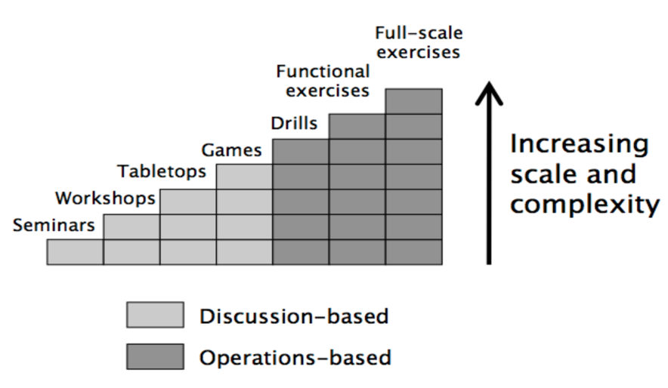

Slide 53
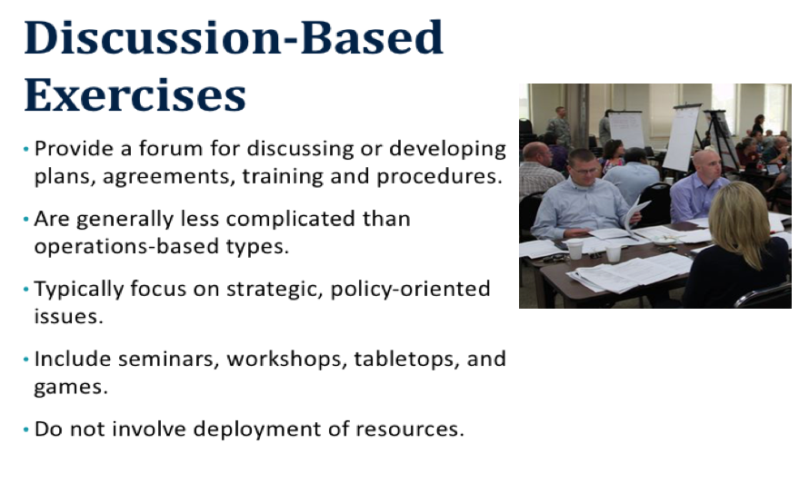

Slide 54
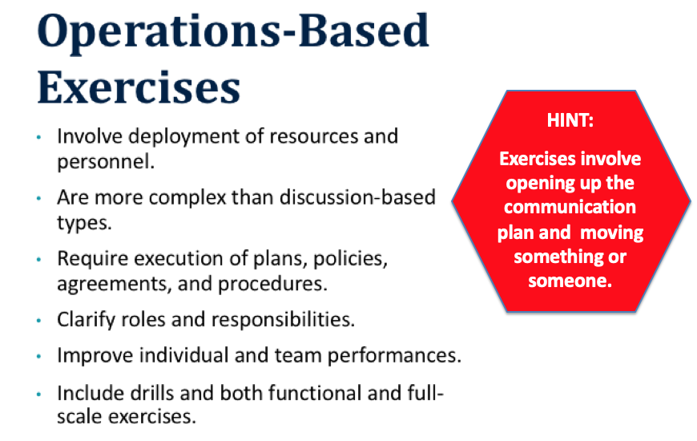

Slide 55
Training and Testing
The clinic must conduct exercises to test the emergency plan at least annually. The clinic must do the following:
Participate in a full-scale exercise that is community-based or when a community-based exercise is not accessible, an individual, facility-based.
If the clinic experiences an actual natural or man-made emergency that requires activation of the emergency plan, the RHC/FQHC is exempt from engaging in a community-based or individual, facility-based full-scale exercise for 1 year following the onset of the actual event.
Clinics often forget they may count one activation towards the two required exercises.

Slide 56
Healthcare Provider
After-Action Report (AAR)
The Centers for Medicare & Medicaid Services (CMS),
Survey and Certification Group has developed a Health
Care Provider After Action Report/Improvement Plan (AAR/IP) template with the assistance of the
U.S. Department of Health and Human Services (HHS),
Office of the Assistant Secretary for Preparedness and Response, the U.S. Department of Homeland Security (DHS), and the CMS Survey and Certification Emergency Preparedness Stakeholder Communication Forum.

Slide 57
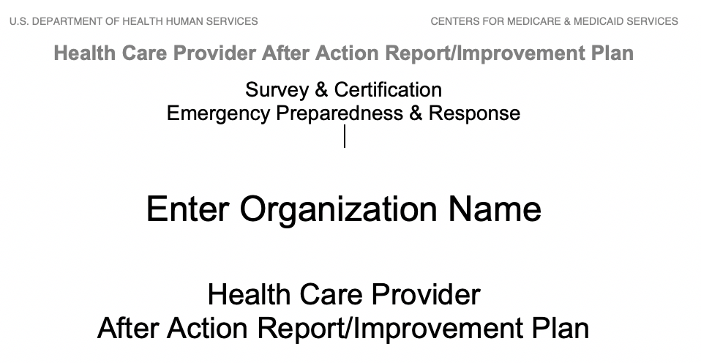
CMS After-Action Report Template (AAR)
Link: https://www.cms.gov/Medicare/Provider-Enrollment-and-Certification/
SurveyCertEmergPrep/Templates-Checklists.html

Slide 58
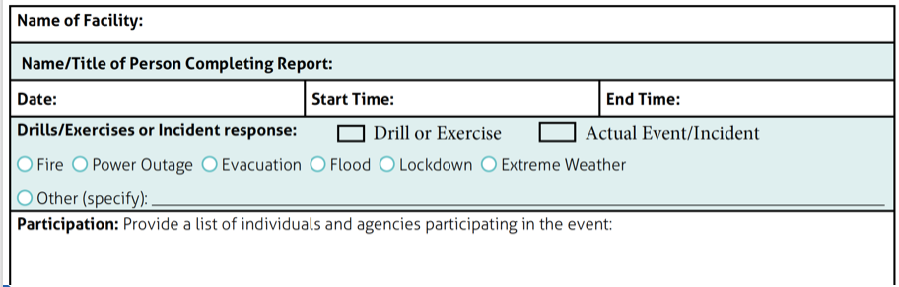
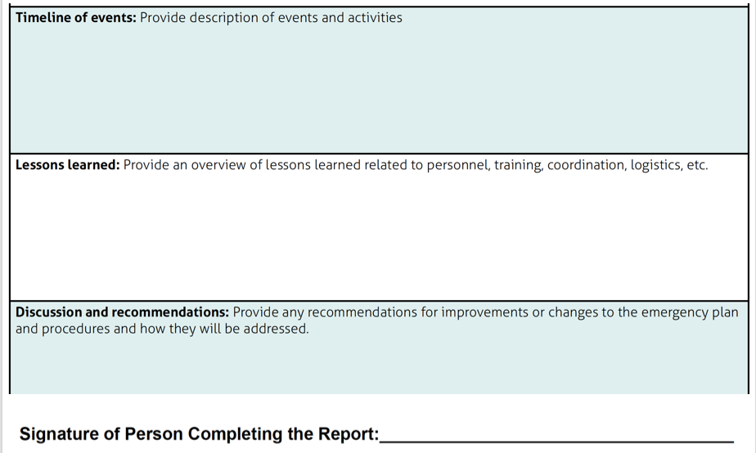
For Smaller Clinic-Based Exercises You May Wish to Use a Simple AAR,
Just Ensure You Cover the Essential Requirements

Slide 59
Training and Testing
Conduct an additional exercise that may include, but is not limited to following:
(A) A second full-scale exercise that is community-based or individual, facility-based.
(B) A tabletop exercise that includes a group discussion led by a facilitator, using a narrated, clinically-relevant emergency scenario, and a set of problem statements, directed messages, or prepared questions designed to challenge an emergency plan.

Slide 60
Training and Testing
Surveyor Procedure:
Interview various staff and ask questions regarding the clinic’s initial and annual training course, to verify staff knowledge of emergency procedures.
Review a sample of staff training files to verify staff has received initial and annual emergency preparedness training.

Slide 61
Testing
Interpretive Guidelines:
Clinics must on an annual basis conduct exercises to test the emergency plan, specifically RHC ‘s are required to conduct a tabletop exercise and participate in a full-scale community-based exercise or conduct an individual facility exercise if the community-based exercise is not available.
For the purposes of this requirement, a full scale exercise is defined and accepted as any operations-based exercise (drill, functional, or full-scale exercise) that assesses a facility’s functional capabilities by simulating a response to an emergency that would impact the facility’s operations and their given community.

Slide 62
Testing
Interpretive Guidelines:
Clinics are expected to contact their local and state agencies and healthcare coalitions, where appropriate, to determine if an opportunity exists and determine if their participation would fulfill this requirement.
In doing so, they are expected to document the date, the personnel and the agency or healthcare coalition that they contacted.

Slide 63
Testing
Interpretive Guidelines:
Clinics that are not able to identify a full-scale community-based exercise, can instead fulfill this part of their requirement by either conducting an individual facility-based exercise, documenting an emergency that required them to fully activate their emergency plan, or by conducting a smaller community-based exercise with other nearby facilities.

Slide 64
Testing
Surveyor Procedure:
Ask to see documentation of the annual tabletop and full-scale exercises (which may include, but is not limited to, the exercise plan, the AAR, and any additional documentation used by the RHC to support the exercise.
2. Ask to see the documentation of the clinic’s efforts to identify a full-scale community based exercise if they did not participate in one (i.e. date and personnel and agencies contacted and the reasons for the inability to participate in a community based exercise).

Slide 65
Testing
Surveyor Procedure:
Request documentation of the clinic’s analysis and response (the AAR) and how the facility updated its emergency program based on this analysis (if an update was recommended).

Slide 66
Integrated Healthcare Systems
If a clinic is part of a healthcare system consisting of multiple separately certified healthcare facilities that elects to have a unified and integrated emergency preparedness program, the RHC/FQHC may choose to participate in the healthcare system's coordinated emergency preparedness program.
If elected, the unified and integrated emergency preparedness program must do all of the following:

Slide 67
Integrated Healthcare Systems
Demonstrate that each separately certified facility within the system actively participated in the development of the unified and integrated emergency preparedness program.
(2) Be developed and maintained in a manner that takes into account each separately certified facility's unique circumstances, patient populations, and services offered.
(3) Demonstrate that each separately certified facility is capable of actively using the unified and integrated emergency preparedness program and is in compliance with the program.

Slide 68
Integrated Healthcare Systems
(4) Include a unified and integrated emergency plan that meets the requirements of paragraphs (a)(2), (3), and (4) of this section. The unified and integrated emergency plan must also be based on and include all of the following:
(i) A documented community-based risk assessment, utilizing an all-hazards approach.
(ii) A documented individual facility-based risk assessment for each separately certified facility within the health system, utilizing an all-hazards approach.

Slide 69
Integrated Healthcare Systems
(5) Include integrated policies and procedures that include:
    A coordinated communication plan
    Training and testing programs

Slide 70
Integrated Healthcare Systems
Interpretive Guidelines:
Healthcare systems that include multiple facilities that are separately certified as a Medicare-participating provider or supplier have the option of developing a unified and integrated emergency preparedness program that includes all of the facilities within the healthcare system instead of each facility developing a separate emergency preparedness program.

Slide 71
Integrated Healthcare Systems
Surveyor Procedure:
Verify whether or not the facility has opted to be part of its healthcare system’s unified and integrated emergency preparedness program. Verify that they are by asking to see documentation of its inclusion in the program.
2. Ask to see documentation that verifies the facility within the system was actively involved in the development of the unified emergency preparedness program.

Slide 72
Integrated Healthcare Systems
Surveyor Procedure:
3. Ask to see documentation that verifies the facility was actively involved in the annual reviews of the program requirements and any program updates.
4. Ask to see a copy of the entire integrated and unified emergency preparedness program and all required components (emergency plan, policies and procedures, communication plan, training and testing program).

Slide 73
Integrated Healthcare Systems
Surveyor Procedure:
5. Ask facility leadership to describe how the unified and integrated emergency preparedness program is updated based on changes within the healthcare system such as when facilities enter or leave the system.

Slide 74
RHC Specifics
Outpatient providers are not required to have P&Ps for the provision of subsistence needs.
RHCS must still have a P&P detailing how refrigerated medications will be handled during/after disasters that disrupt electrical power.
RHC procedure may need to evacuate staff/patients when safe to do so, close and secure the clinic, then notify staff/patients that the clinic is closed until further notice.

Slide 75
RHC Specifics
Don’t procrastinate…its estimated that you will need approximately 40 administrative hours to implement and meet compliance
Contact your State agencies first and see what is available to your clinic
Don’t recreate the wheel – Use GOOGLE
Form a team to implement & set action dates for monthly progress
Delegate to appropriate staff
If a PB RHC, work closely with your HC System

Slide 76
RHC Specifics
CMS estimates that it will cost $6,016 per RHC to implement these emergency preparedness rules.
Independent RHCs will be impacted more adversely due to their limited labor and financial resources.

Slide 77
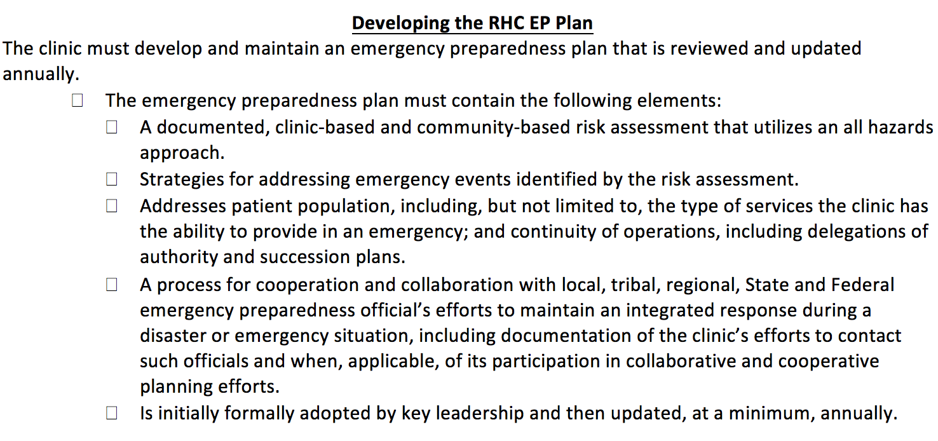
Resource: The Compliance Team’s RHC EP Checklist

Slide 78

Resource: “CERT”
Community Emergency Response Team

Slide 79
What is CERT?
The Community Emergency Response Team (CERT) program educates volunteers about disaster preparedness for the hazards that may impact their area and trains them in basic disaster response skills, such as fire safety, light search and rescue, team organization, and disaster medical operations. CERT offers a consistent, nationwide approach to volunteer training and organization that professional responders can rely on during disaster situations, which allows them to focus on more complex tasks. Through CERT, the capabilities to
prepare for, respond to and recover from disasters is built and enhanced.
Link: https://www.citizencorps.fema.gov/cc/listCert.do

Slide 80
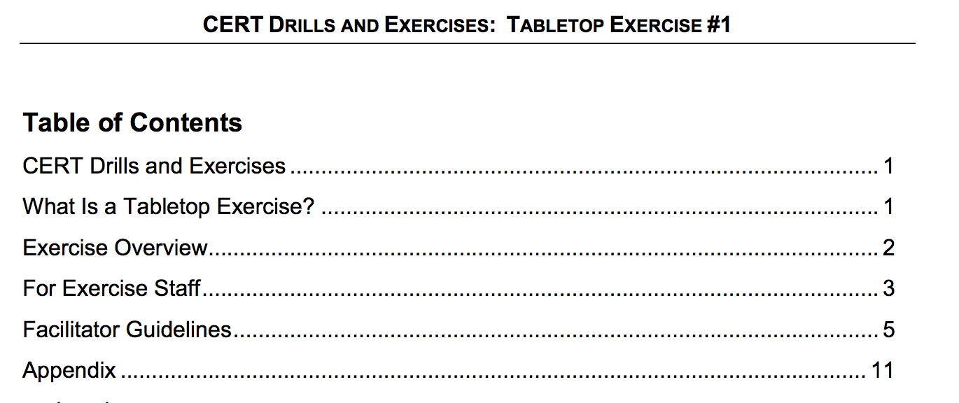
FEMA.GOV
Community Emergency Response Teams

Slide 81
Mississippi CERT found at FEMA.GOV
Program Name | Miles | Program Name
Calhoun County Career and Tech CERT | 37 Mile(s) | Calhoun County Career and Tech CERT
Tippah County CERT | 41 Mile(s) | Tippah County CERT
Point of Contact: Mark T Whitaker
Title: Instructor
Organization: Calhoun County Career and Technical Center
Mailing Address:301 North Madison
Calhoun City, MS 38916
Phone:6626281141
Email:mwhitaker@calhoun.k12.ms.us

Slide 82

Resource: ASPRTRACIE.HHS.GOV

Slide 83
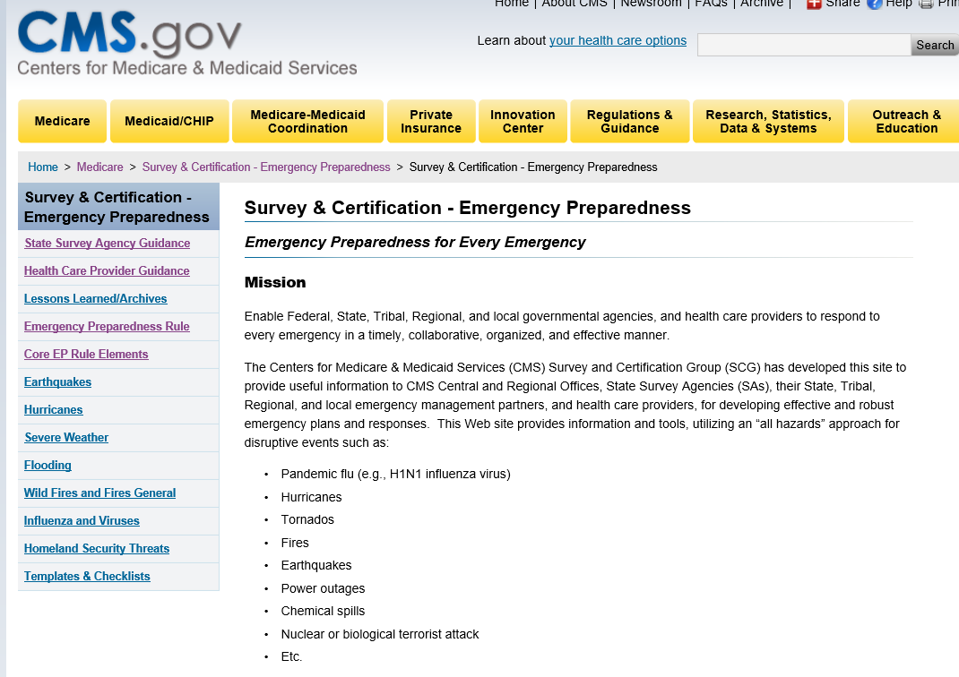
Resource: CMS.GOV

Slide 84
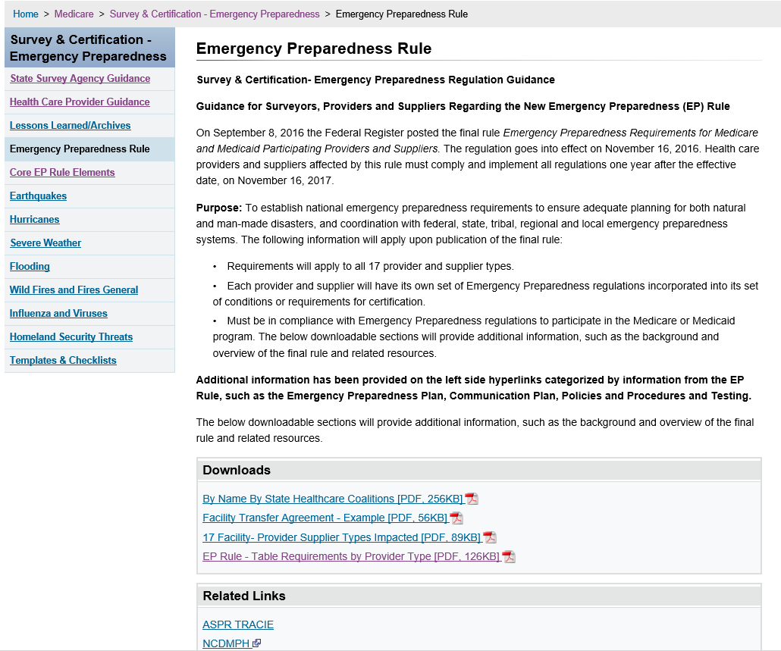
CMS.GOV

Slide 85
CMS.GOV
Frequently Asked Questions (FAQs) have been developed and are posted on the CMS Emergency Preparedness Website https://www.cms.gov/Medicare/Provider-Enrollment-and-Certification/SurveyCertEmergPrep/Emergency-Prep-Rule.html
SCGEmergencyPrep@cms.hhs.gov

Slide 86

Resource: CALHOSPITALPREPARE.ORG

Slide 87
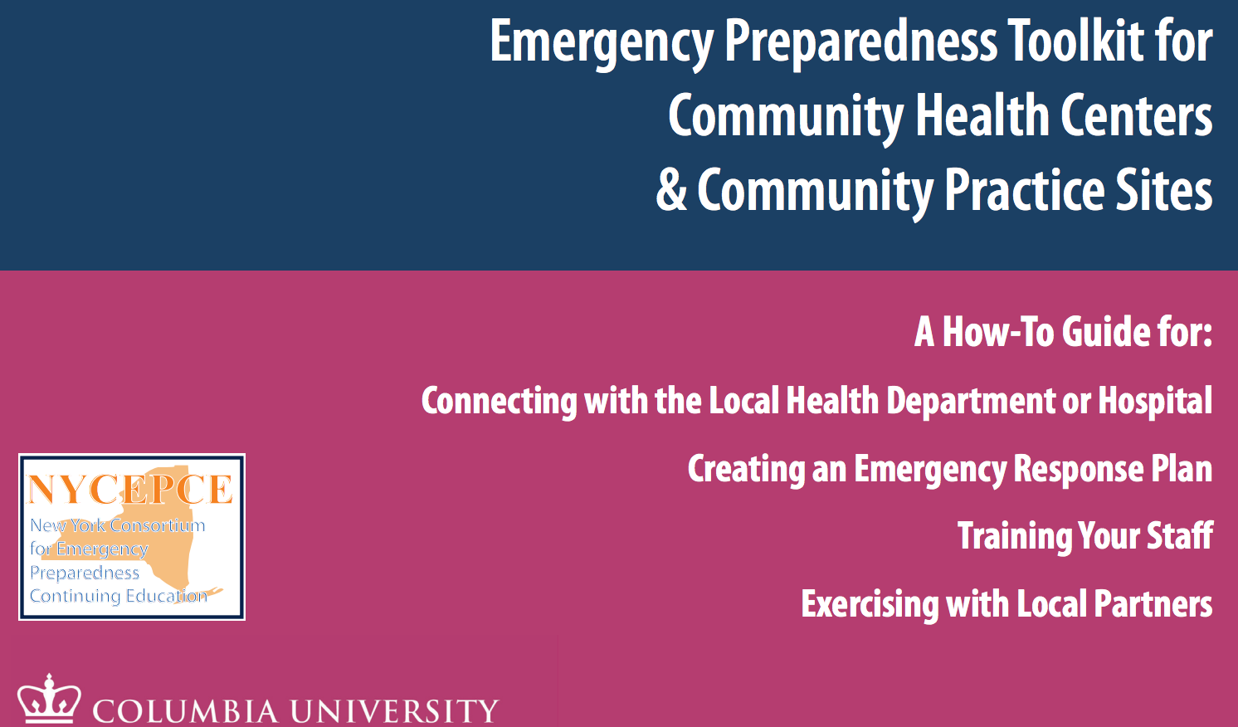
Resource: CIDRAP.UMN.EDU

Slide 88
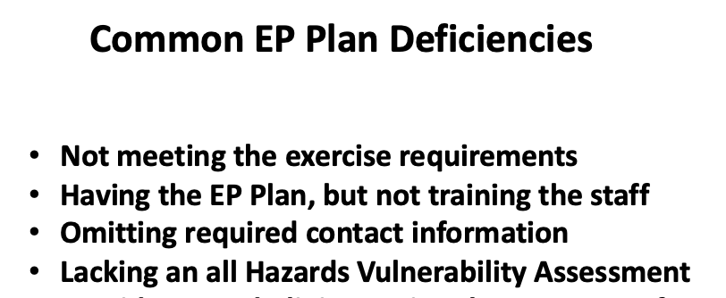

Slide 89
Survey Finding Implications
In the event an organization is non-compliant, the same general enforcement procedures will occur
as is currently in place for any other conditions or requirements cited for non-compliance.

Slide 90
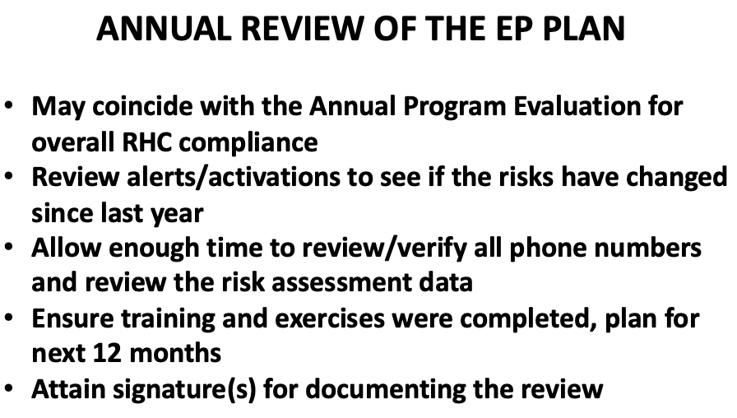
Ongoing Compliance

Slide 91




Additional Trusted
RHC Resources

Slide 92
Thank You
Kate Hill, RN
VP of Clinical Services
215-654-9110
khill@thecomplianceteam.org

