Slide 1

Managing Your RHC
Julie Quinn, CPA
VP, Compliance & Cost Reporting
Health Services Associates
Southeast Regional Office
Health Services Associates, Inc.
2 East Main Street 54 Pheasant Ln
Fremont, MI 49412 Ringgold, GA
Ph: 231.924.0244 231.250.0244
Fx: 231.924.4882 888.200.4788
Promoting Access to Health Care

Slide 2
OBJECTIVES
Participants will understand what makes good management.
Participants will learn process to build a team within the practice.
Participants will understand how good management skills enhance the practice and patient care.

Slide 3
RHC REGULATIONS FOR STAFF
J 31
  The clinic is under the medical direction of a physician, and has a health care staff that meets the requirements.
J42
  The staff is sufficient to provide the services essential to the operation of the clinic.

Slide 4
WHAT IS MORALE?
According to Miriam-Webster Dictionary:
  Moral principles, teaching, or conduct
  The mental and emotional condition of an individual or group with regard to the function or tasks at hand, a sense of common purpose with respect to a group.
  The level of individual psychological well-being based on such factors as a sense of purpose and confidence in the future.

Slide 5
WHAT IS MORALE?
“A happy person is not a person in a certain set of circumstances, but rather a person with a certain set of attitudes”
                Hugh Downs

Slide 6
FACTS
“An office staff with high morale doesn’t happen by accident.”
Mary Jo Welker MD

Slide 7
FACTS
No matter how boring or tedious the work may be, it can be made enjoyable with a positive environment.
No matter how fun the work itself may be, it can be made miserable with a hostile environment.

Slide 8
STATISTICS
Left unchecked, poor morale can poison an entire office and even affect patient care.
Good or bad, attitude flows from the top.
70% of your employees are LESS motivated today than they used to be.
80% of your employees COULD perform significantly better IF THEY WANTED TO.
50% of your employees only put enough effort into their work to KEEP THEIR JOB.

Slide 9
GOOD OR BAD MORALE
What do you see in your team?
When staff morale is chronically low, employees suffer, providers suffer, and the practice suffers as patients leave to find a more pleasant health-care environment where people actually seem to enjoy their jobs.

Slide 10
DANGER OF LOW MORALE
Low morale is a DANGER in the medical office/clinic because it can lead to a whole set of issues hazardous to quality patient care.
PARTICIPATION QUESTION:
  How can low morale affect your office quality of care?

Slide 11
KEY SIGNS OF DECLINING MORALE
Lack of attention to details concerning patient care.
Missed deadlines.
Minimal productivity.
Negative attitude toward patients.
Resentment of providers or co-workers/management.
Talking ABOUT people rather than WITH people.
Keeping secrets or withholding information.
Constant snide remarks and bad attitude.
Infects others.
Negative impact on attempts to improve office morale.

Slide 12
DO YOU HAVE A TOXIC EMPLOYEE?
Trouble-maker.
Naysayer
Bad Apple
Gloom and Doom
Negative attitude and “Stinkin Thinkin”
  These can drag high office morale down into the mud.

Slide 13
WHAT TO DO WITH BAD MORALE!
Identify the ringleaders.
Hold them accountable.
Work with them to help correct their attitude or WEED THEM OUT!
  Discuss one on one.
  Identify the extenuating circumstances.
    Home problems, personality conflict with others, depression, etc.

Slide 14
WHAT TO DO WITH BAD MORALE!
Explain the problems that are being caused.
Set up clear expectations.
Monitor.
DOCUMENT.

Slide 15
HOW TO PROMOTE GOOD MORALE
Most people will give back when they feel appreciated and cared for. This benefits everyone.

Slide 16
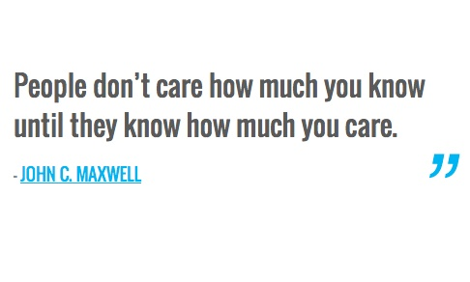
How to promote good morale

Slide 17
HOW TO PROMOTE GOOD MORALE
KNOW YOUR TEAM
  Characteristics
  Goals
  Interests
  Work Styles
Build a great foundation.
Know the office deficiencies.
Recognize the strengths and use them.
Create a positive atmosphere.

Slide 18
HOW TO PROMOTE GOOD MORALE
Grow an attitude of gratitude.
  Staff need to feel appreciated.
  EVERYONE is of value.
  Encouragement and say Thank You.

Slide 19
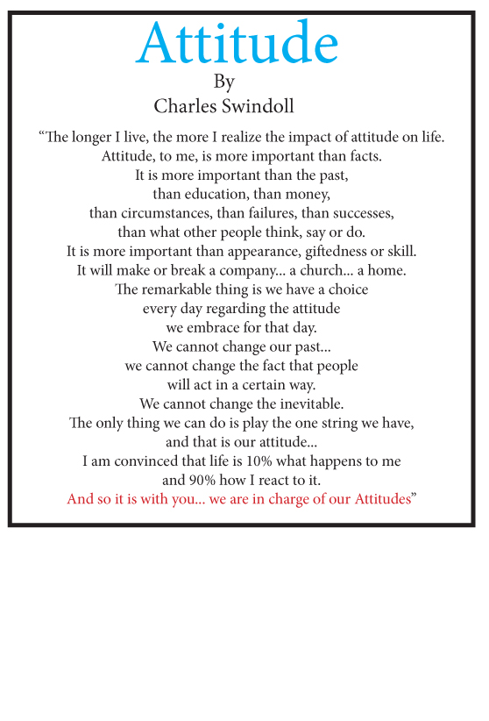

Slide 20
HOW TO PROMOTE GOOD MORALE
Hold regular office meetings:
  Team
  Build relationships
  Company updates and news
  Safe room.
  Ownership
Define the mission.
Solicit input.
Specify roles.
Acknowledge success.
Foster Advancement.

Slide 21
HOW TO PROMOTE GOOD MORALE
“IT IS YOUR ATTITUDE, NOT YOUR APTITUDE, THAT DETERMINES YOUR ALTITUDE.”
Zig Zigler

Slide 22
LEADERSHIP AND A GOOD TEAM
Leadership is about the future
  “Leader” implies that someone is taking others to a destination beyond the here and now.
Leadership is influence.
  Are you happy with YOUR Performance?
  What are YOUR Goals?
  What is YOUR effect on the staff?
  How effective are YOU to inspire and influence?
    Good influence is NOT heavy fisted tactics.

Slide 23
LEADERSHIP AND A GOOD TEAM
Make sure the employees understand the mission/vision.
Provide strong employee orientation and training.
Hire the RIGHT people for the RIGHT Job.
Be flexible.
Give recognition/express appreciation.

Slide 24
LEADERSHIP AND A GOOD TEAM
Be able to confront change and LEAD the team through the changes. Be the change agent.
  Know what needs to change.
  Know the staff and how they deal with change.
  Know how the staff accepts change.
  Utilize the strengths of the staff to deal with change.

Slide 25
LEADERSHIP AND A GOOD TEAM
“Find ways to reach down and touch everyone in a unit. Make individuals feel important and part of something larger than themselves.”
Colin Powell

Slide 26
HOW TO BUILD A GOOD TEAM
The team must have a committed leader.
Team members must all play some vital part of the project/work.
The team must have a focus.
Team members need to be in the right position.
NO member of the team is less important than another, or more important than another.

Slide 27
HOW TO BUILD A GOOD TEAM
A team strategically trains and plans.
Serving the team is more important than the position.
Team members must show respect for each other.
A team is only as strong as it is disciplined.
COMMUNICATION IS CRUCIAL.

Slide 28
HOW TO BUILD A GOOD TEAM
Great teams exhibit sincerity, transparency, and vulnerability.
The team needs to be focused in the same direction.
Non-participatory team members could and should be removed.

Slide 29
QUESTION
How does the team approach affect patient care?
Do the patients feel the impact of the team morale?

Slide 30
TIME MANAGEMENT
How much time do you spend each day on unimportant tasks?
Do you need more time in the day to get your work done?
Are you aware of how you utilize your time through the day?

Slide 31
TIME MANAGEMENT
Great time management means being effective as well as efficient.
KNOW the difference between IMPORTANT and URGENT.
  Important: There is an outcome that leads to the completion of your goals.
  Urgent: Demand immediate attention, often to assist in completion of someone else’s goals.

Slide 32
TIME MANAGEMENT
Are you being PROACTIVE or REACTIVE?
BLOCK TIME for planning
Do you have a ‘sacred time’ every day?

Slide 33
TIME MANAGEMENT
Analyze how your use your time.
Keep a log for time study.
Track the time and see when you have peak performance times.
  Maximize the work projects into the performance levels.
Make TO DO Lists.
  WARNING: Do not let the TO DO list hinder you.
Manage the interruptions.

Slide 34
REMINDER

Slide 35


